Slide 1



LifeWatch Data Cloud
Lennert Schepers
Coordinator LifeWatch Flanders

Slide 2
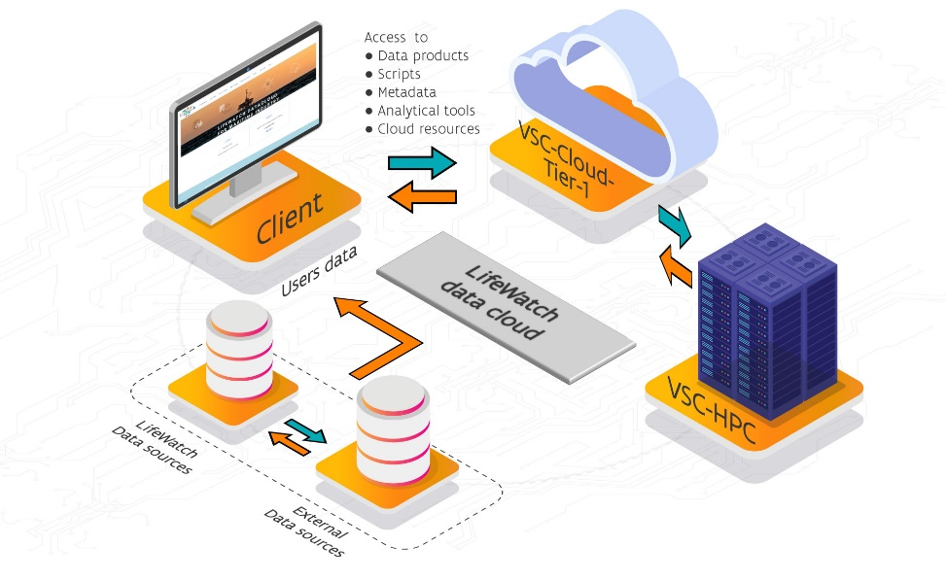
LifeWatch Data Cloud
Introduction LifeWatch
LifeWatch Data Cloud
Use Case 1: modeling plankton interactions
Use Case 2: the European Tracking Network
Future perspectives
Notes:
use case NPZ model: also explain research topic - also how to access VSC rstudio
ETN: mention training to COST, thanks to VSC access to machine that gives access to a machine. Rstudio server
outlook for the future: SUMES, mariculture heat maps (link to data products of George),...
data explorer demonstration
link with DTO - mention that developments will not be done independently. DTO will be independent of HPC infrastructure. Could be VSC or EuroHPC,... to be decided how much will be run on VSC itself.

Slide 3
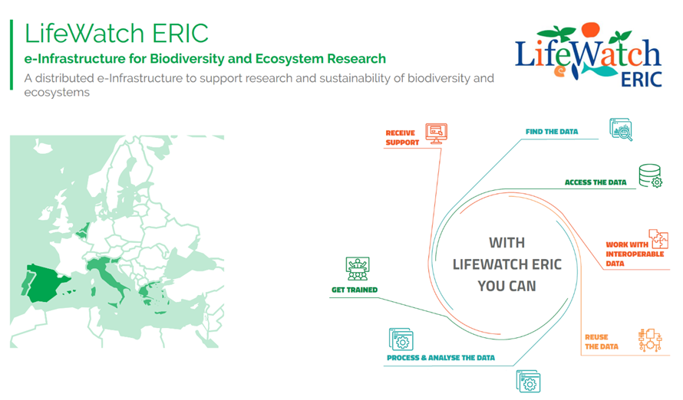
What is LifeWatch?

Slide 4
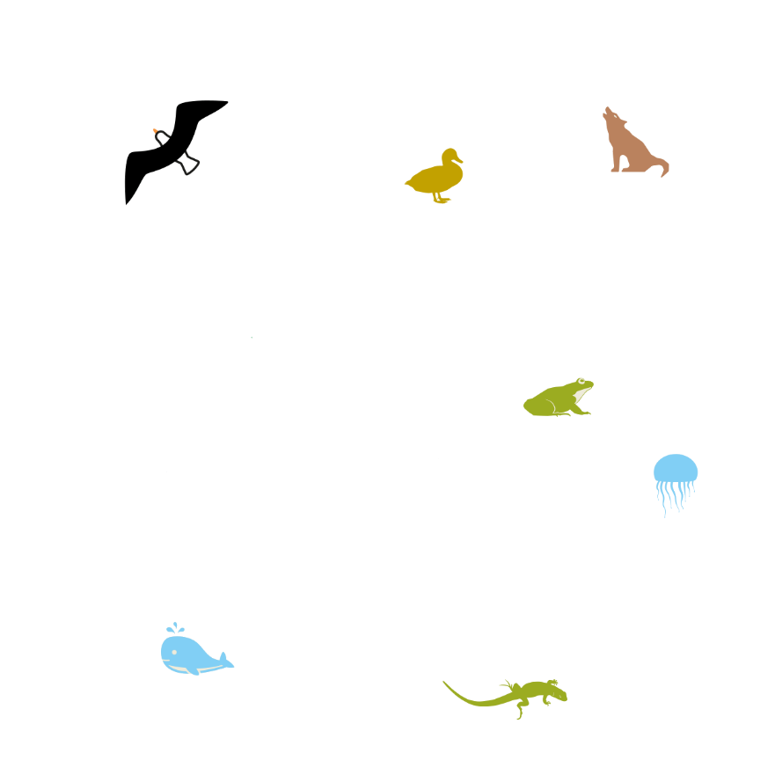
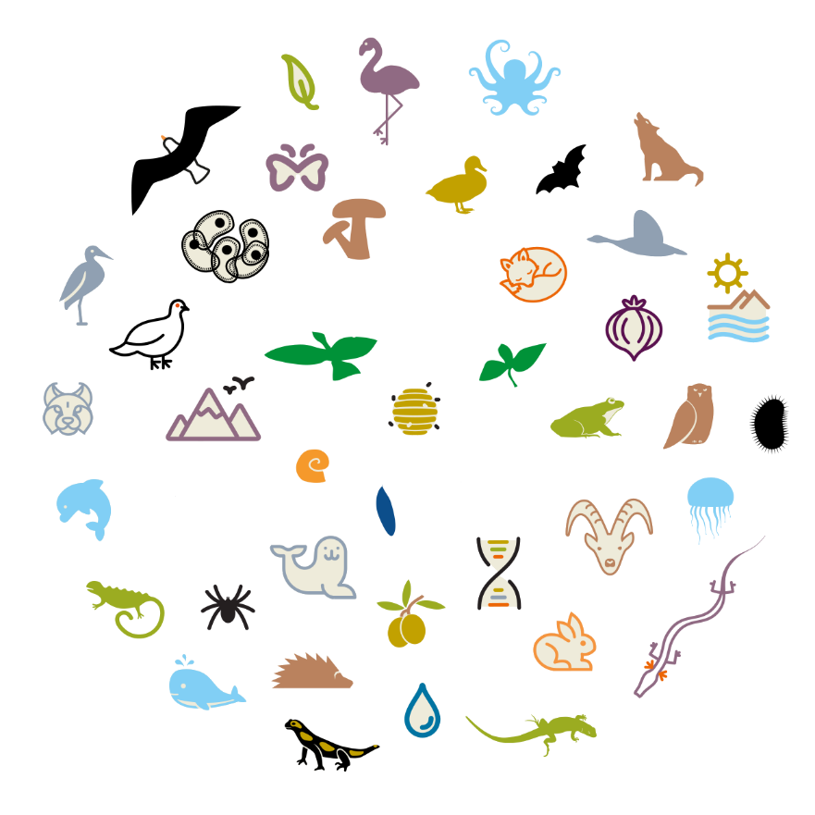
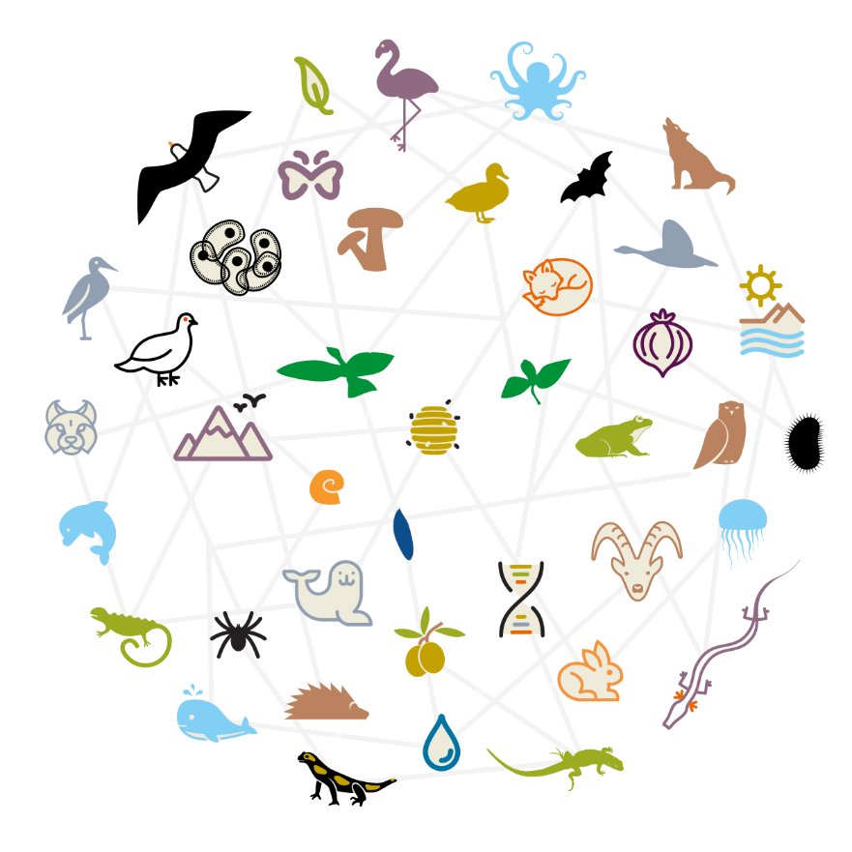
What is LifeWatch?
What is biodiversity?

Slide 5
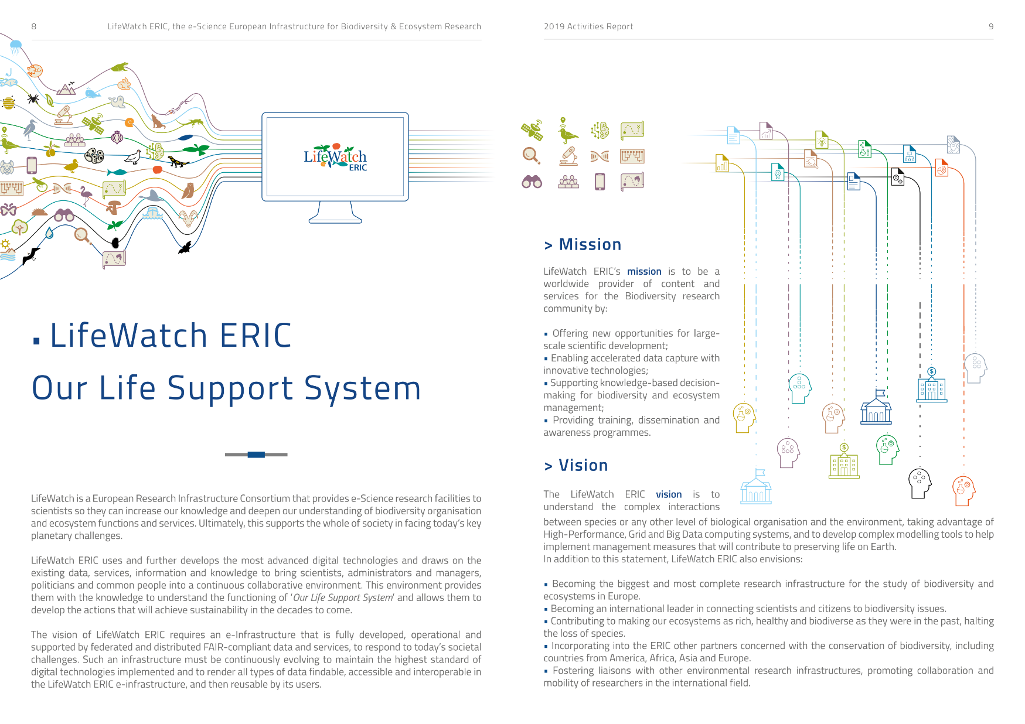
What is LifeWatch?

Slide 6
What is LifeWatch?

Slide 7
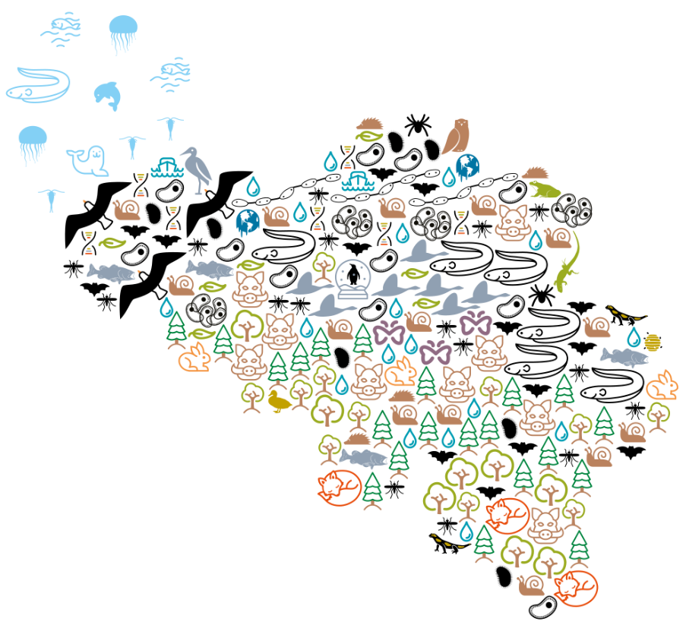
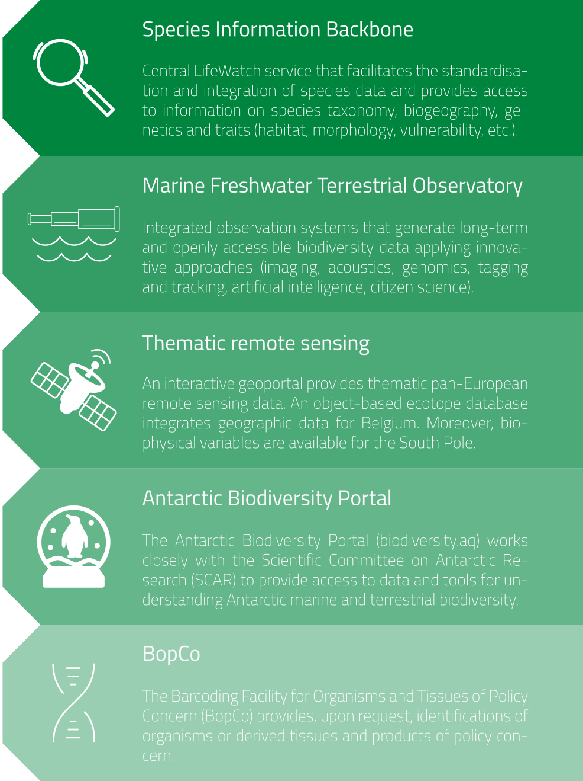
What is LifeWatch Belgium?

Slide 8
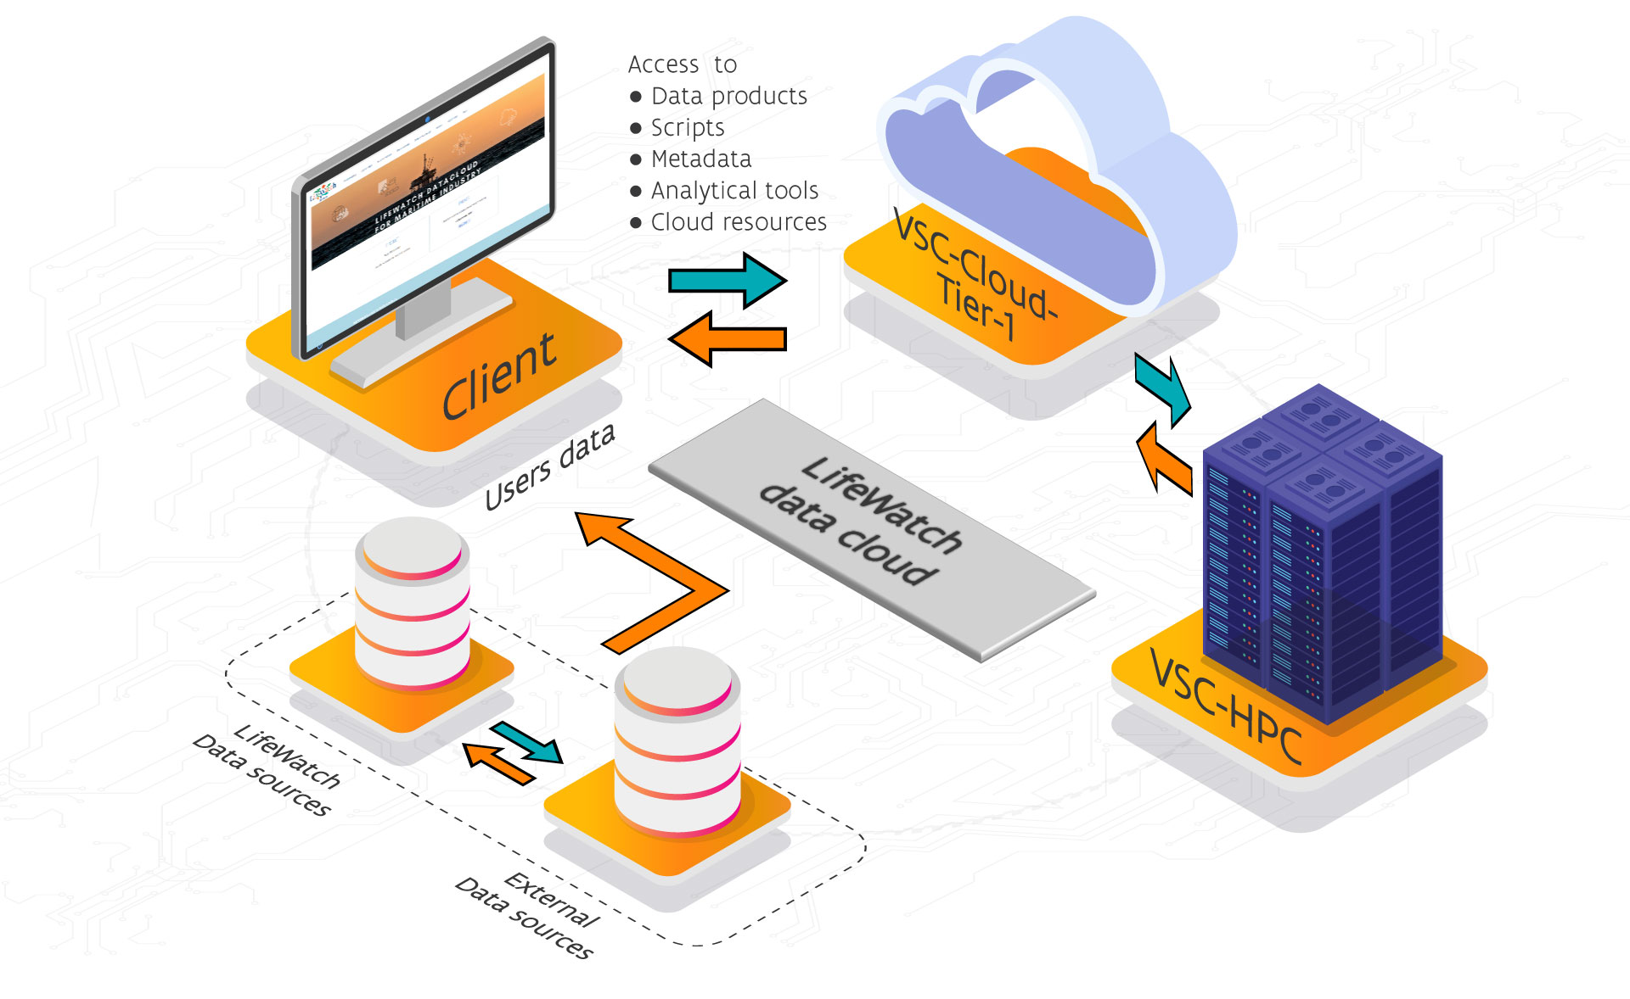

LifeWatch Data Cloud
LifeWatch Maritime Industry Advisory Board:
  request for analysis platform
Initial scope of Maritime Industry
  Expanding to freshwater/terrestrial
  Expanding to research/policy

Slide 9

LifeWatch Data Cloud

Slide 10
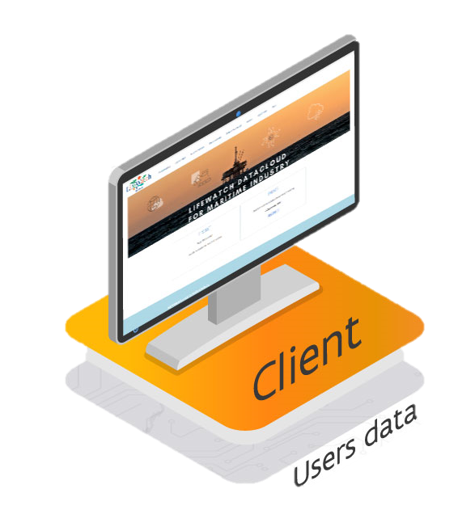

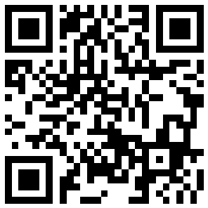
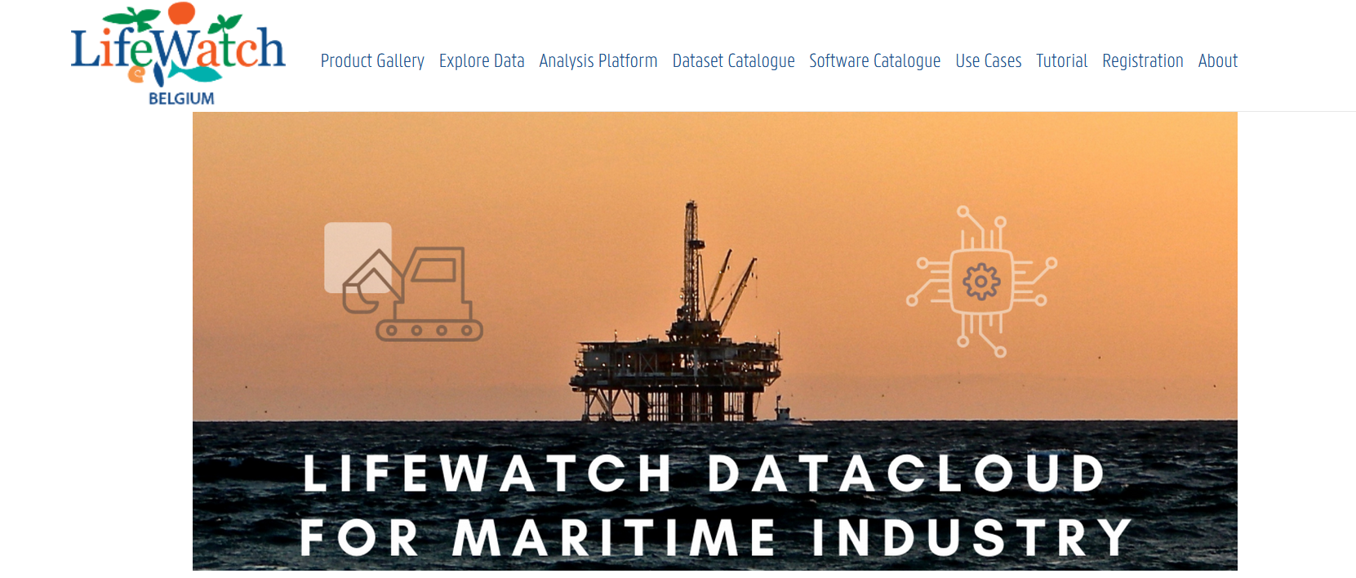
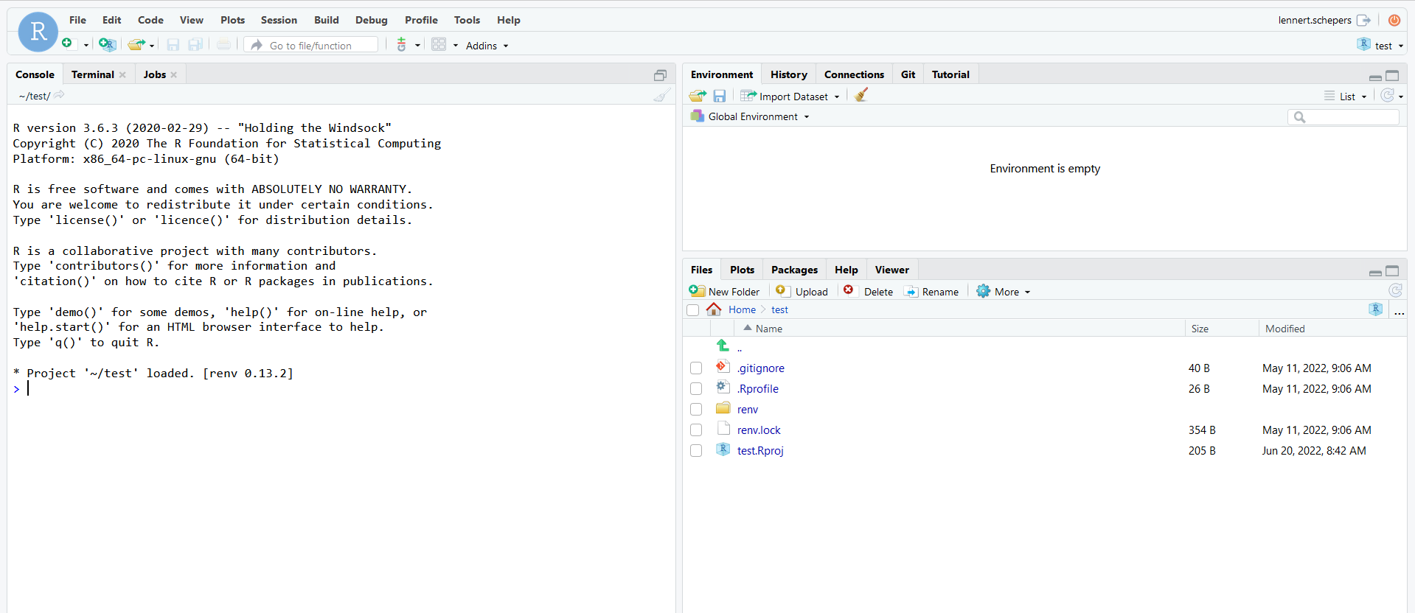
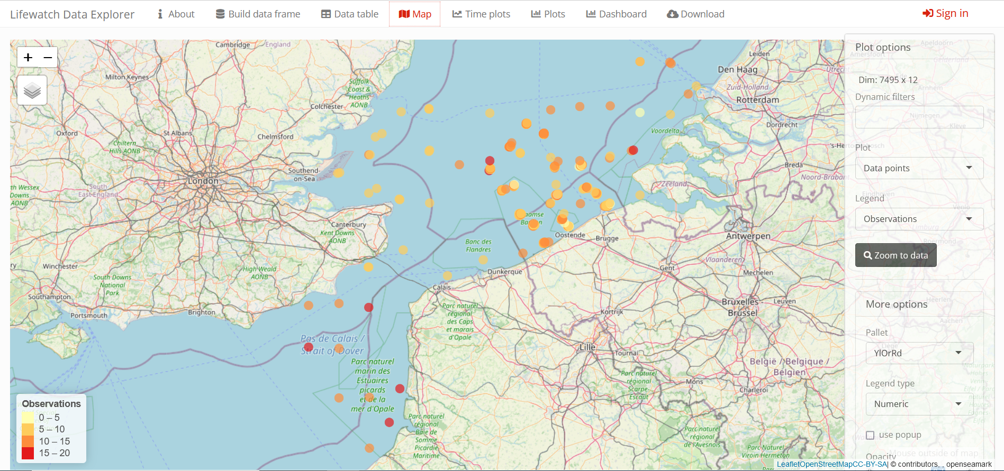

LifeWatch Data Cloud - Client
Website: https://datacloudmi.lifewatch.be
Rstudio server: https://rstudio.vsc.lifewatch.be/
  R package to retrieve the LifeWatch data
LifeWatch Data Explorer (Rshiny application)
  https://rshiny.vsc.lifewatch.be/
Rstudio Register here
Notes:
use case NPZ model: also explain research topic - also how to access VSC rstudio
ETN: mention training to COST, thanks to VSC access to machine that gives access to a machine. Rstudio server
outlook for the future: SUMES, mariculture heat maps (link to data products of George),...
data explorer demonstration
link with DTO - mention that developments will not be done independently. DTO will be independent of HPC infrastructure. Could be VSC or EuroHPC,... to be decided how much will be run on VSC itself.

Slide 11
LifeWatch Data Cloud

Slide 12
Use Case 1
Modeling plankton interactions

Slide 13
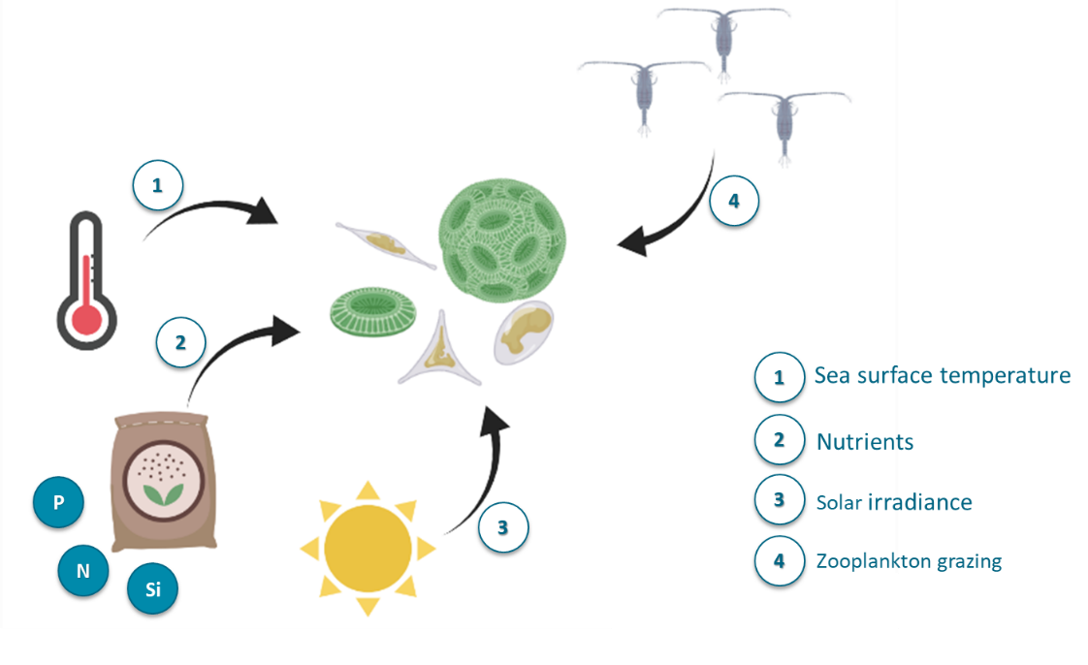

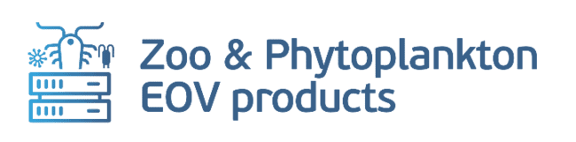
Use Case 1: modeling plankton interactions
Plankton forms the base of the base of the marine foodweb
Challenges
  Climate change
  Blue economy activities
  Field observations are costly
Otero et al.
https://doi.org/10.5194/bg-2022-11

Slide 14
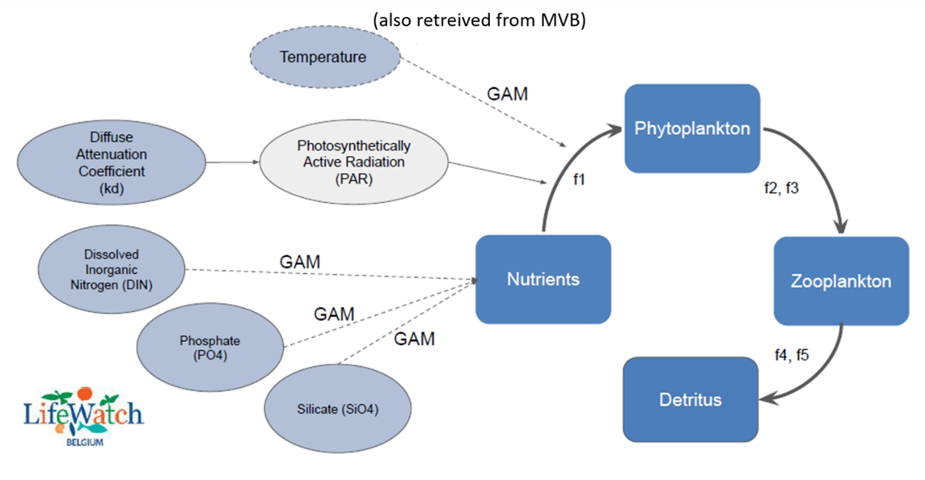
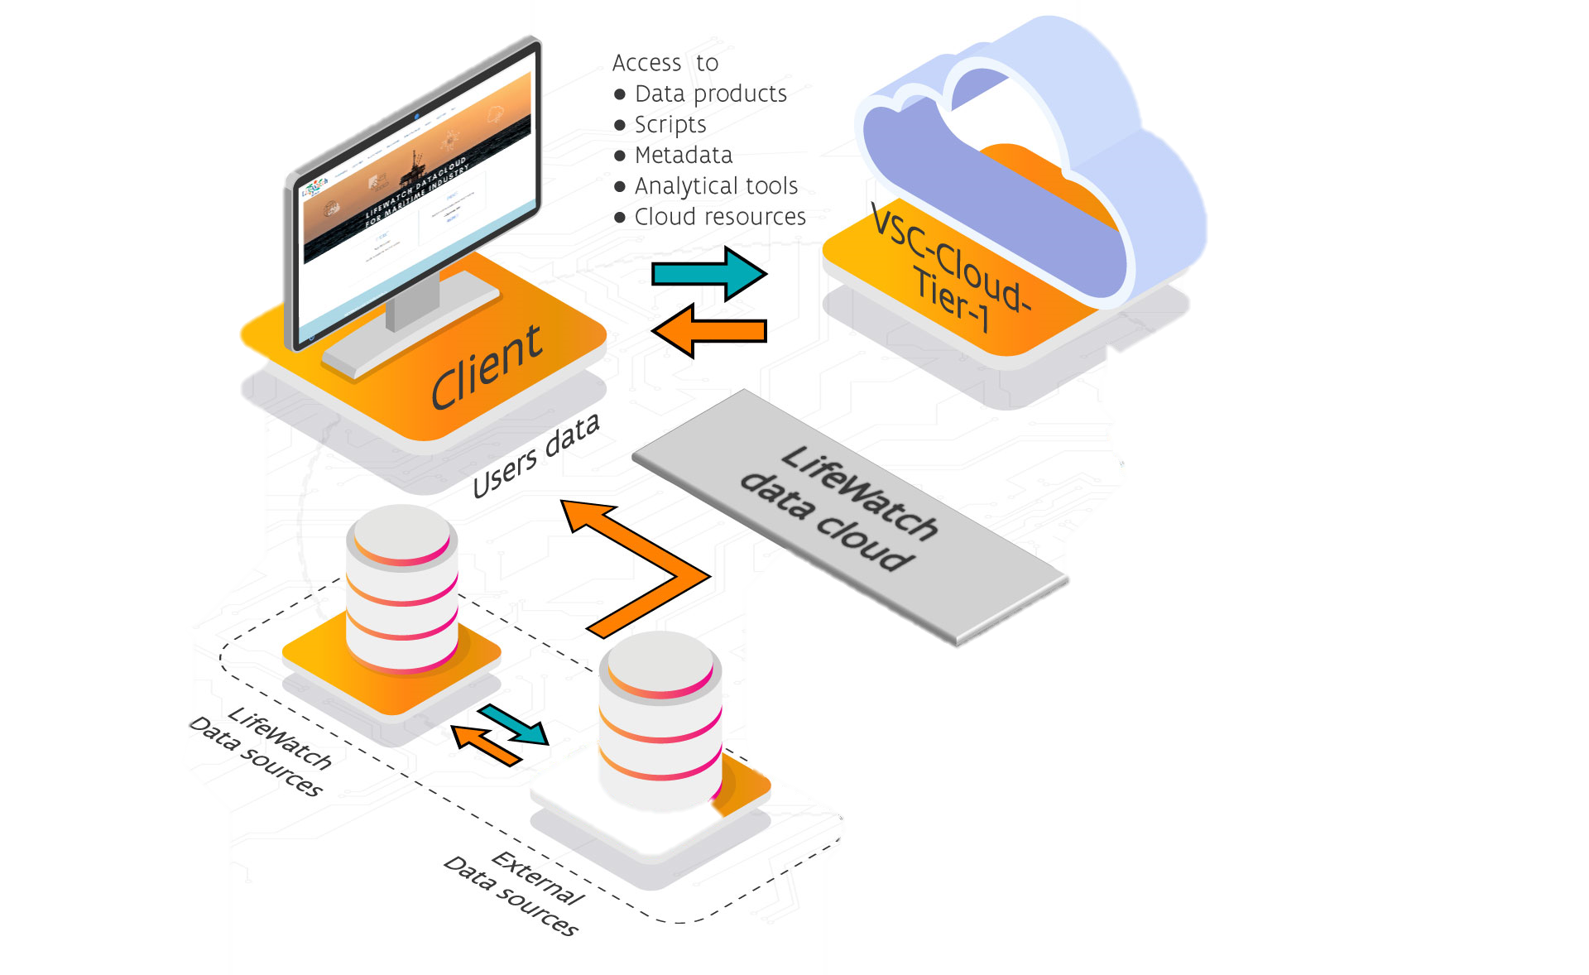
Use Case 1: modeling plankton interactions
Mechanistic model to derive phytoplankton drivers
Otero et al.
https://doi.org/10.5194/bg-2022-11

Slide 15

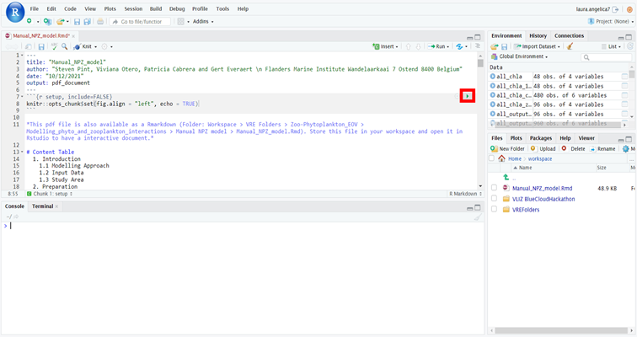
Use Case 1: modeling plankton interactions
Mechanistic model to derive phytoplankton drivers
Otero et al.
https://doi.org/10.5194/bg-2022-11

Slide 16
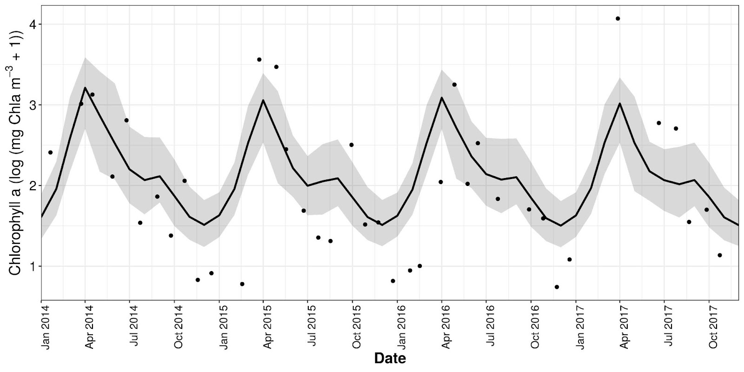
Use Case 1: modeling plankton interactions
Seasonal variation of phytoplankton
Otero et al.
https://doi.org/10.5194/bg-2022-11

Slide 17
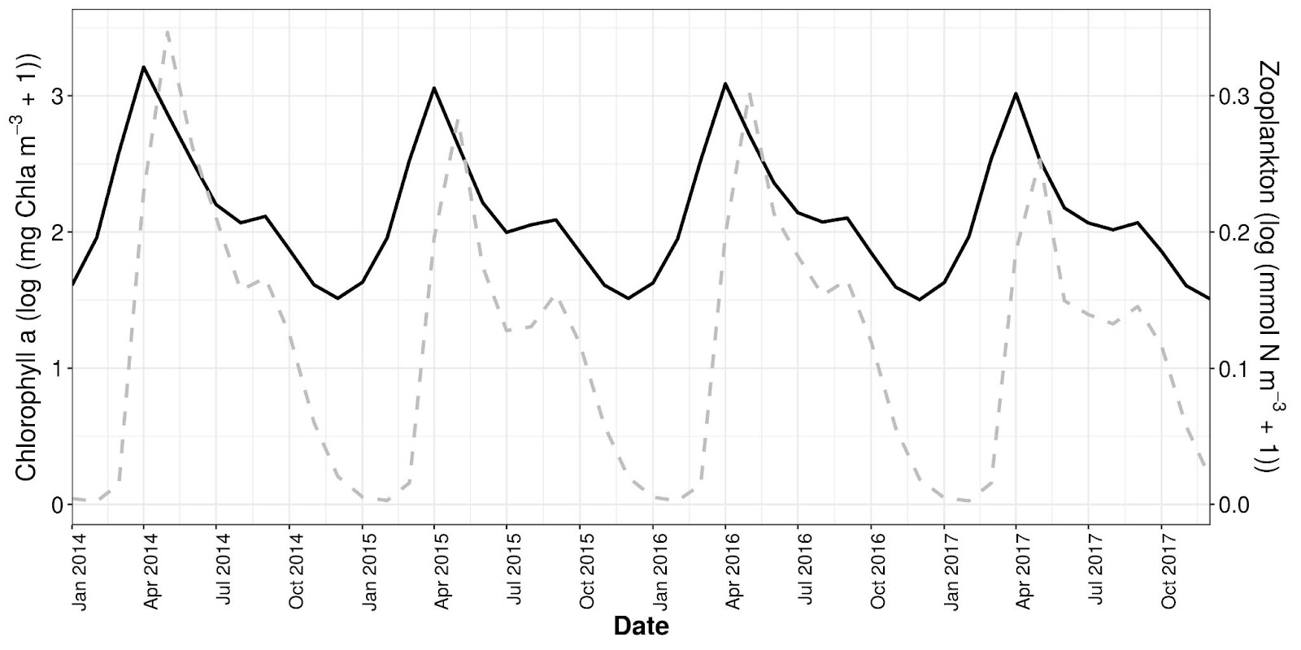
Use Case 1: modeling plankton interactions
Phytoplankton and zooplankton grazing
Otero et al.
https://doi.org/10.5194/bg-2022-11

Slide 18
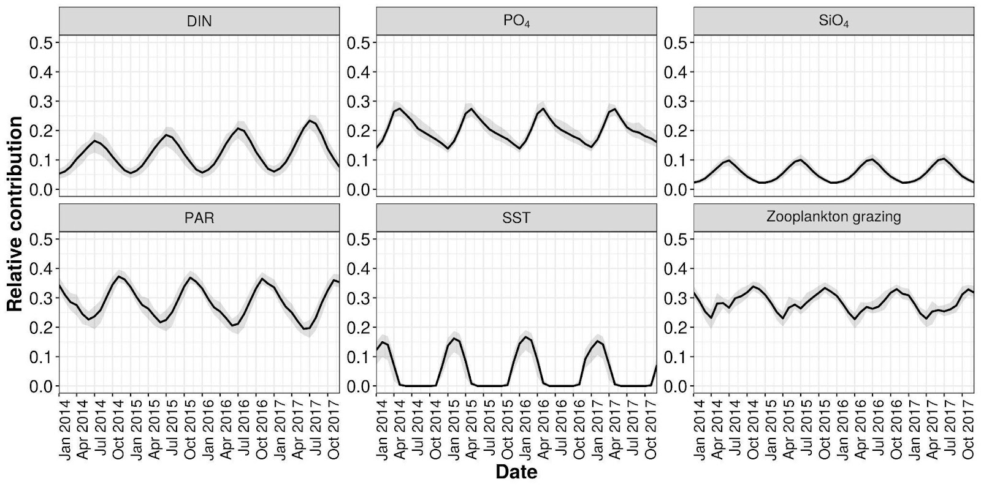
Use Case 1: modeling plankton interactions
Relative contribution of drivers over time
Nitrogen
Phosphate
Silicate
Light
Temperature
Zooplankton
Otero et al.
https://doi.org/10.5194/bg-2022-11

Slide 19
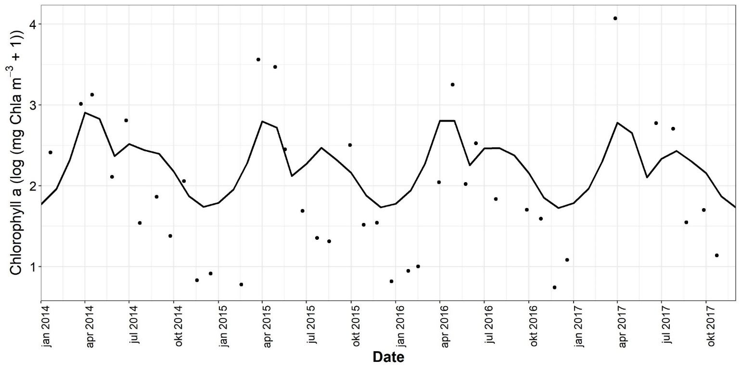
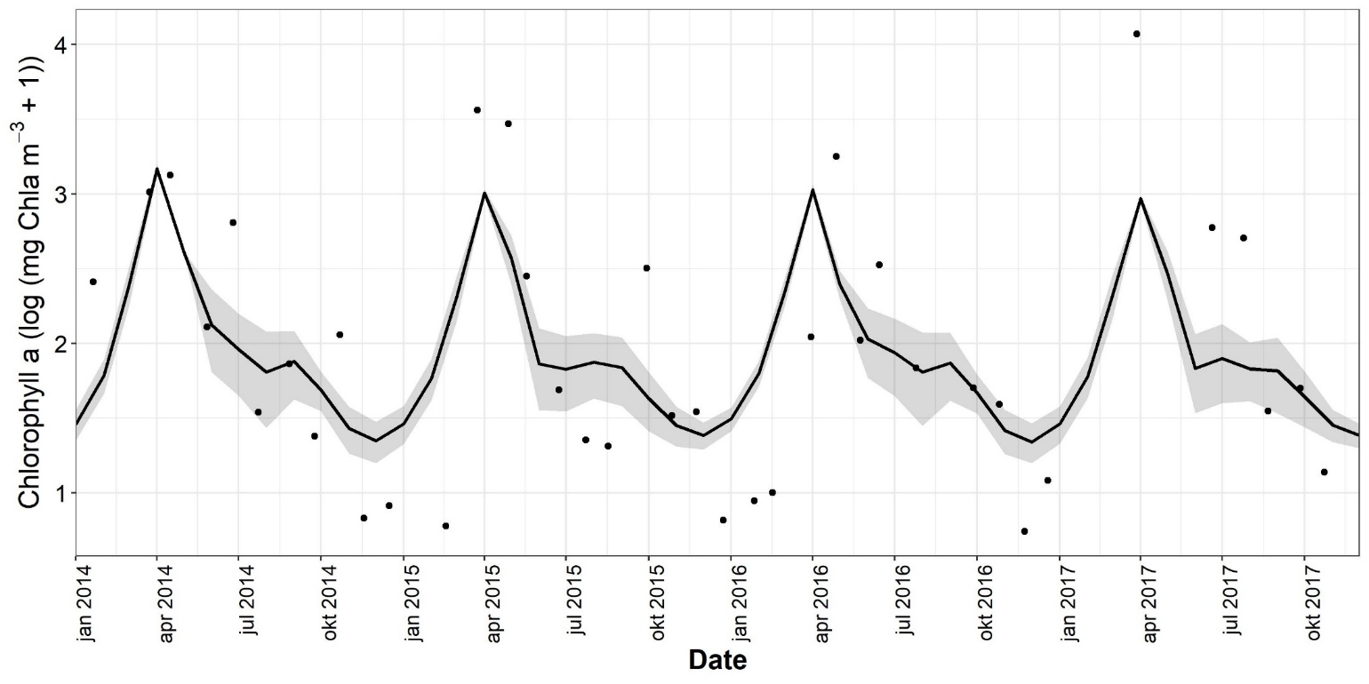
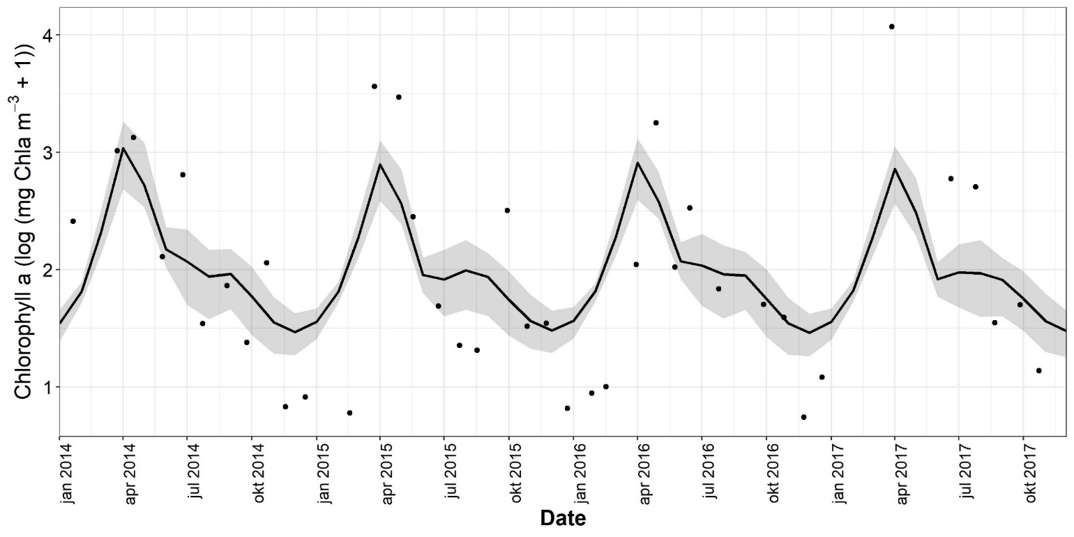
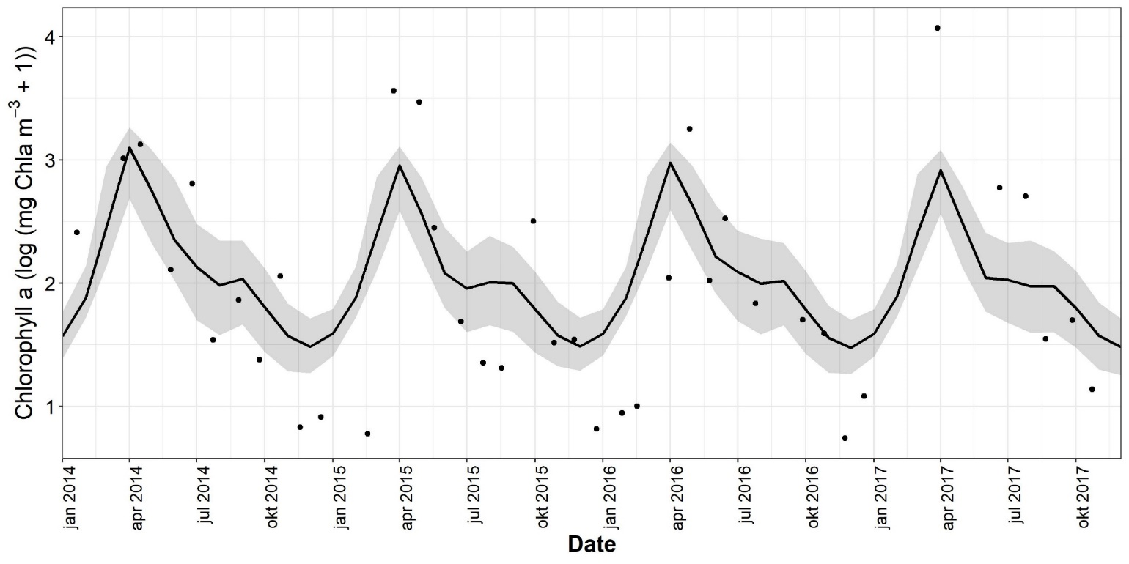
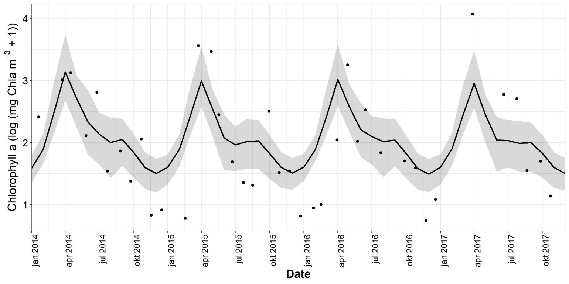

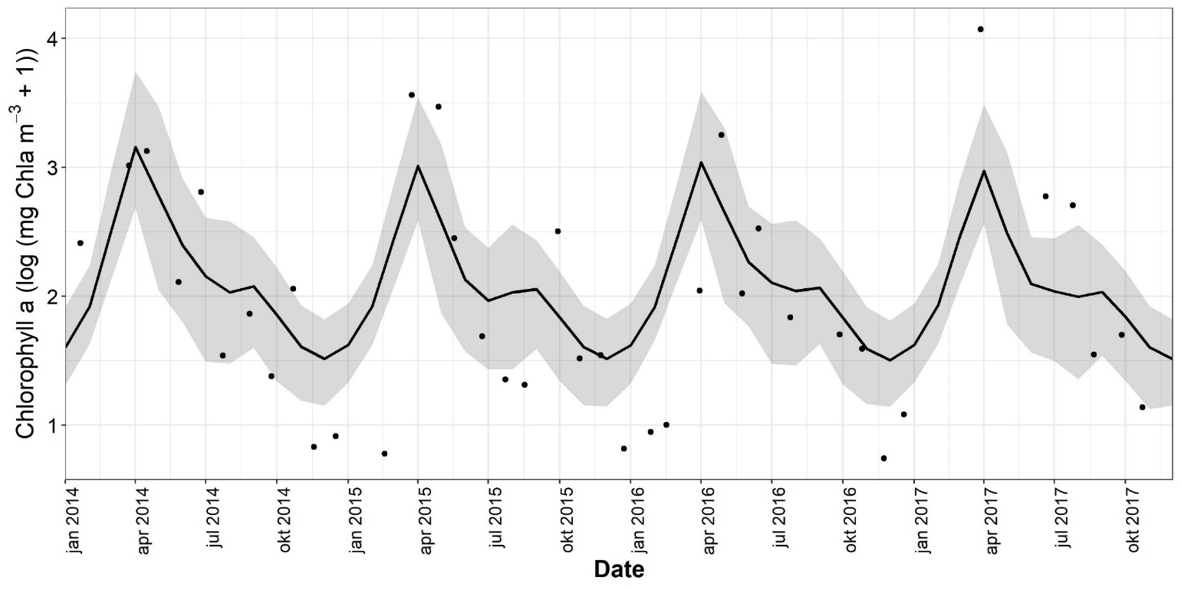
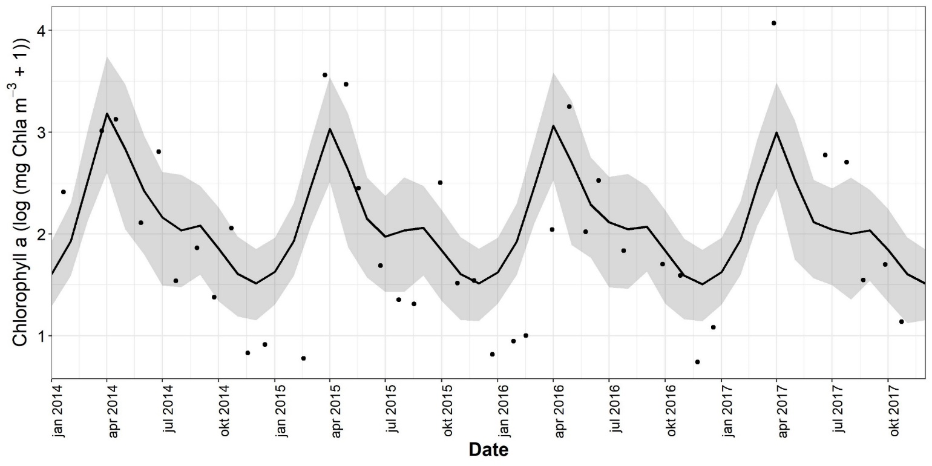
Use Case 1: modeling plankton interactions
Why using VSC resources?
1000 model runs
2500 model runs
5000 model runs
10 model runs
50 model runs
100 model runs
250 model runs
500 model runs
Otero et al.
https://doi.org/10.5194/bg-2022-11

Slide 20
Use Case 2
The European Tracking Network

Slide 21
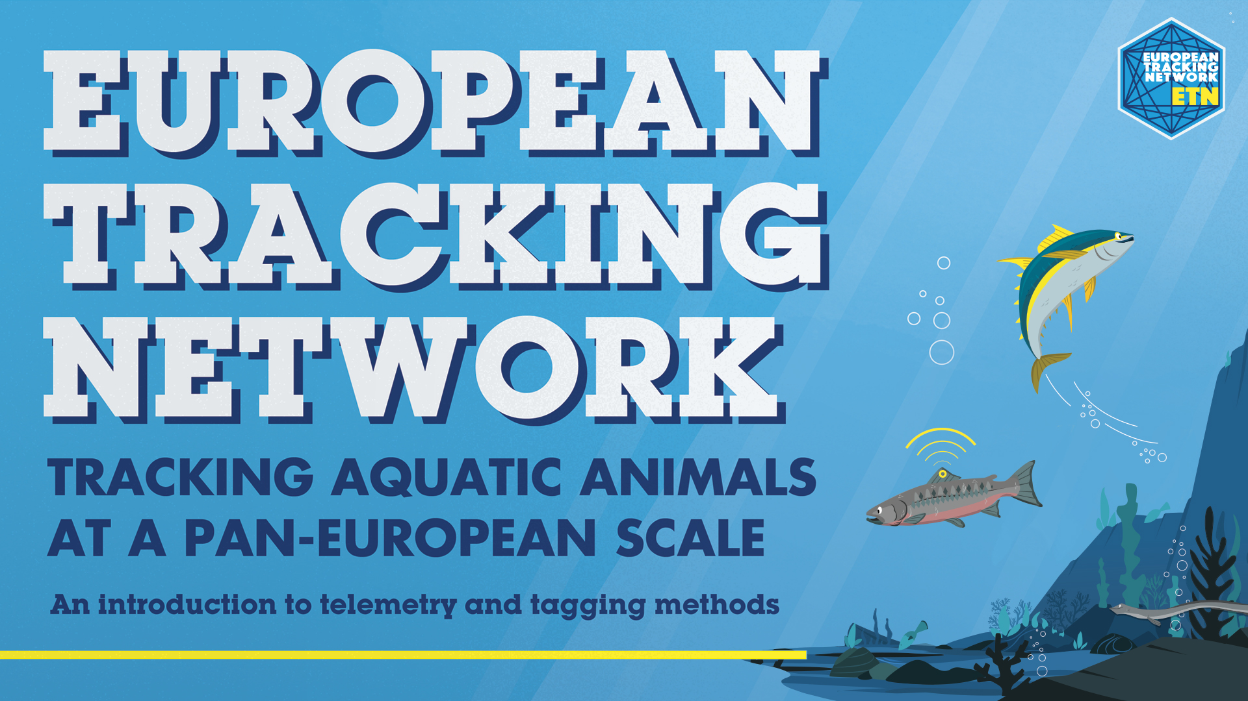

Use Case 2: the European Tracking Network
Aquatic tracking of animals
Movement / Migration

Slide 22
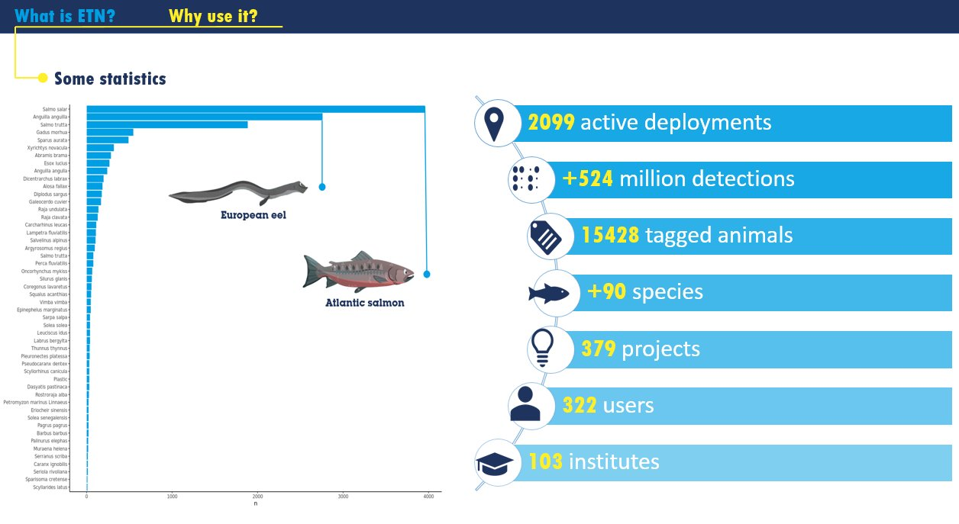
Use Case 2: the European Tracking Network
Aquatic tracking of animals
Movement / Migration

Slide 23
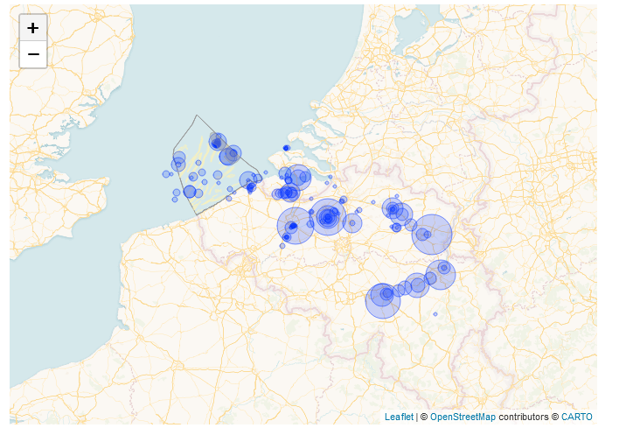

Use Case 2: the European Tracking Network
LifeWatch ETN portal and database hosted at VLIZ
  Copy of database stored at VSC and linked to data cloud
  RStudio and ETN database used by ETN scientific community (>350 users)
Animals detected per site in Belgium

Slide 24
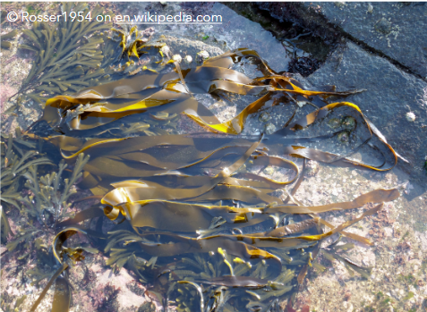
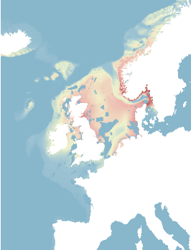
Future Perspectives
Project collaboration:
  SUMES: SUstainable Marine Ecosystem Services
    Vlaio/Blue Cluster project – UA / UGent / VLIZ
  Mariculture heat maps
    Possible future topic
Digital Twin(s) (of the Oceans)
Expand users to freshwater / terrestrial
Help you to use the LifeWatch Data Cloud?
Suitability map (red = most suited) of Laminaria digitata (Oarweed/vingerwier) based on environmental variables, depth and marine spatial planning
Westmeijer et al. 2019 https://doi.org/10.1016/j.algal.2019.101529

Slide 25
Thank you
Lennert Schepers
lennert.schepers@vliz.be
info@lifewatch.be

