Slide 1
VSC Users Day
Beyond traditional HPC:
Tier-1 Cloud and Tier-1 Data, Open OnDemand, containers

Slide 2
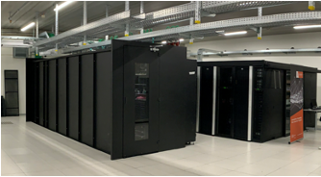

Beyond traditional HPC
Tier-1 Compute
Compute Power
Hortense

Slide 3


Beyond traditional HPC
Tier-1 Compute
Compute Power
Webportal
(Open OnDemand)
Containers
Hortense
Tier-1 Cloud
Tier-1 Data
Flexibility
Storage capacity
Data management

Slide 4
Tier-1 Web portal
Entry level flexibility in the browser for everyone

Slide 5

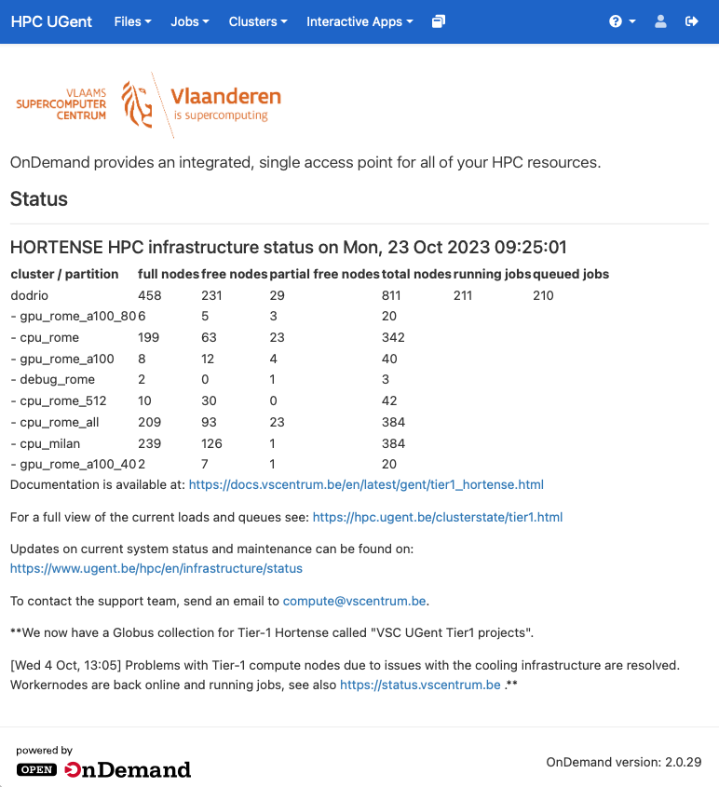
Tier-1 Web portal (powered by Open OnDemand)
https://tier1.hpc.ugent.be
Easy access to HPC in the browser
No SSH keys needed
No local software installation required
(standard browser e.g. Firefox, no plugins)
File browser
Job composer
Terminal in browser
Interactive Apps
  Ideal for GUIs/interactive applications
  Popular applications preinstalled
  e.g. Jupyter Notebook, RStudio
  Custom applications possible

Slide 6
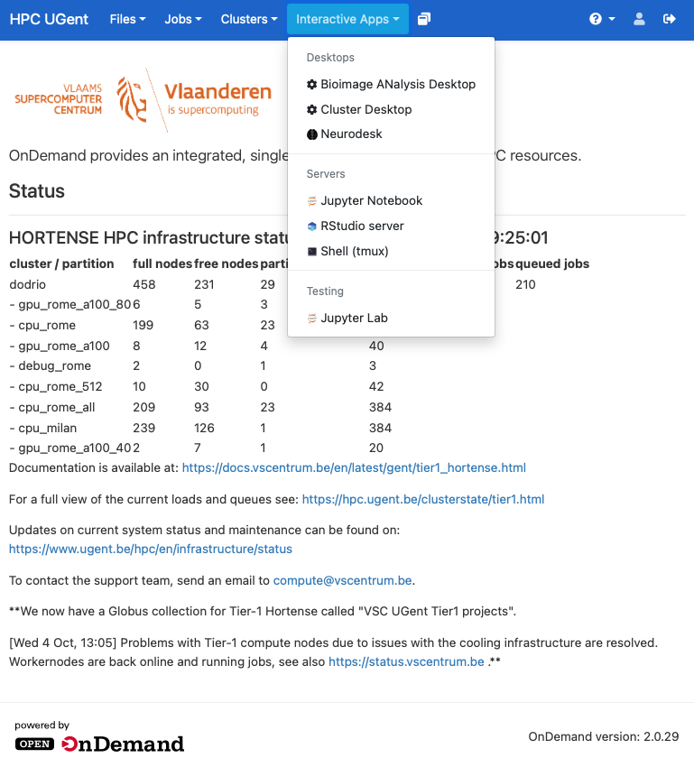
Tier-1 Web portal (powered by Open OnDemand)
https://tier1.hpc.ugent.be
Easy access to HPC in the browser
No SSH keys needed
No local software installation required
(standard browser e.g. Firefox, no plugins)
File browser
Job composer
Terminal in browser
Interactive Apps
  Ideal for GUIs/interactive applications
  Popular applications preinstalled
  e.g. Jupyter Notebook, RStudio
  Custom applications possible

Slide 7
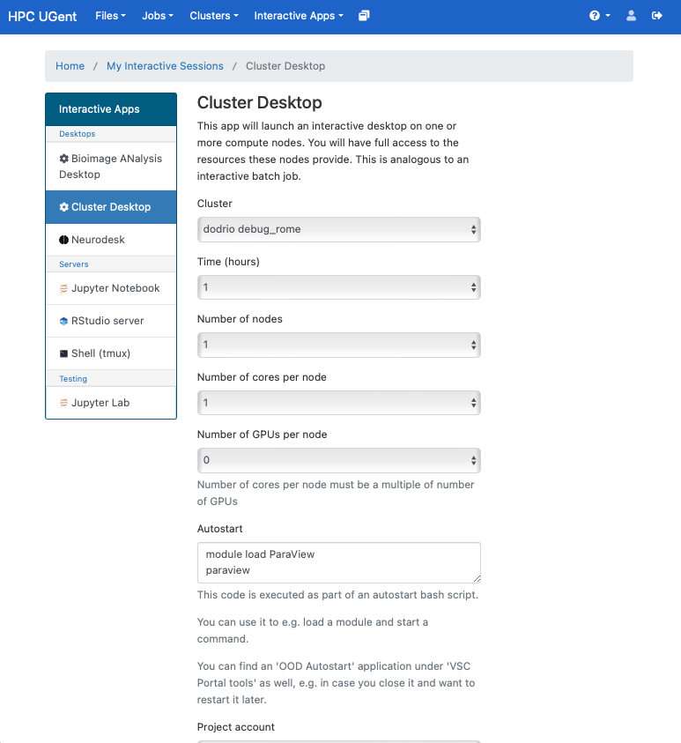
Tier-1 debug partition
dodrio/debug_rome
interactive/ debug partition
for quick (immediate) access
not accounted in credits
limited user resources
  max 5 jobs (running/waiting) in queue
  up to 3 running jobs
  max 8 CPU cores for all running jobs
hardware is oversubscribed factor 4
every node has 2 types of GPUs:
  1 NVIDIA V100 GPU for exclusive access
  (you need to request it in jobscript)
  1 NVIDIA Quadro P1000 GPU
  always available but shared
> module swap cluster/dodrio/debug_rome

Slide 8
Containers on
Tier-1/Tier-2
Sacrificing performance for mobility?

Slide 9
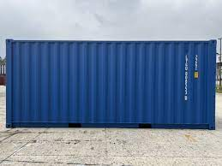

Containers on Tier-1/Tier-2
Containers?
Standalone package of software that can run in any environment, regardless of type/vendor
e.g. docker, apptainer
Benefits:
Portability
Reproducibility
Writeable
Stackable
Downsides:
Performance
Not clear what is inside
(unless you build it yourself)
Tier-1
“Containers ... make it easier for scientific researchers to self-manage their software stack and take it with them to whatever compute infrastructure they are working on. Most people don’t consider that they’re often sacrificing performance for mobility.”

Slide 10
Containers on Tier-1/Tier-2
Before considering to use containers on Tier-1/Tier-2 please bear in mind:
Containers images are typically non-optimized binaries of software
They can work significantly slower than compiled software
sporadic use = okay (many) production runs = bad
VSC Tier-1/2 ecosystem now supports
+1.500 software modules, with +2.000 extensions
properly compiled and optimized for the exact hardware
VSC staff has invested a lot of time in this
Save yourself (and other Tier-1/2 users) time and try out software modules first
https://docs.vscentrum.be/software

Slide 11
Containers on Tier-1/Tier-2
Docker does not run on VSC infrastructure (requires persistent root privilege)
Singularity/Apptainer containers are better suited for HPC systems:
operating-system-level virtualization
It is possible to convert docker images to apptainer images
How-to and examples at
https://docs.vscentrum.be/software/singularity.html
https://docs.hpc.ugent.be/apptainer
Caveats:
Check local policies if Apptainer image can reside on all filesystems
(e.g. at UGent must be scratch, local disk of workernode or ramdisk)
Use --fakeroot option to make new Apptainer images or convert docker images
You never know what is in a container, unless you build it yourself

Slide 12
Tier-1 Cloud
Virtual Machines with ultimate flexibility for power users

Slide 13
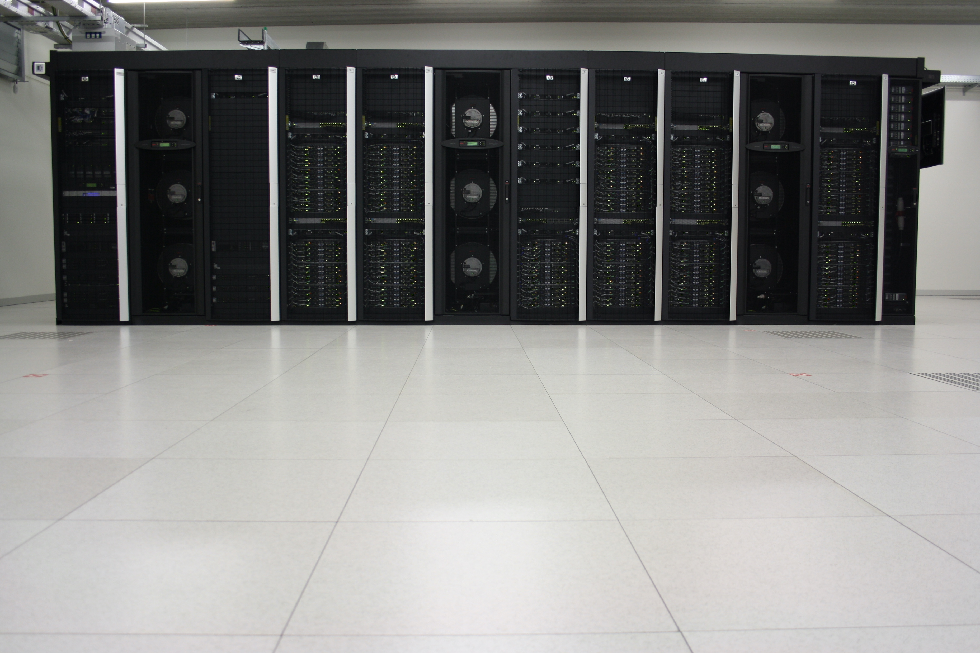
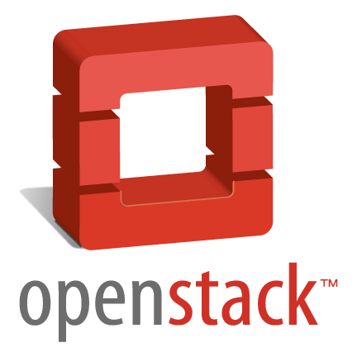

Tier-1 Cloud – Specs
‘Platform as a Service’ for power users
Deploy resources for scientific / R&D use case
  virtual machines
  storage systems
  private/public networks
  …
Deployed with Red Hat OpenStack Platform
Supported by VSC team (UGent) and Red Hat support
High availability setup on single site
Powerful, but effort required!
You are responsible for:
installation, maintenance, user management, ...

Slide 14
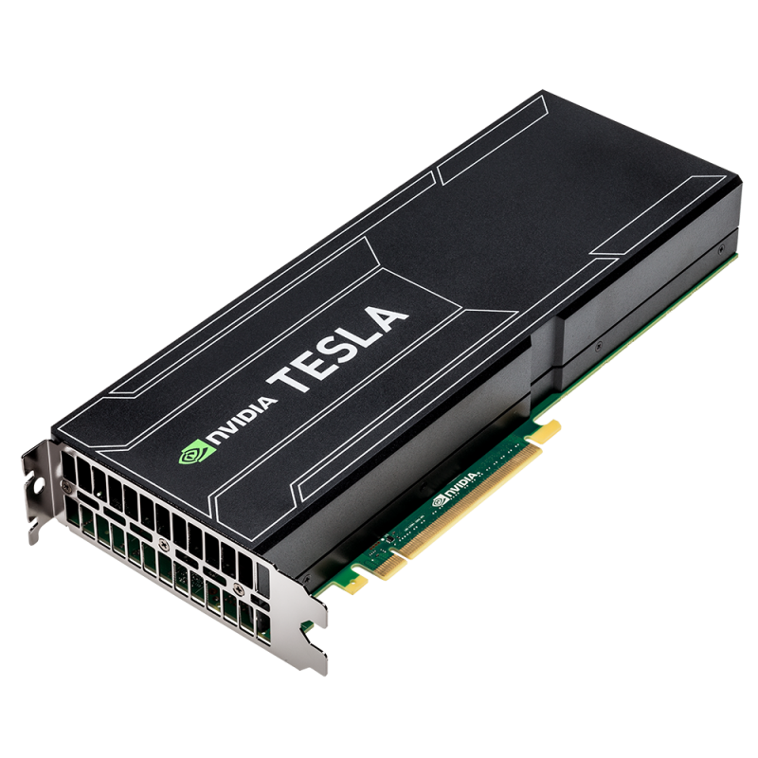


Tier-1 Cloud – Specs
https://docs.vscentrum.be/cloud
9 UPSv1-GPUv2 hypervisors
AMD Epyc 7542 2.9GHz
128 Cores
512 GB RAM
3 NVIDIA Ampere 2
  16GB GDDR6 mem
Connected to UPS
80 CPUv1 hypervisors (older)
Intel Xeon CPU E5-2680 2.40GHz
28 Cores
512 GB RAM
9 GPUv3 hypervisors
AMD Epyc 7542 2.9GHz
128 Cores
512 GB RAM
2 NVIDIA Tesla 4
  16GB GDDR6 mem
Connected to UPS
1 public IP per project
Various VM images/flavors/instance types
Full GPU PCI device passthrough (no more virtual GPUs)
Each VM can attach a full GPU
Users can install the latest Nvidia drivers for their VMs

Slide 15

Tier-1 Cloud – Orchestration
https://docs.vscentrum.be/cloud
Tier-1 Cloud enables orchestration with Terraform templates
generate complex cloud infrastructures as user with templates
compatible with multiple cloud providers e.g. AWS CloudFormation
HashiCorp Terraform is an infrastrucure as code tool (IaC):
https://www.terraform.io
Easy to use
Supports thousands of providers including OpenStack, AWS, Azure...
Recommended way to deploy cloud infrastructures for new projects
Several examples in VSC Tier-1 Cloud documentation:
https://docs.vscentrum.be/cloud/terraform.html

Slide 16
Tier-1 Cloud – Access
https://www.vscentrum.be/cloud
Starting/exploratory: continuously open
3 project access calls per year: Feb, June, Oct
Requesting follow-up project is possible
Results from calls, so far (started June 2021):
10 pilot projects
14 starting grants
20 academic projects
3 exploratory industry/SME projects
 | Academic researchers |  | Industry/SME researchers
Access model | Starting Grant (lightweight) | Project access (evaluation & selection) | Exploratory | Contract
Price | Free of charge | Free of charge | Free of charge | Full cost
Duration | 8 months | Up to 2 years | 8 months | Contract duration

Slide 17
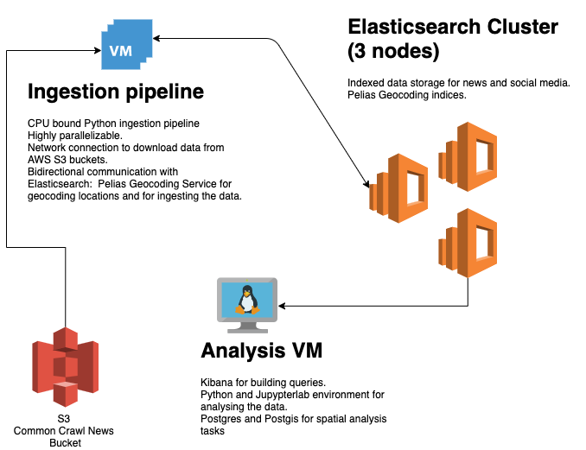
Tier-1 Cloud – Analysis of projects
Typical use cases
User interface (web)
  data analytics tool (database)
    custom calculations (compute)
Web-based data management/processing platform
Study HPC configuration (for optimal AI training)
Interactive prototyping environment
Teaching purposes – dedicated VMs for students
Target audience
Researchers within project (purpose = ease of use)
Broad audience researchers (purpose = service delivery)
Students
VUB – Social media and news outlets as a source for understanding the spatial distribution and intensity of natural hazard events on a global scale

Slide 18
Open OnDemand
HPC access made easy

Slide 19
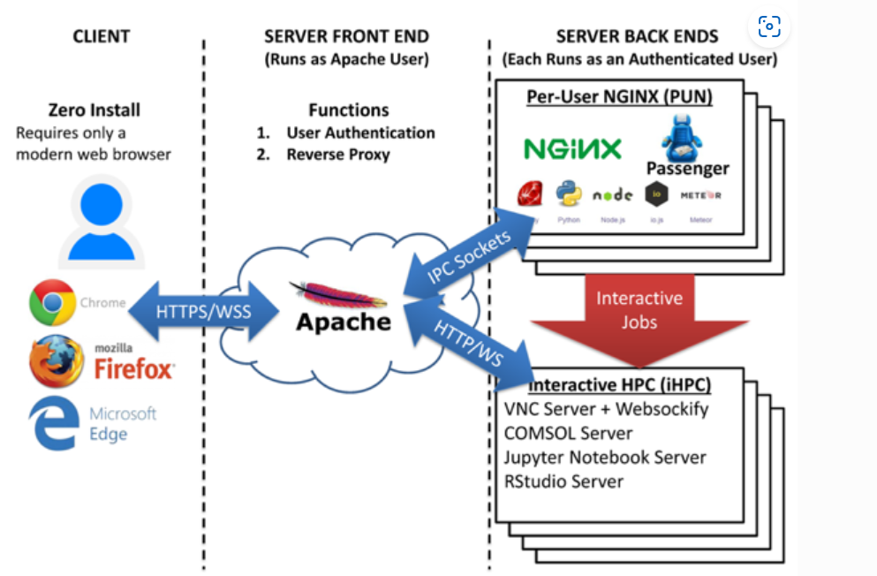
Open OnDemand
Browser based, integrated, single access point for all of your high performance computing (HPC) resources
Opensource developed
  OSC lead
  US NSF sponsored since 2015
  250+ installations
Roll-out within VSC ongoing
  Currently available at
    Tier-1
    Tier-2 UGent
    Tier-2 KU Leuven
19

Slide 20
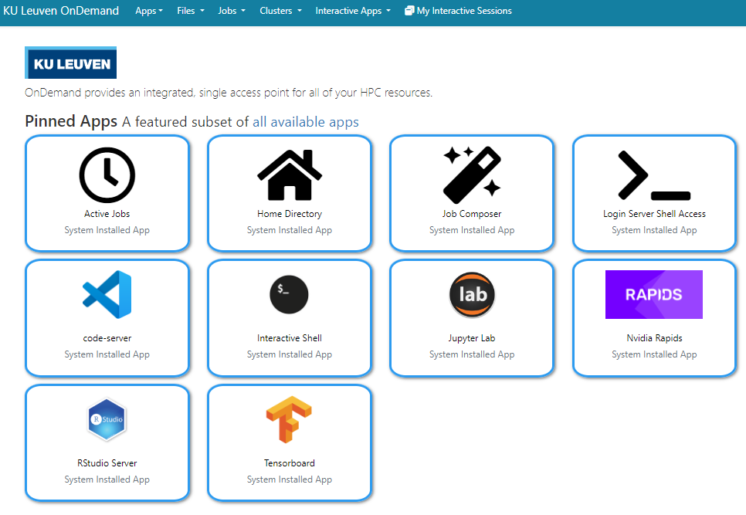
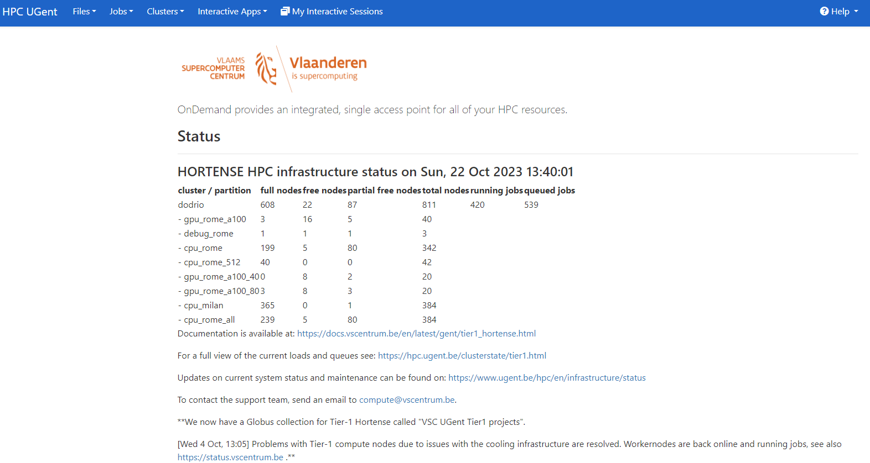
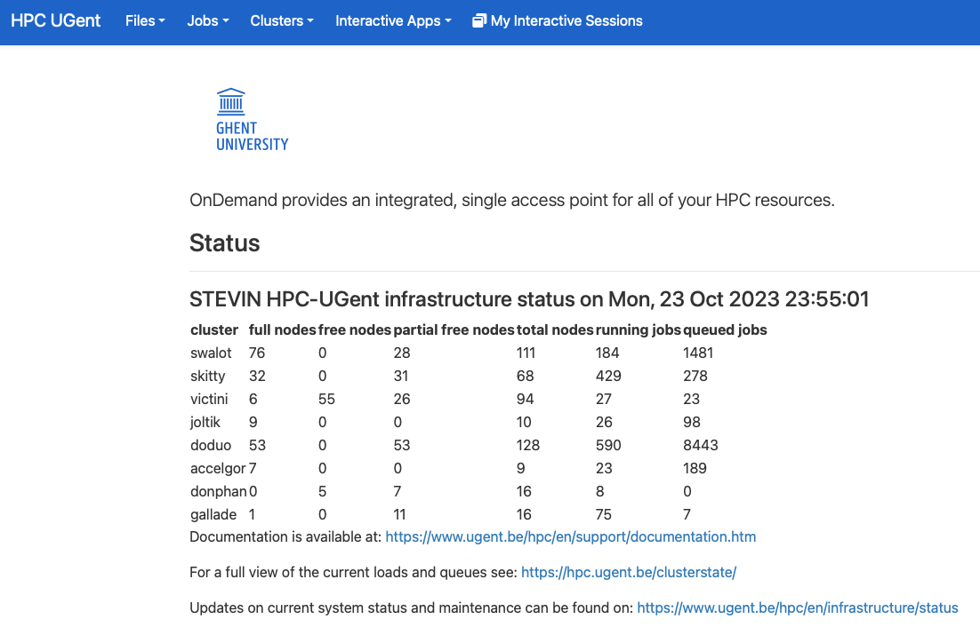
Open OnDemand
Easy access – nothing to install
Functionality
Basic file transfers
Job monitoring
Shell access
Interactive apps
20

Slide 21
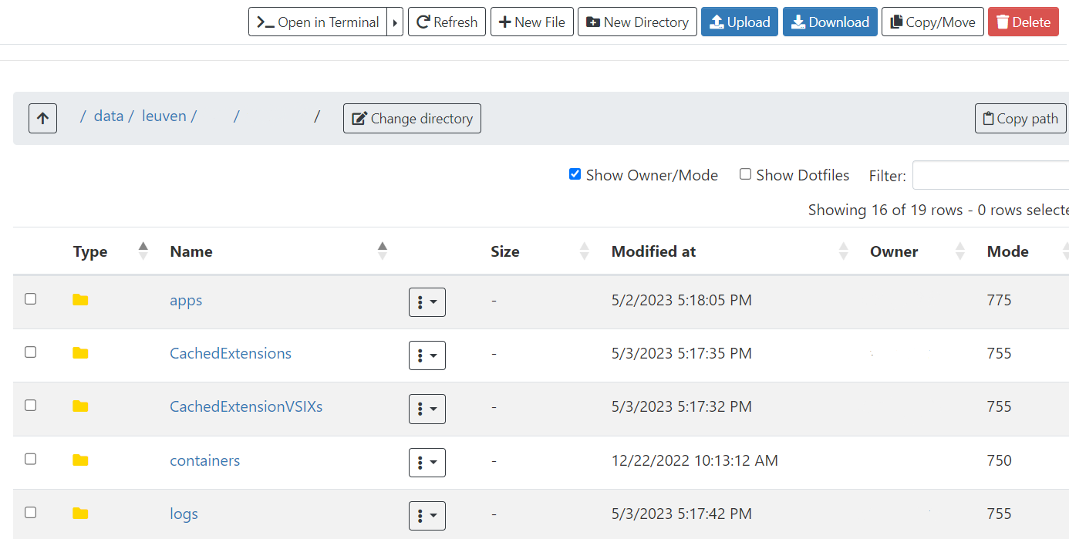
Open OnDemand
Ideal for:
Basic file manipulations
Small down/uploads
For more complex data operations
Globus
Tier-1 Data workflows
21

Slide 22
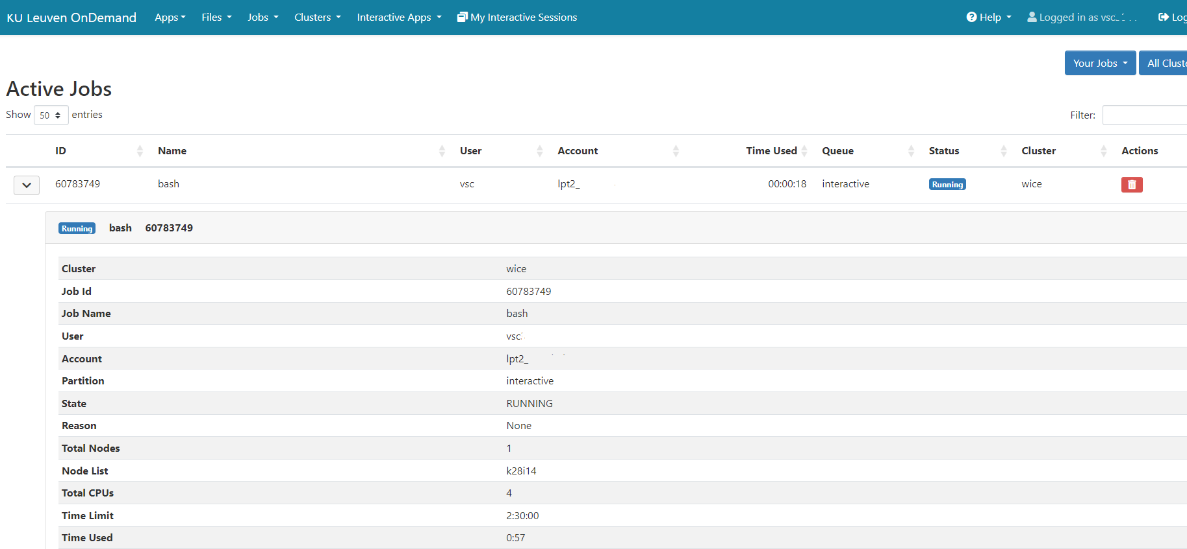
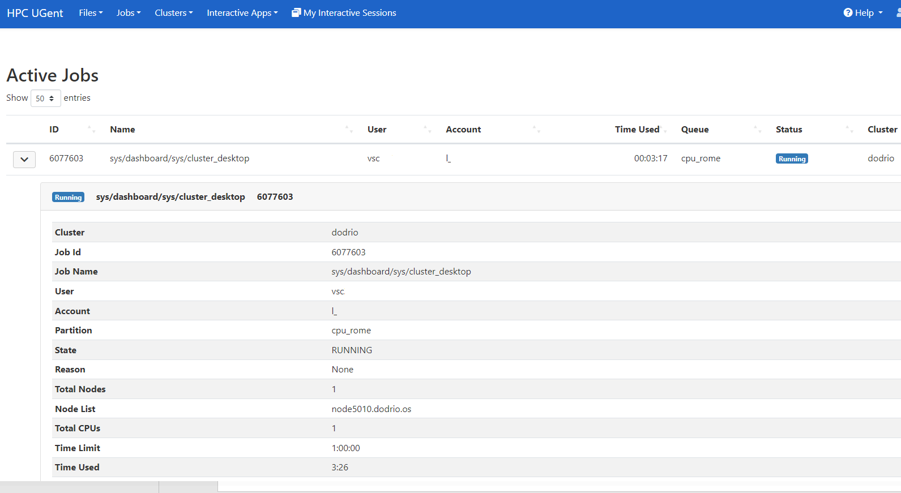
Open OnDemand – Job Monitoring
Overview of active jobs
Job information
All jobs - submitted from
  OnDemand
  Terminal outside of OnDemand
And yes, you can delete your job
22

Slide 23
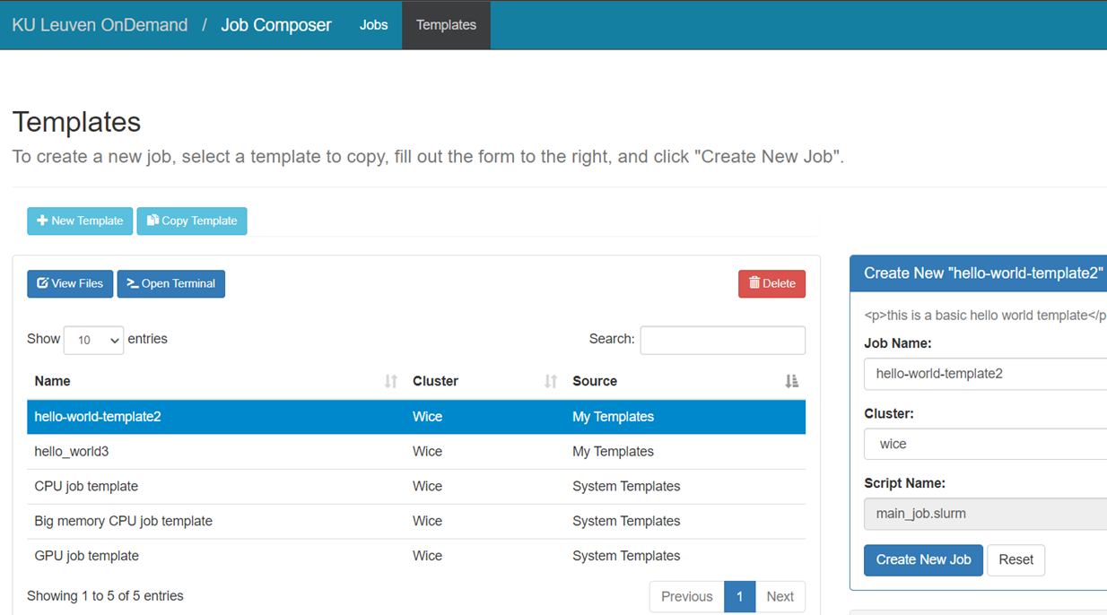
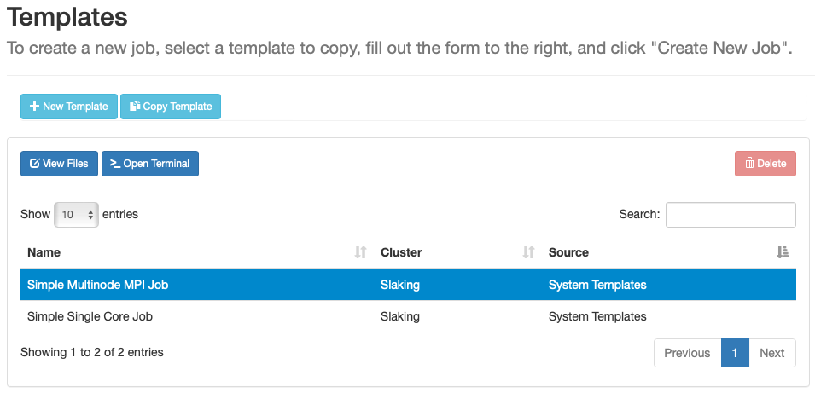
Open OnDemand – Job Submission
Easy for creating general scripts
Personal use
Teams
Create jobs in a couple of clicks
Basic templates provided
23

Slide 24
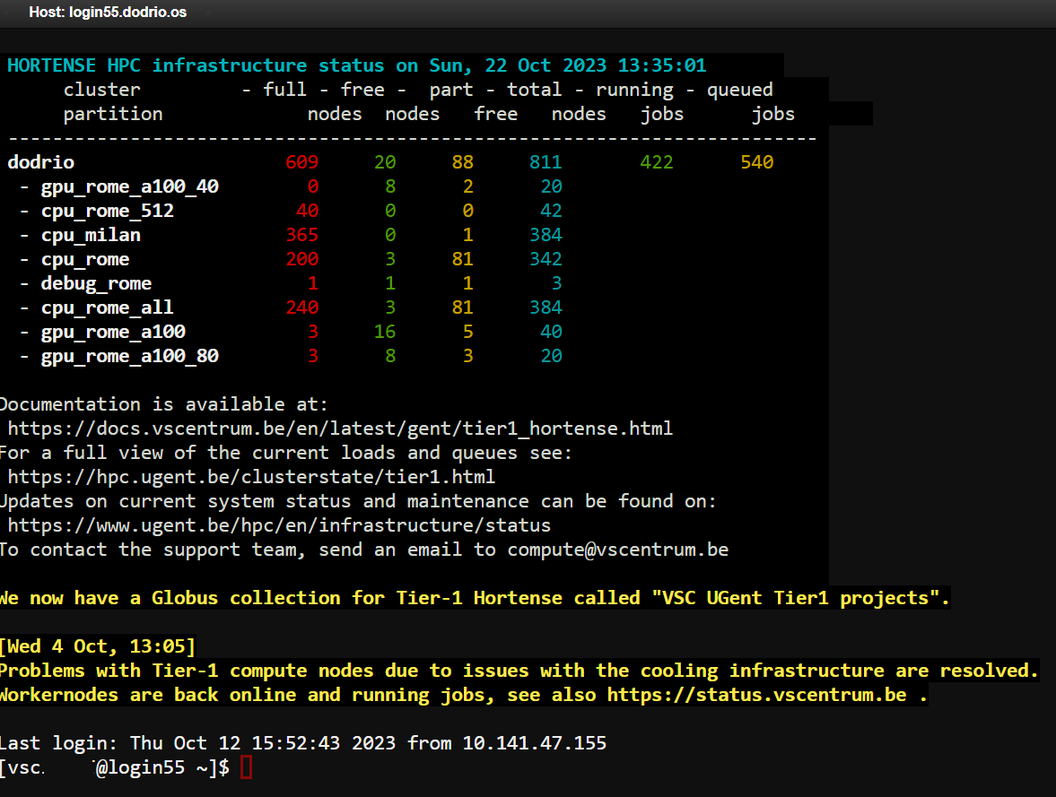
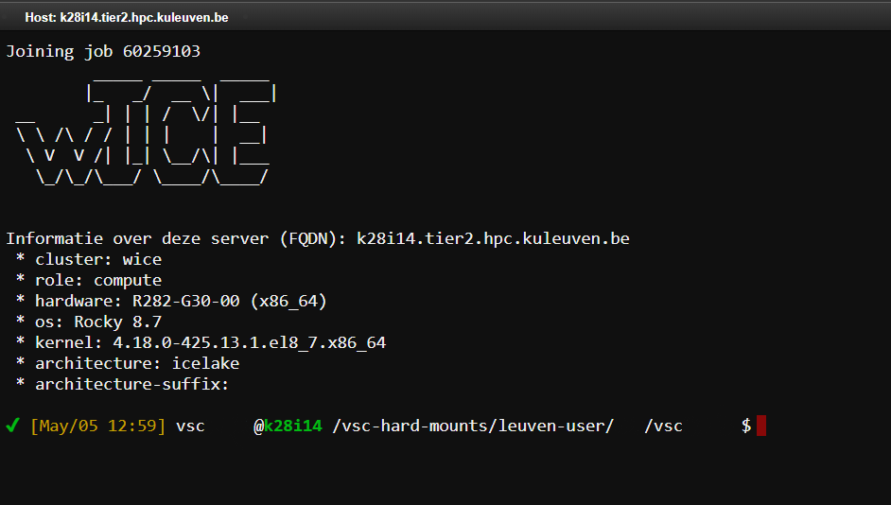
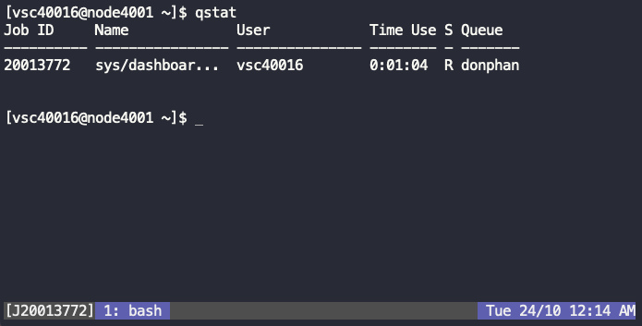
Open OnDemand – Integrated shells
Login node shell access
Interactive session on compute node
24

Slide 25
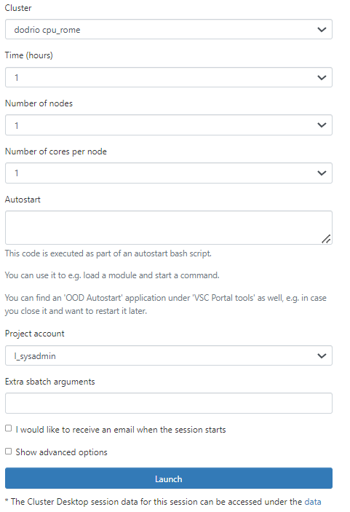
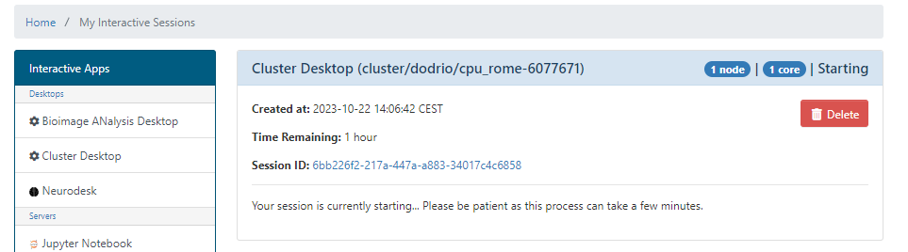
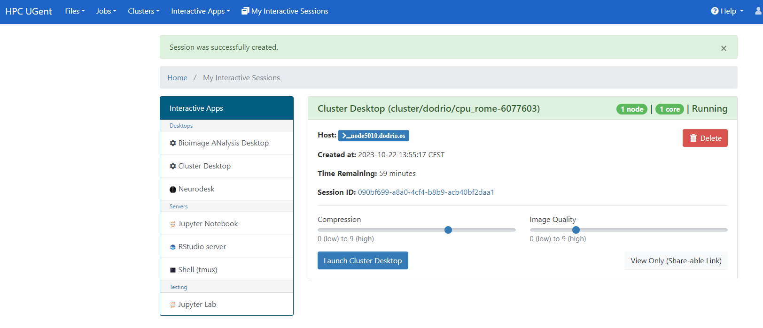
Open OnDemand – Interactive apps
Applications with GUI in the browser
Specify job specifics in submit form
Submit an interactive job from the web browser
  Job will be processed through the queue
Connect to the created session
25

Slide 26
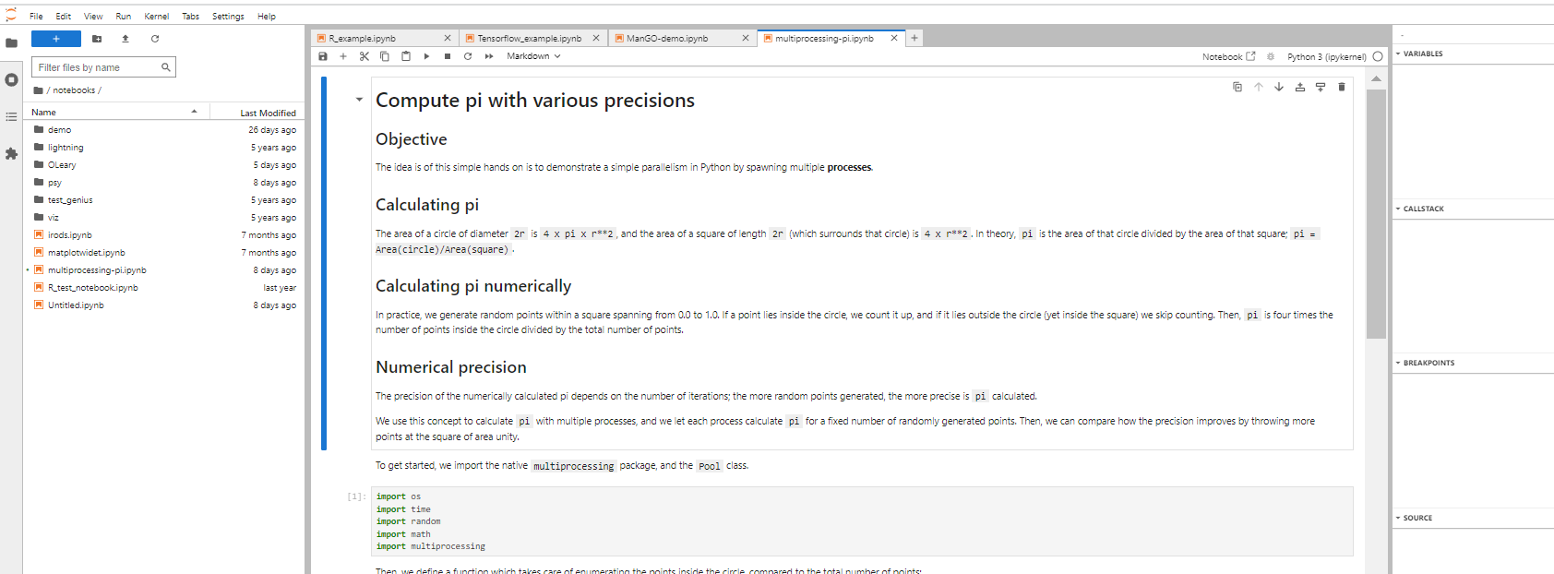
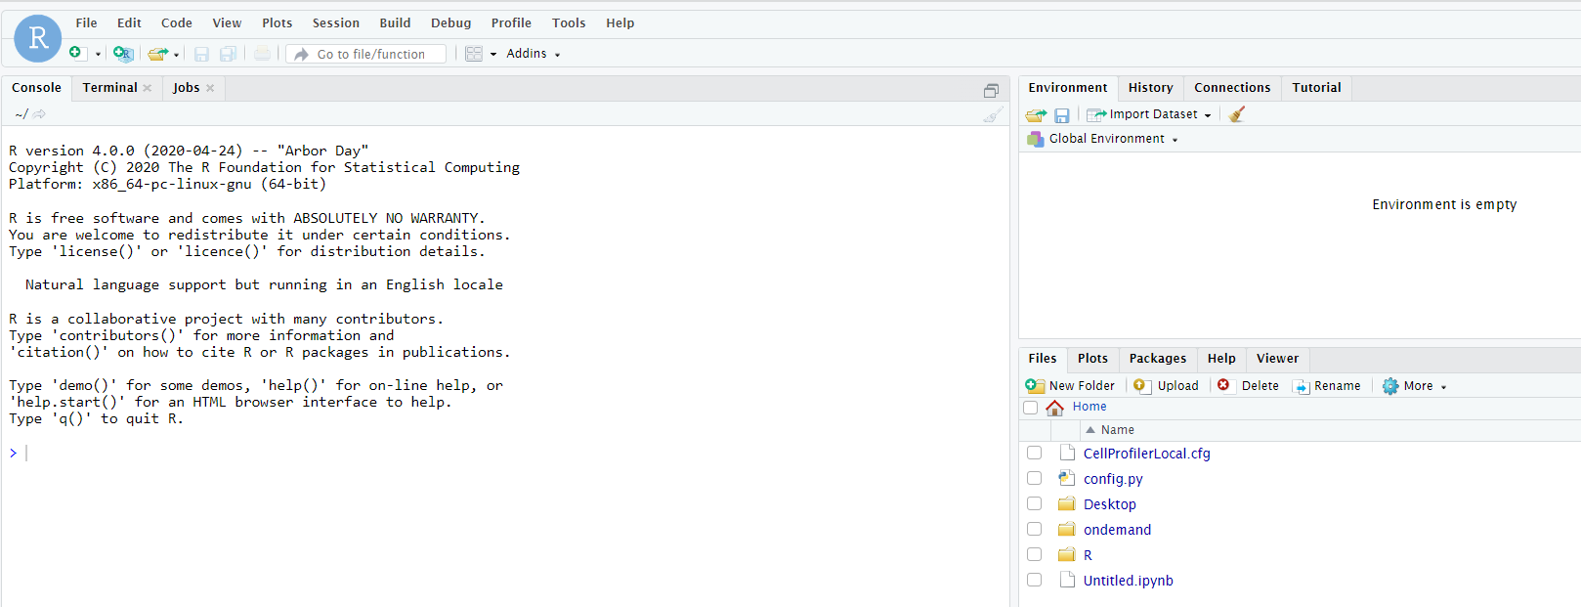
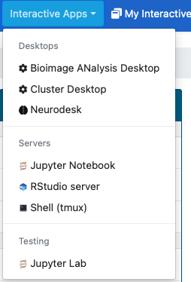
Open OnDemand – Interactive apps
Type of applications
Client/server based
  Jupyter(lab)
  RStudio
  Tensorboard
  Code server
Desktop applications
  Regular desktop
  Specific desktop environment
  Applications like Abaqus, Ansys, Matlab
Specific for training, workshop, ...
  Customized web portal applications possible
  https://docs.hpc.ugent.be/teaching_training
  Contact your local support
26

Slide 27
Open OnDemand – Future
  Further roll-out
  Follow OnDemand releases
    E.g. Globus integration in 3.1
  Integration XDMoD
27

Slide 28
VSC Users Day
Beyond traditional HPC:
Tier-1 Cloud and Tier-1 Data, Open OnDemand, containers

