Slide 1
ChatGPT for HPC
Geert Jan Bex (geertjan.bex@uhasselt.be)
License: this presentation is released under the Creative Commons CC BY 4.0, see https://creativecommons.org/licenses/by/4.0/deed.ast

Slide 2
https://tinyurl.com/3tb5wd3p

Slide 4
Introduction
What is your reply to the following question:
Can you use ChatGPT successfully for research
in your domain?

Slide 5
Introduction
AI tools are... tools
Tools are only useful when you know how to use them
Can you wield a tool without knowing material you are using it on?
Domain knowledge!

Slide 6
Use cases
Question answering Google on steroids?
Code generation Do we still need programmers?
Documentation generation Write my manual
Debugging Here’s my code and the error message: figure it out
Data exploration Analyze my data

Slide 7
Question answering & conversations
ChatGPT

Slide 8
Question answering
Can you list the steps to create a robust
job script for the Slurm scheduler that runs
an MPI application on multiple nodes?
https://chat.openai.com/share/ec63fb76-69d9-4639-a85f-e6a478d13a6a

Slide 9
Conversation: improve and refine
Can you help me write a job script for the Slurm scheduler that runs a
hybrid MPI/OpenMP application on 4 compute nodes that have
32 cores each? Each MPI process should use 4 threads. The application
is build using Intel MPI, which is installed as a module, as well as with the
Intel compiler suite. Lmod modules are used to manage software
versions. The application is expected to run for 10 hours and each
process will use 3 GB RAM. The application is located in the directory
in which the job will be submitted.
https://chat.openai.com/share/299c77a3-c05a-4222-8f8f-4c56c5004612

Slide 10
Question results
Can you describe the attractive-repulsive
force between molecules and give the name
of the function that describes the potential
energy?
Are you sure this is correct? Using the formula for F,
the force would be purely attractive, which
contradicts the potential energy.
https://chat.openai.com/share/5d9fb2f6-0d64-4a56-96b7-23db767c2bc1

Slide 11
Hallucinations
I would like to use m4 to replace text using a macro. However, the text to
replace is part of a string that contains an underscore, and I only want to
replace the part of the string that comes after the underscore. For
instance, the M4 tempale would contain 'test_SOMETING' and that should
become 'test_14'.
What is the syntax to use in the template to achieve this?
https://chat.openai.com/share/edae3999-df97-4c0b-bc83-b2477c413585

Slide 12
Code generation
ChatGPT-4 & GitHub Copilot

Slide 13
Boilerplate code
Handling command line arguments
Error handling
Writing documentation
Writing unit tests
Boring!
Error prone!

Slide 14
Command line arguments boredom
https://asciinema.org/a/613753

Slide 15
Generating tests & error handling
Consider the following code…
int f(int n) {
int r = 1;
for (int i = n; i > 0; i--) {
r *= i;
}
return r;
}
Can you suggest some relevant unit tests?
How would you handle negative values of n?
https://chat.openai.com/share/c2244a7c-db02-4079-8085-5b5429b80bcf

Slide 16
Refactoring
Could you refactor the particle class
according to the builder design pattern?
The large number of parameters of the
constructor is somewhat daunting.
https://chat.openai.com/share/cbc7b6cf-fd57-451d-a3e8-20134827de59

Slide 17
Generating documentation
https://asciinema.org/a/613818

Slide 18
Debugging
ChatGPT-4 + Advanced Data Analysis

Slide 19
Debugging
When running the application, it
terminates with a segmentation fault.
Can you suggest a fix?
Can you suggest another fix?
https://chat.openai.com/share/bdde1463-84aa-49c5-b4a1-89e774dc25b6

Slide 20
Data analysis
ChatGPT-4 + Advanced Data Analysis

Slide 21
Data exploration
Global Peace Index (GPI) dataset
Could you give me a table with three
columns:
1. the year
2. the name of the country that has the minimum value
for that year 3. the value for that country in that year
You can ignore missing values.
https://chat.openai.com/share/671287f4-e152-4ba6-a3ad-11d3425857d0

Slide 22
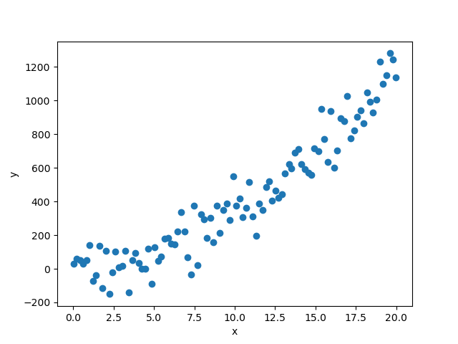
Data analysis
PNG file
Actual model:
$$f\left(x\right)=1+2x+3x^{2}$$
Quadratic fit (scipy):
$$f\left(x\right)=2.8+4.5x+2.8x^{2}$$
$$R^{2}=0.93$$
ChatGPT 4.0:
$$f\left(x\right)=−50+10x+3x^{2}$$
$$R^{2}=0.94$$
https://chat.openai.com/c/f7a7d7ee-3b87-48c8-9bd7-efe29a4fa7eb
(not publicly sharable due to images)

Slide 23
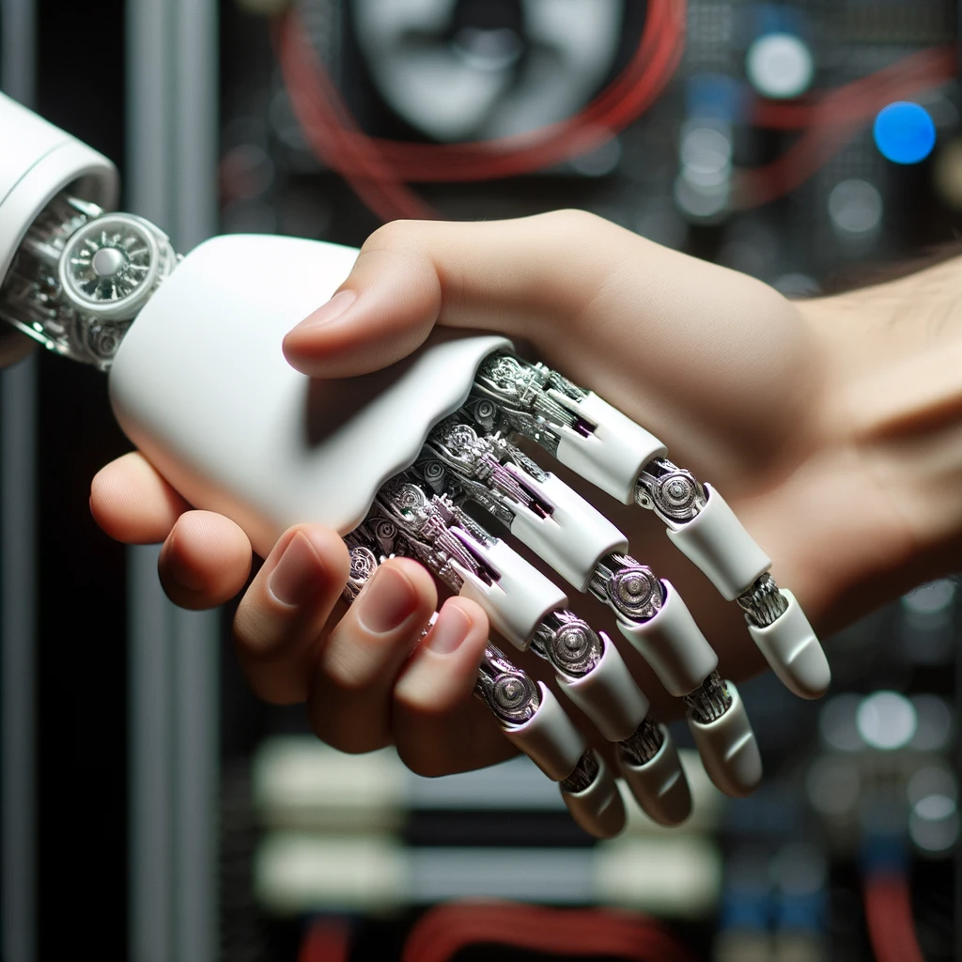
Conclusions

Slide 24
Conclusions
You need to know what you are chatting about
Very valuable tools, real timesavers
This is just the beginning...
https://chat.openai.com/c/5a24f956-8851-4e72-80a4-d0d71b2820e2

