Slide 1


Flanders BioImaging –
Towards efficient centralized research data management and analysis of bioimaging data
Sebastian Munck
VIB Bio Imaging Core
VIB Center for Brain & Disease, Research
KU Leuven, Department of Neurosciences
3rd of July, 2020
Sebastian Munck

Slide 2

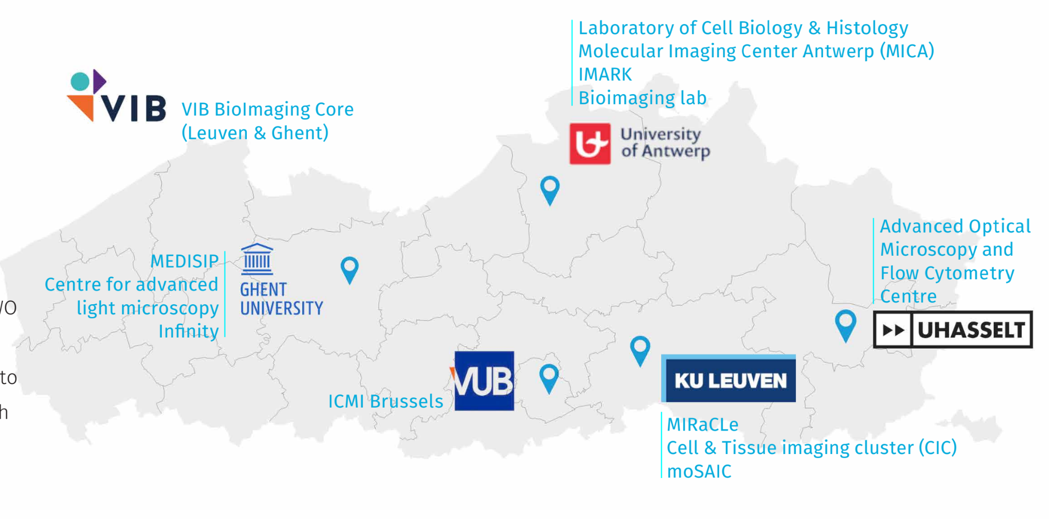
A consortium of state-of-the-art imaging facilities
Innovative services
Collaborative imaging
Technology development
(2023: Candidate Euro-BioImaging node)

Slide 3
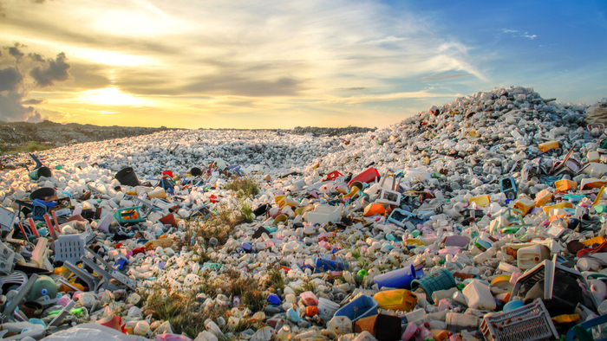
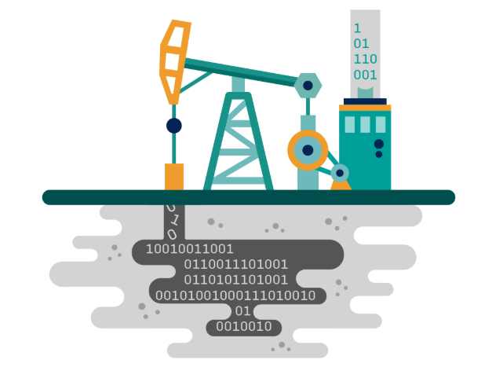


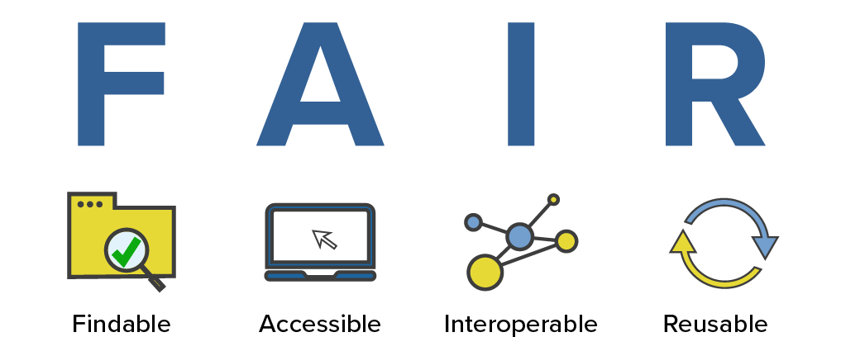
As imaging consortium we aim to provide the best image data
Data has a dual nature

Slide 4
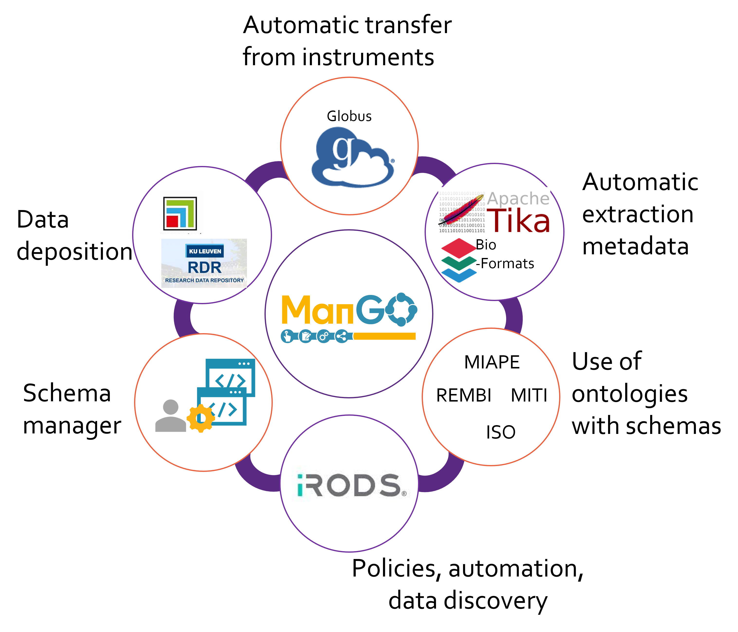
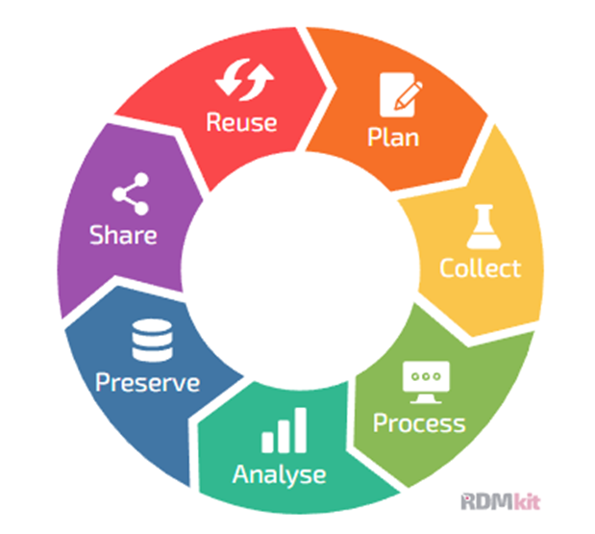
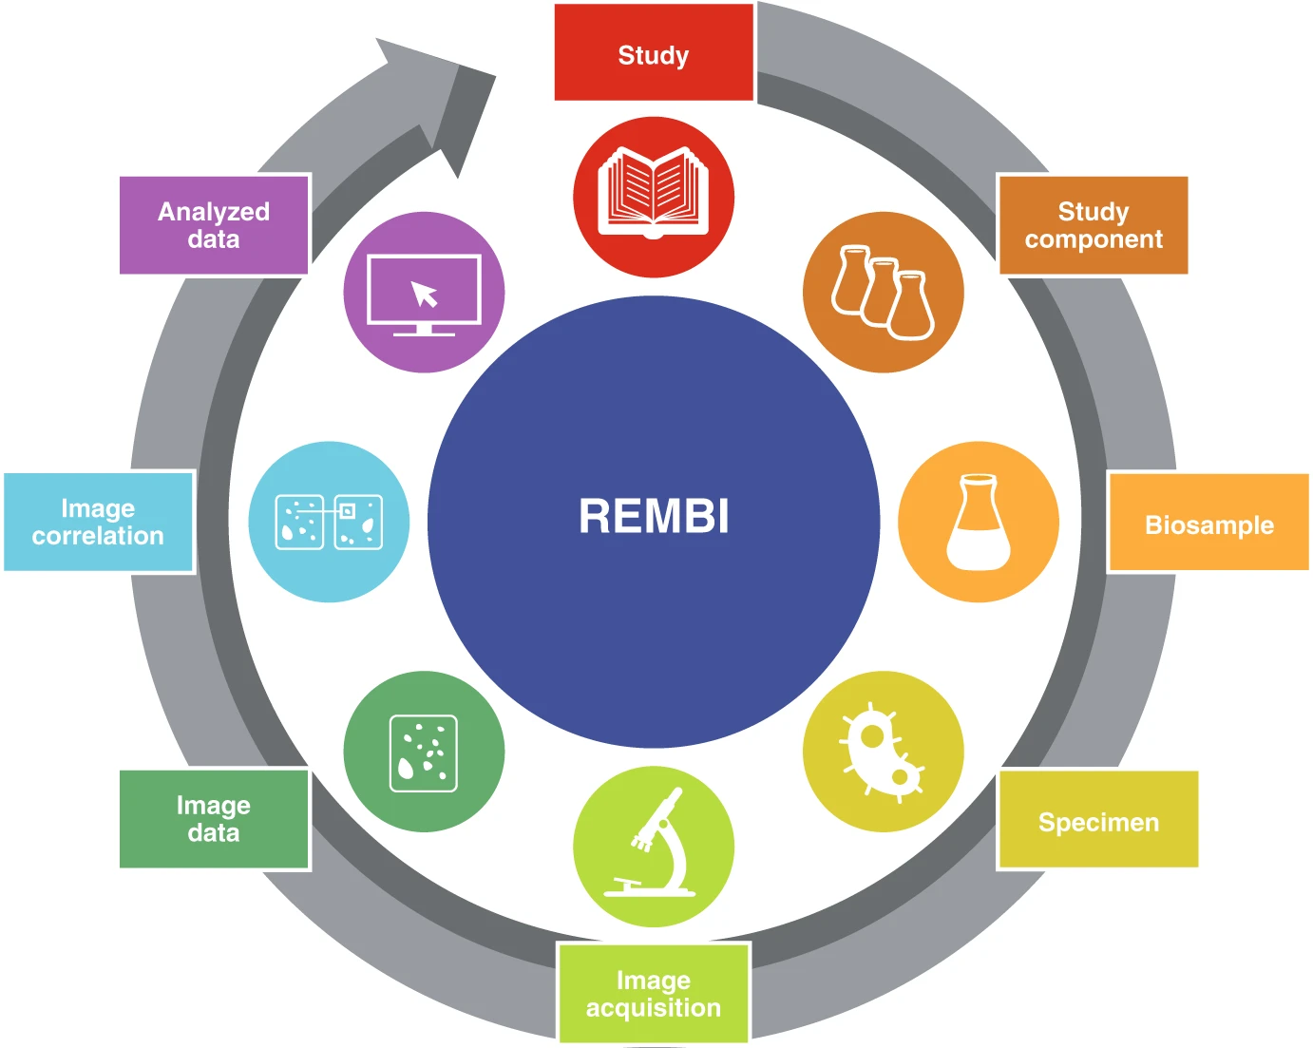
Research data management should combine efficiency and user-friendliness
Data-life-cycle

Slide 5
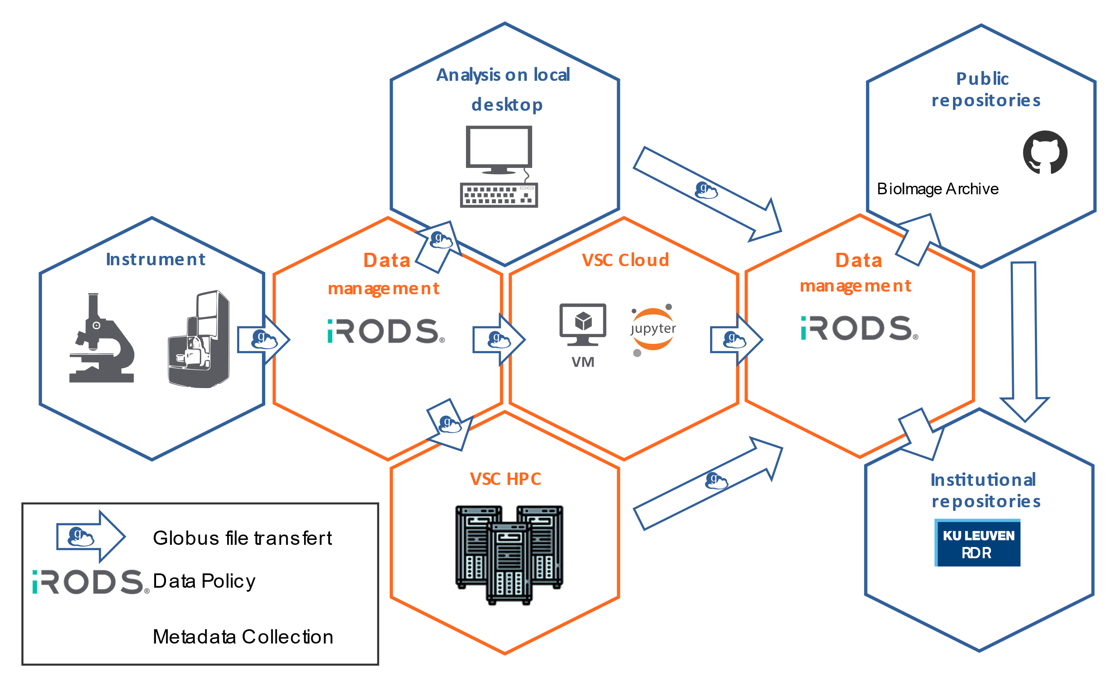




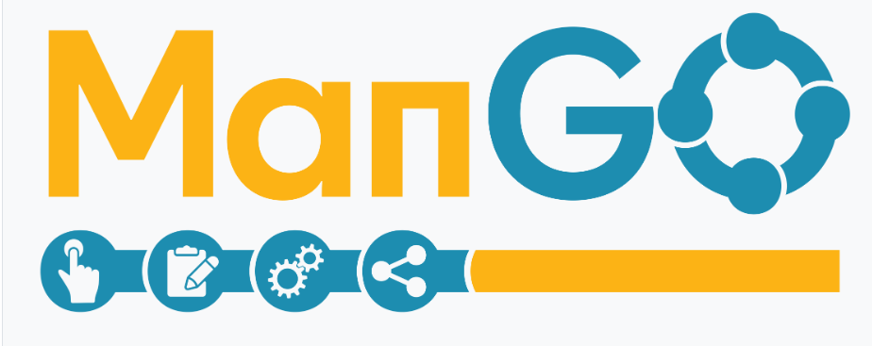



Collaboration and sharing data - computational resource is key

Slide 6
How does this scheme translate to a use case

Slide 7
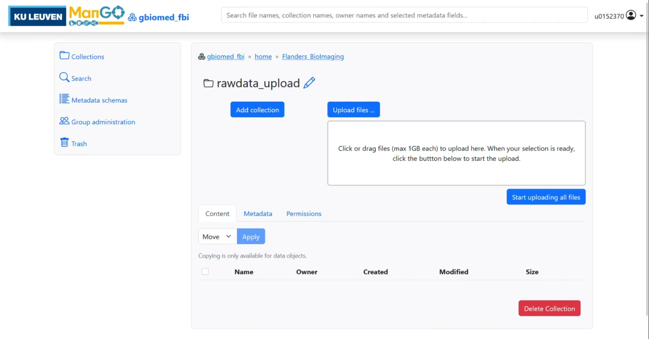
ManGO, file transfer

Slide 8
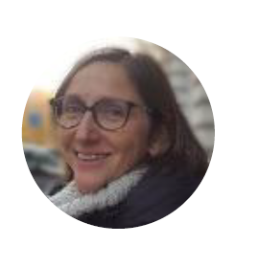
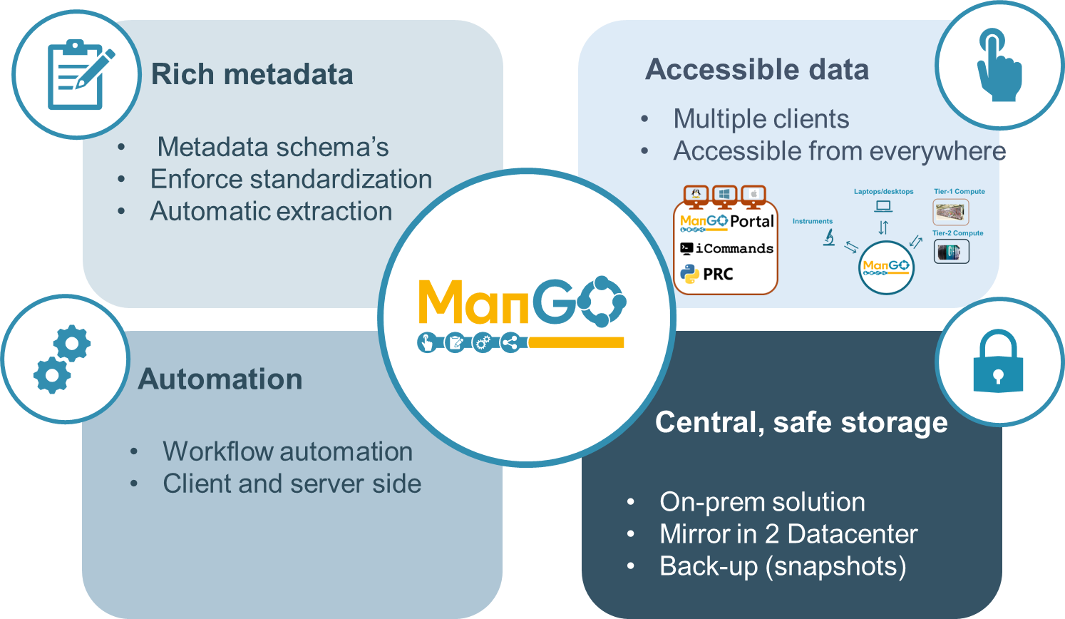

ManGO data management platform based in iRODS
Ingrid Barcena Roig
Integrated Rule-Oriented Data System (iRODS)
open source data management software
used by research, commercial, and governmental organizations worldwide.
https://www.kuleuven.be/rdm/en

Slide 9
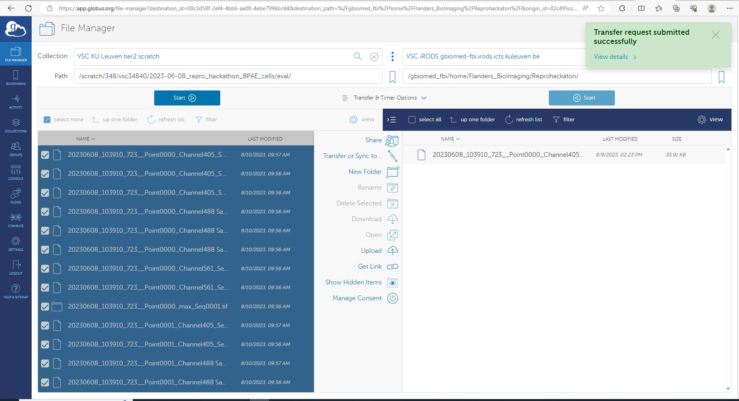
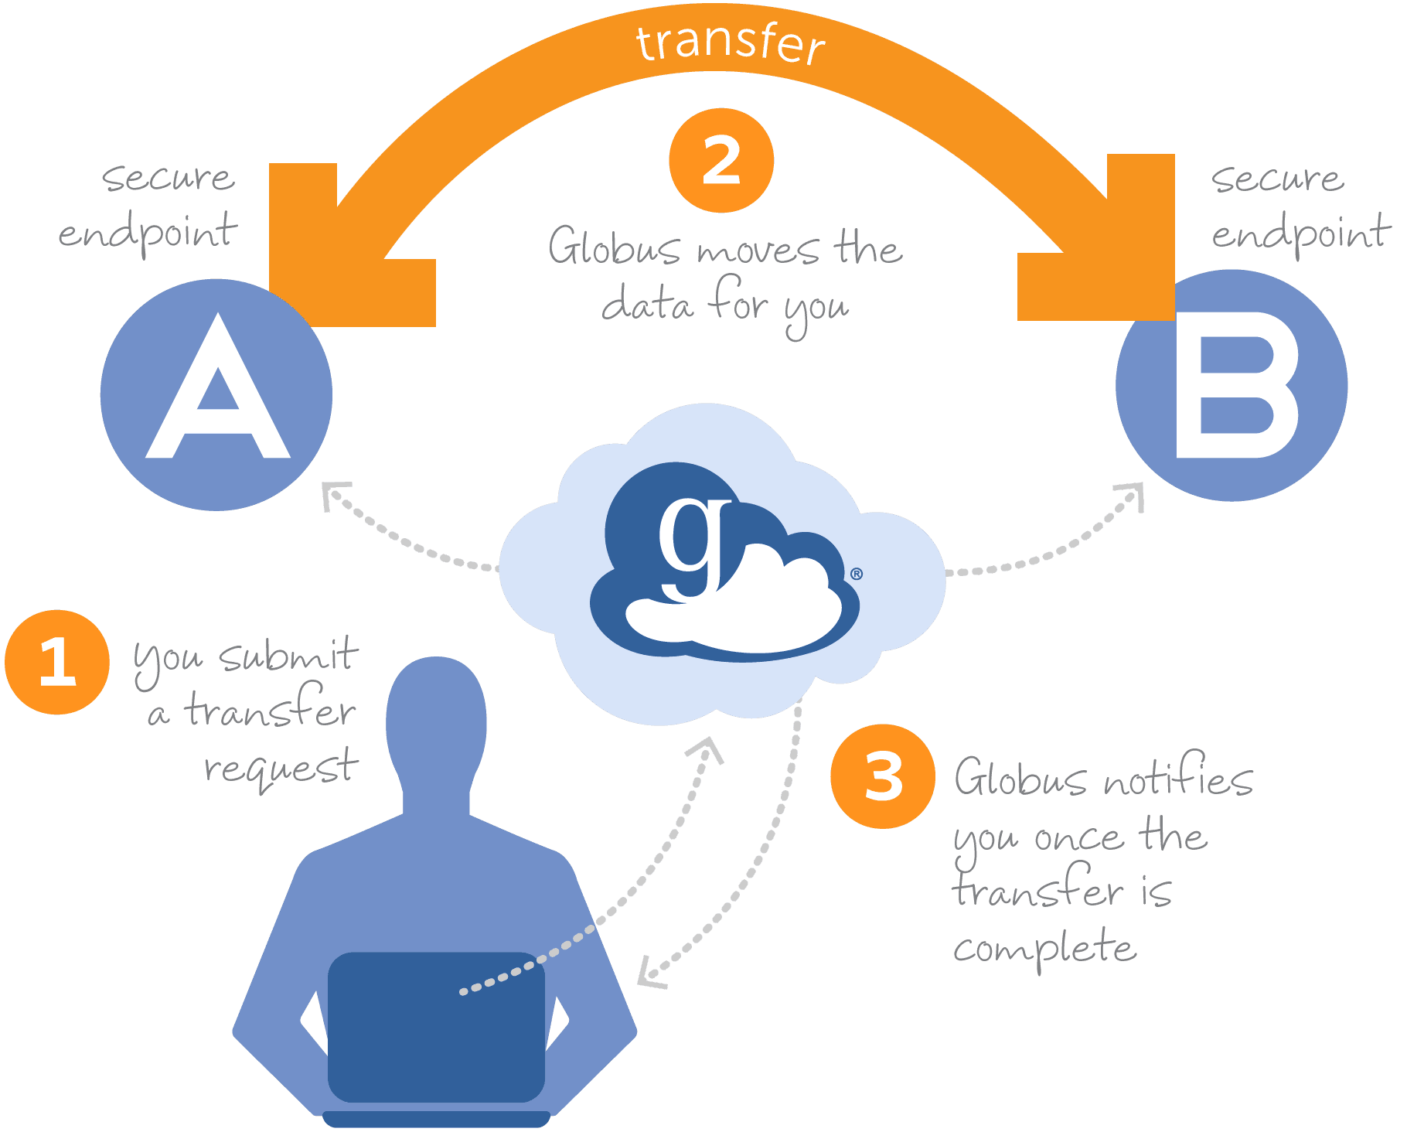

Alternative data transfer with Globus (files >5GB)
Globus provides a secure, unified interface to your research data. Use Globus to 'fire and forget' high-performance data transfers between systems within and across organizations

Slide 10
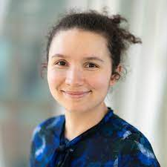
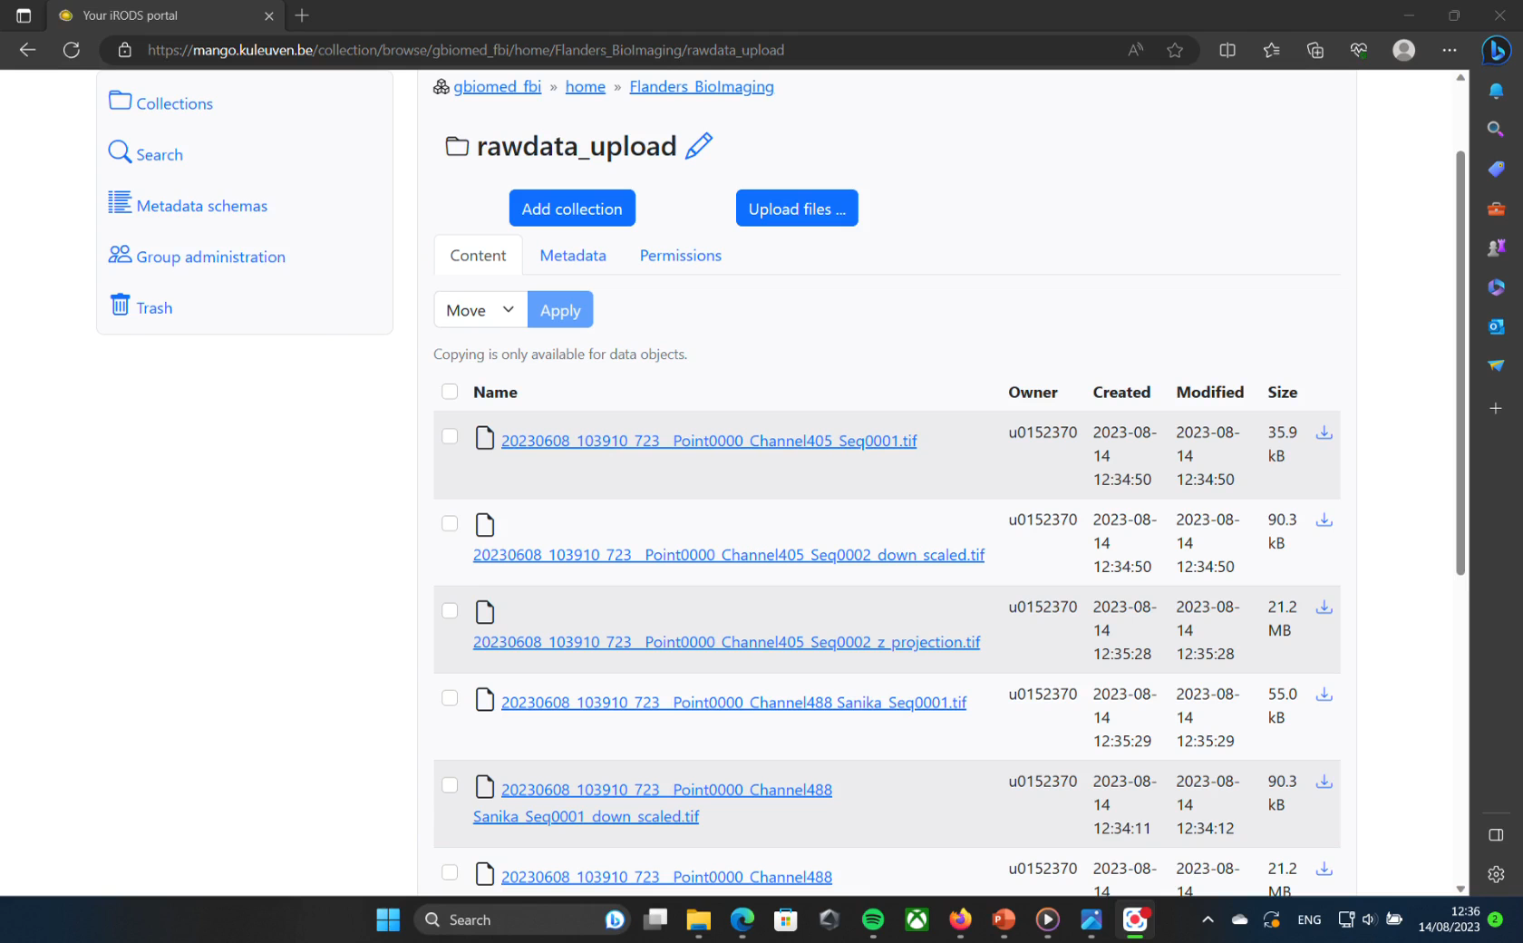
ManGO: data transfer, metadata schemes, automatic metadata extraction, search
Tatiana Woller
Tatiana Woller
Metadata schema
Specific metadata added
Extraction of the machine based metadata
  Extracted metadata are added to the database and can be searched for
Search function

Slide 11
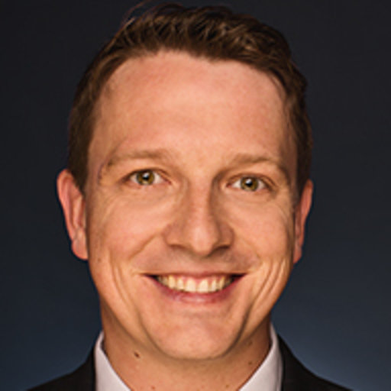
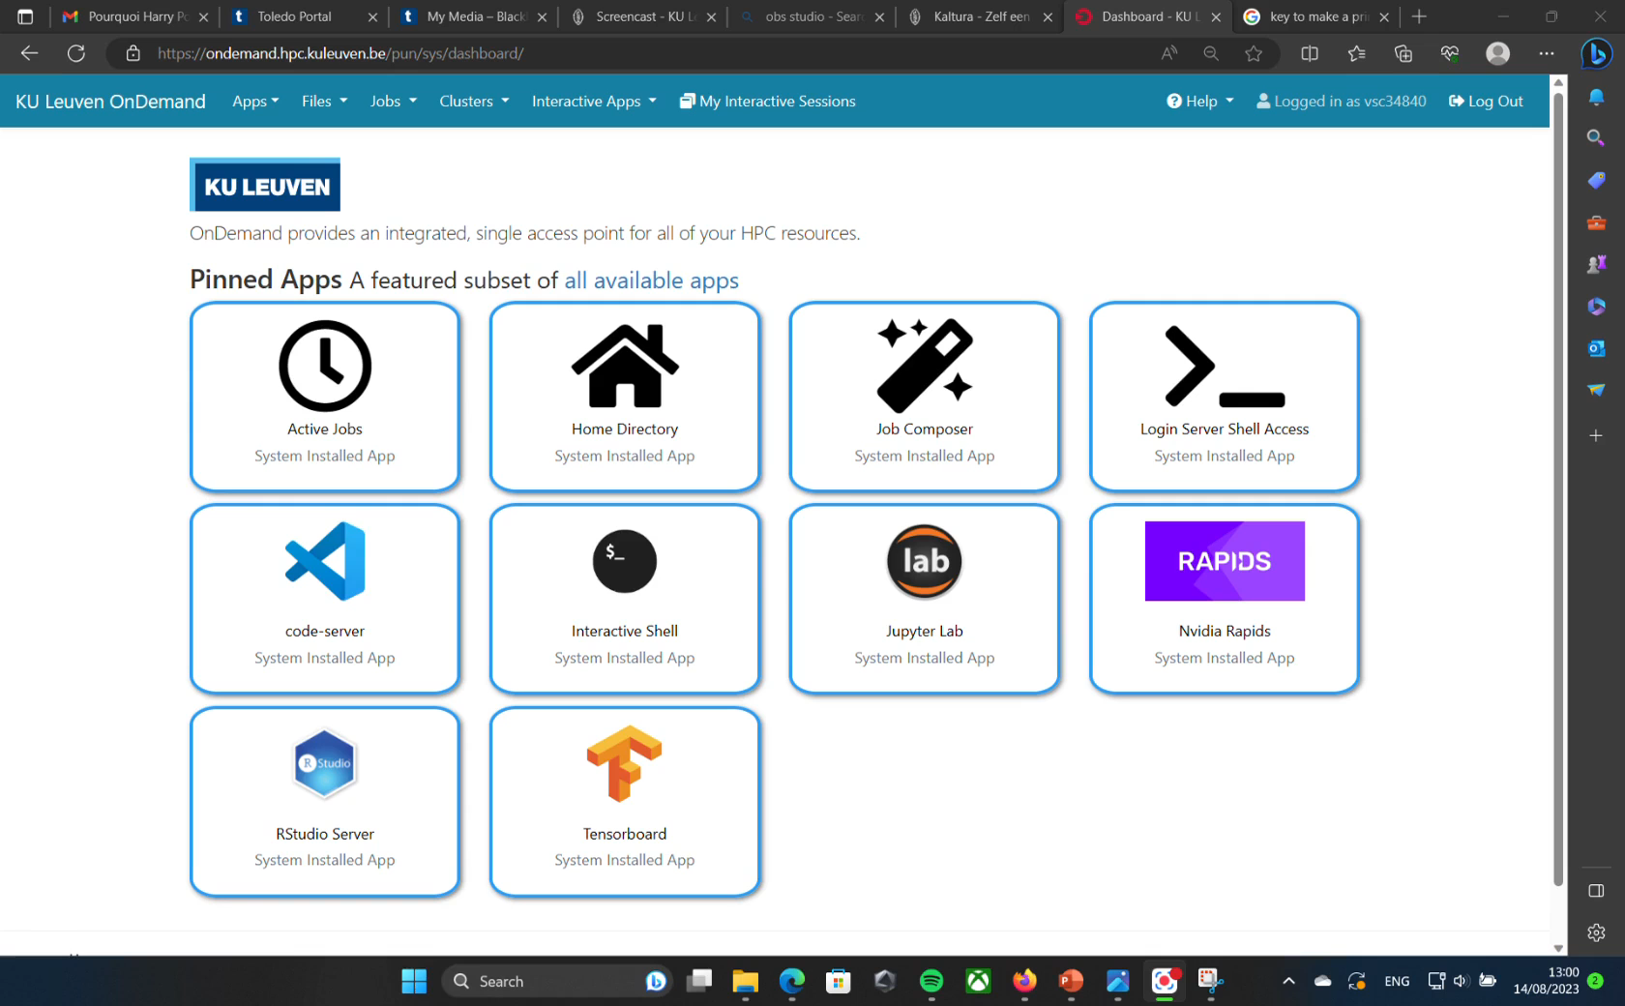
Analysis
Till Korten
& Tatiana
Running a Jupyter notebook on our cluster to analyze the uploaded data

Slide 12

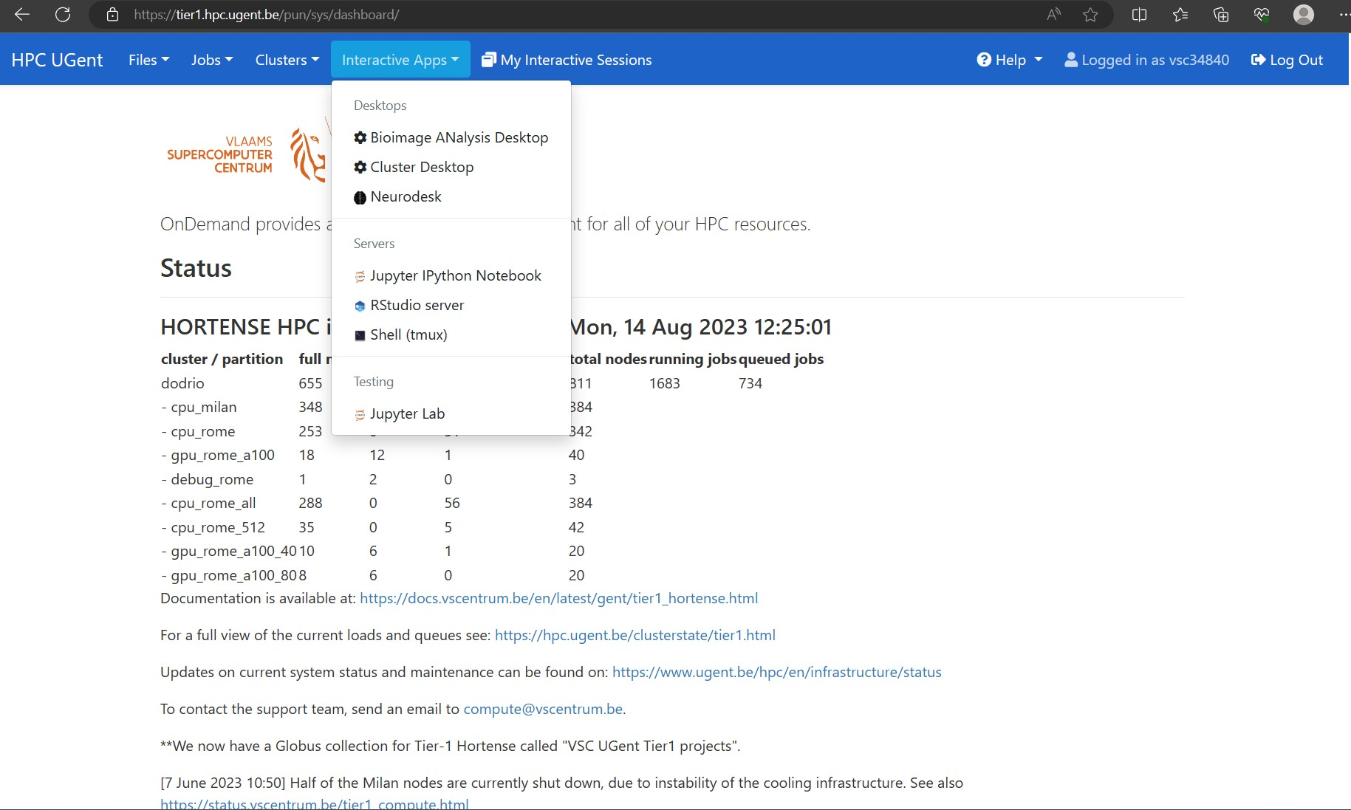
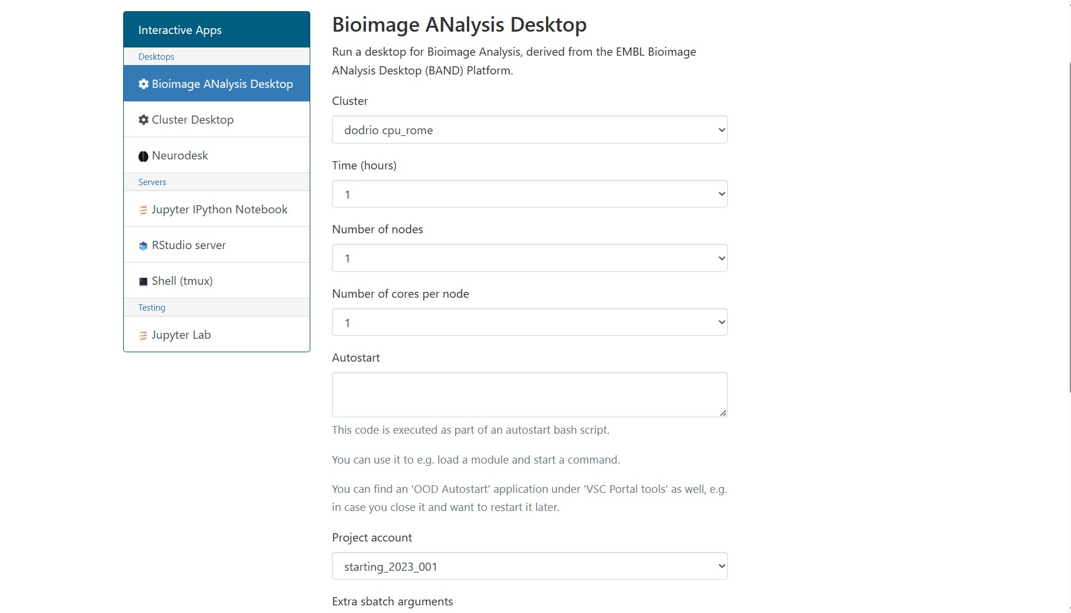
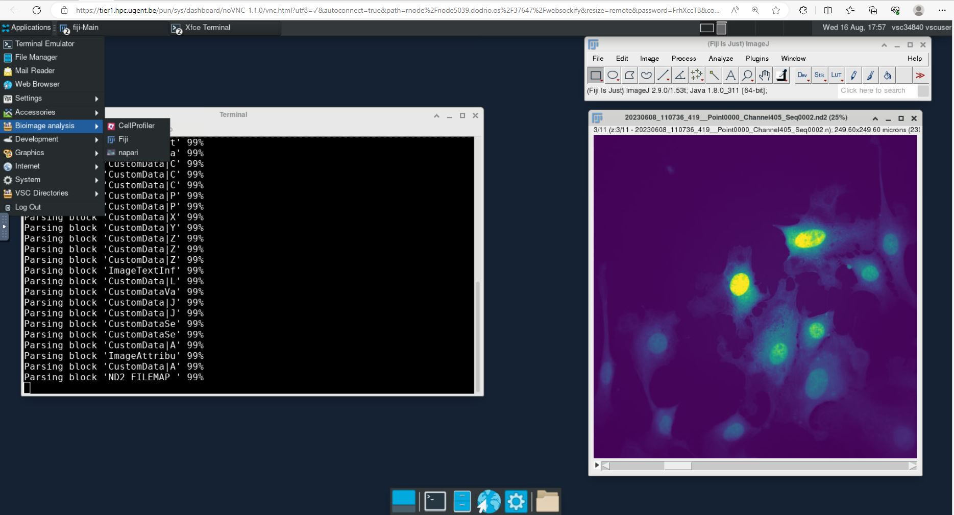
Different options are available from Open-OnDemand
Open-OnDemand emulating the BioImage analysis desktop BAND (EMBL)

Slide 13
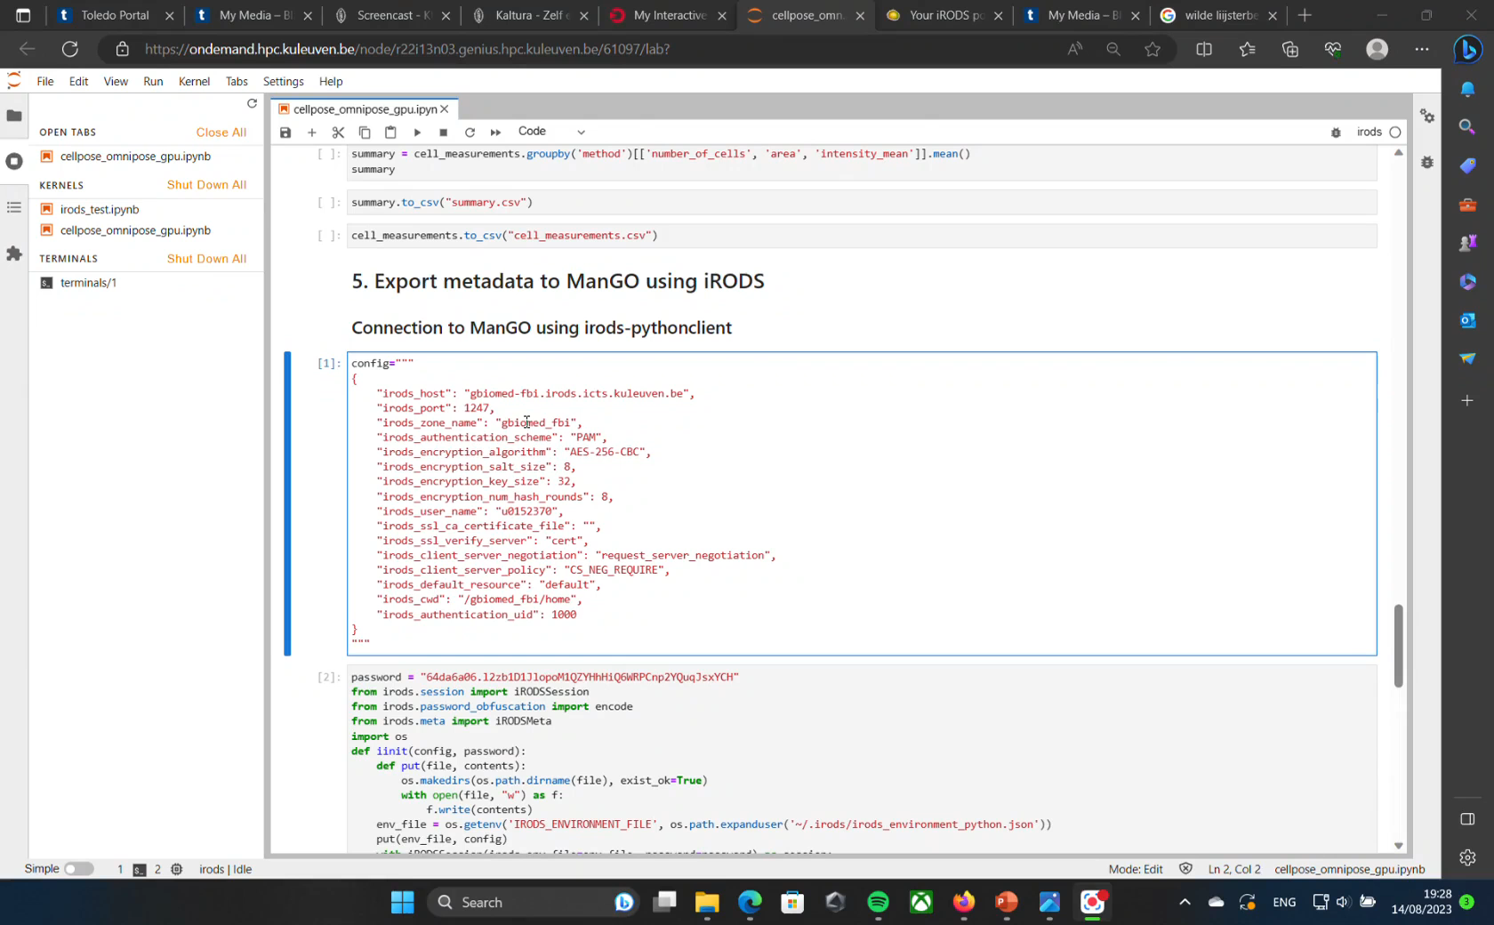
From the analysis to ManGO
Connecting to ManGO using a python irods-client.
Checking that the file to which we add metadata is present
Create a new folder, “analysis,” in ManGO and export the csv file together with some metadata.
On the ManGO platform checking whether the csv file is present and if it has the right metadata.

Slide 14
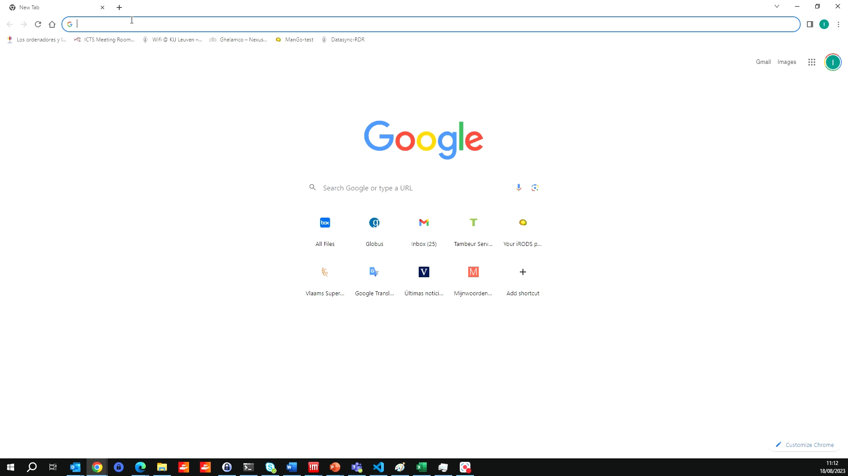
Publish to an institutional repository
Create a dataset on RDR (the KU Leuven data repository)
Use the RDR Integration tool to directly select and upload files to RDR

Slide 15
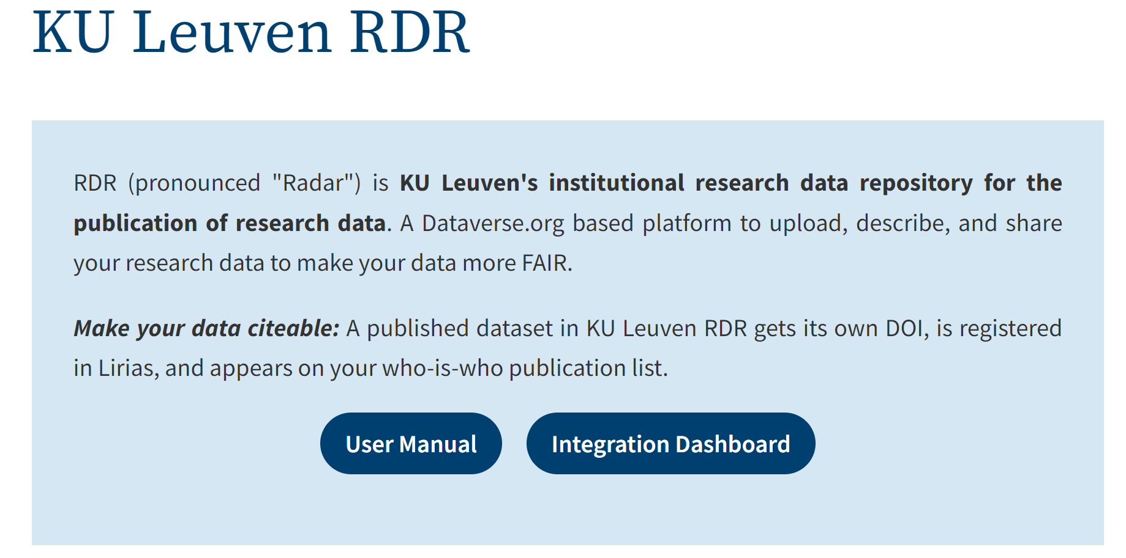
Local repository to publish research data
Working on scheme compatibility
For direct upload from ManGo to BioImage Archive

Slide 16
The data journey through connected ideas/tiles
FAIR by design
Upload
Search Annotate
Globus
ManGO
Metadata
Schemas
Rembi
etc.
ManGO
Analyze
BAND
Jupyter
Repository
BioImageArchive
RDR KU Leuven
Proof of concept
Open source
Complete workflow from acquisition to publishing
Flexible
Content agnostic
Future
From proof of concept to Multiple instances around the world
Using robust pieces that click together
Transfer
RDM
Analysis
Deposition

Slide 17
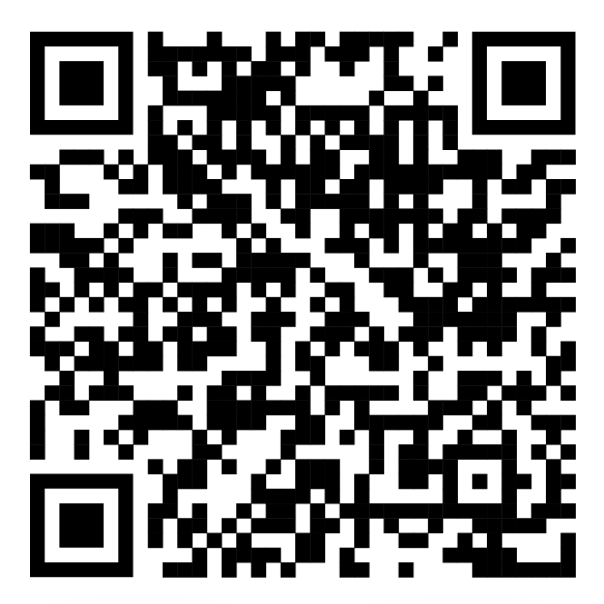
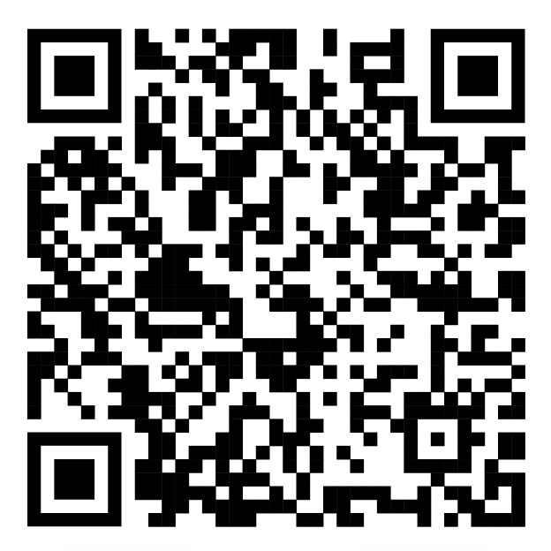
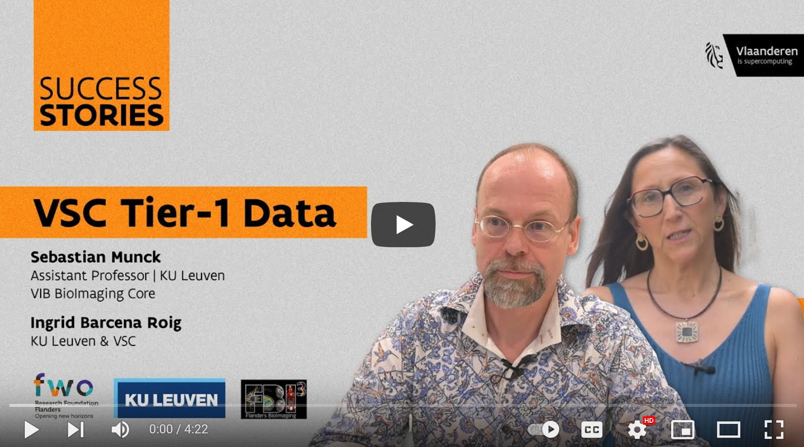
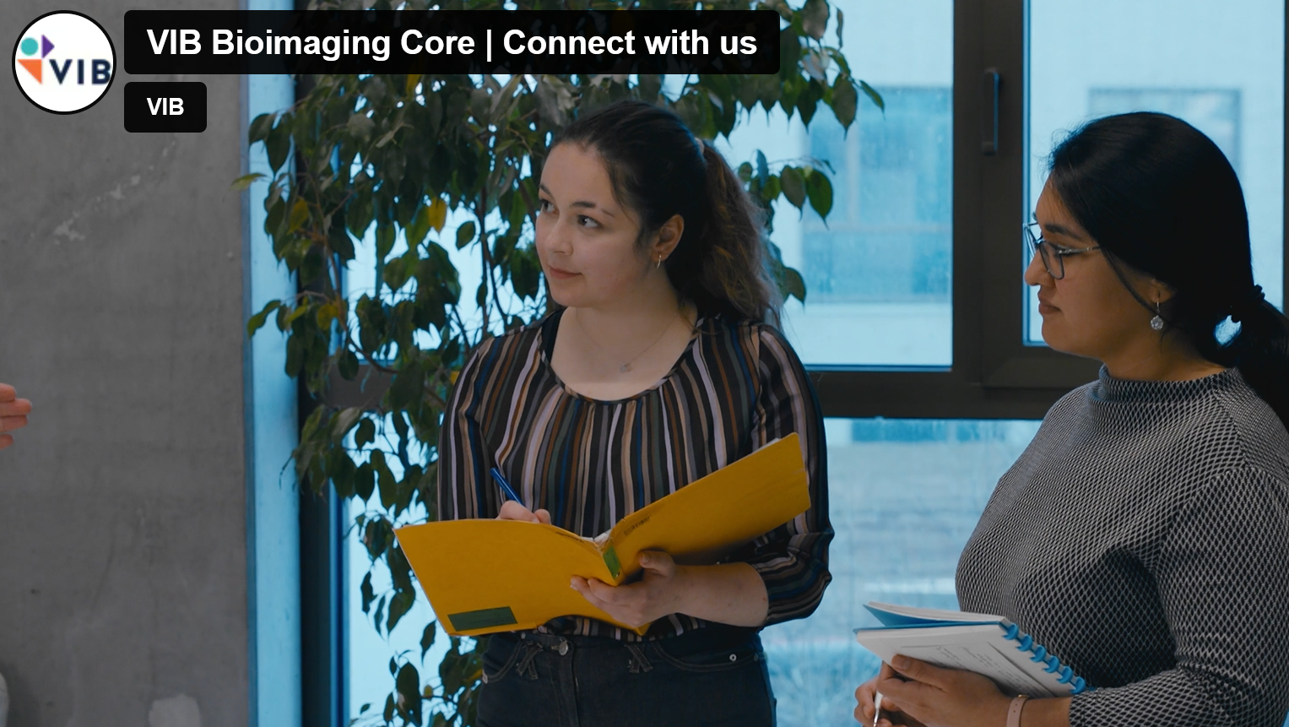
If you want to see more
https://www.youtube.com/watch?v=sHcybYzBGQE
https://vimeo.com/575708865/f3c88eb813
Success Stories | Tier-1 Data | Sebastian Munck & Ingrid Barcena Roig
VIB Bioimaging Core | Connect with us

Slide 18
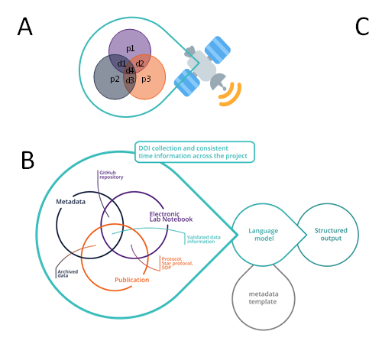
What is next:
Learning from deep space communication for reproducible BioImaging and data analysis
Inspired by the principle of using redundancy for error correction, we compare entries and consolidate metadata
The information taken from lab-notebooks, manuscripts and meta-data servers such as MnGO can be digested by ChatGPT and the differences visualized

Slide 19
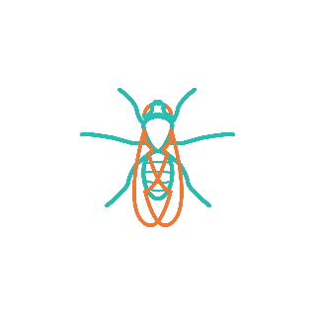













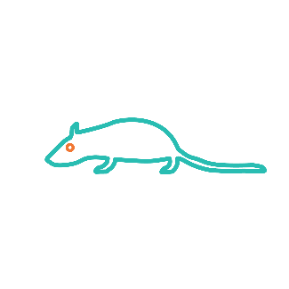


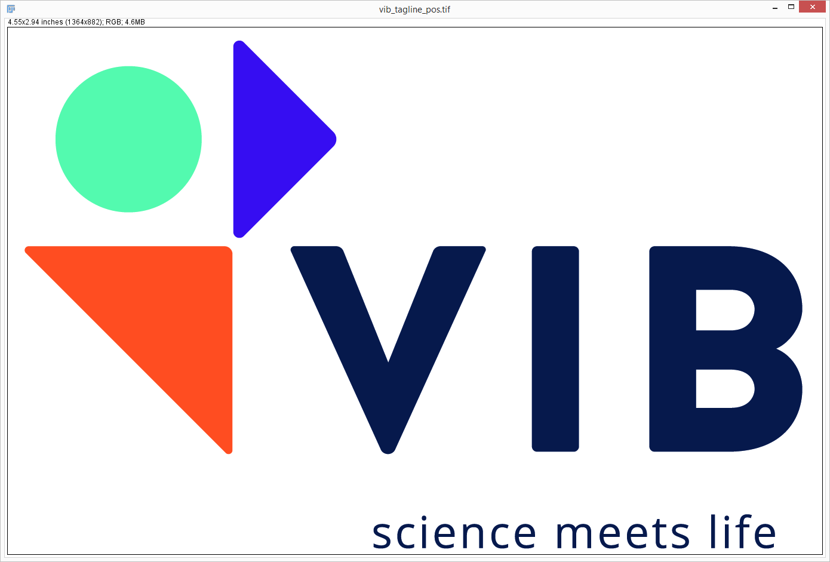






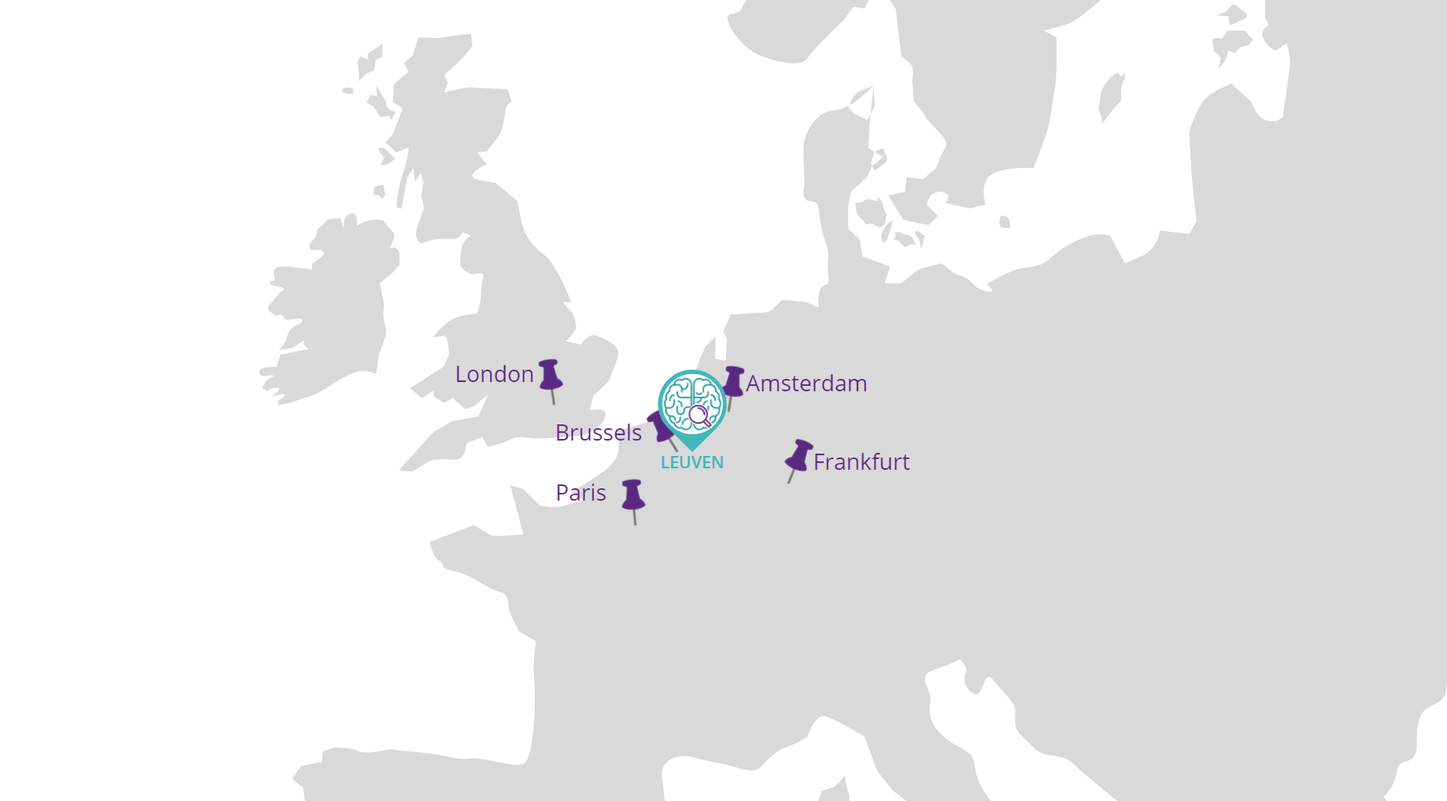


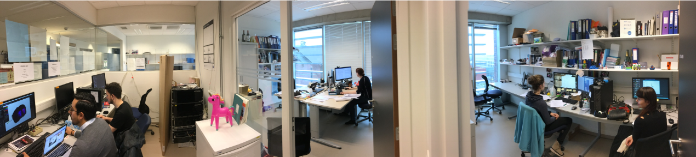
FLANDERS BIOIMAGING - LIAISE
Leading Imaging Application
Integrated Service Enablement find me @
8 Research Areas
Diverse Model Systems
Brain & Disease
Medical Biotechnology
Inflammation
Microbiology
Drosophila
Yeast
Mouse
Xenopus
Cancer Biology
Molecular Neurology
Plant Systems Biology
Structural Biology
Zebrafish
Rat
Maize
Arabidopsis
Supporting VIB in
Experimental design
Acquisition
& Analysis
Development
Equipment
Users
Thanks to:
All labs and users
VIB Bio Imaging Core Facility
Benjamin Pavie
Nicolas Peredo
Natalia Gunko
Pieter Baatsen
Katlijn Vints
Abril Escamilla Ayala
Nikky Corthout
Axelle Kerstens
Hélène Roberge
VIB Technology Training
Alex Botzki
Tatiana Woller
TU Dresden
Till Korten
Robert Haase
University of Antwerp
Winnok De Vos
Marlies Verschuuren
Tim Van De Looverbosch
KU Leuven Nuclear medicine & molecular imaging
Koen Van Laere
Chris Cawthorne
VSC
Ingrid Barcena-Roig
Jan Ooghe
Mariana Montes
Organization
VIB-KU LEUVEN
CENTER FOR BRAIN
& DISEASE RESEARCH
cbd.vib.be
@BioImagingCore; @SebastianMunck
BELGIUM
most castles per km²
the word ‘spa’ originates here
541 days without government
lowest salary gap between man and women in EU
beer, fries, waffles and lysosomes

