Slide 1
Create Ansible content more efficiently by leveraging artificial intelligence
Frédéric Wautelet
University of Namur
Notes:
Hi everybody.
My name is Frédéric Wautelet.
I’m system engineer and I’m in charge of the management of the HPC infrastructure at the University of Namur.
Our HPC cluster is part of the CÉCI. The CÉCI is the equivalent of the VSC for the French-speaking part of Belgium.
I’m very pleased to present you an overview of Ansible Lightspeed.

Slide 2
Ansible LightSpeed
What is Ansible?
Free and open-source software.
Automates software deployment and configuration management.
Ensures consistency across systems.
Notes:
First, what is Ansible?
Ansible is a free, open-source configuration management and software automation project.
Its main objective is to configure IT resources in a reproducible way.
It's a configuration management tool used mainly in production environments like servers for initial configurations.
Ansible automates complex configurations, ensuring system consistency without manual intervention.

Slide 3
Ansible LightSpeed
Ansible features
Origin and Creator
Created by Michael DeHaan in 2012.
Acquired by RedHat in 2015 and later by IBM in 2018.
Versatility in HPC Clusters
Can be used to set up Linux or Windows workstations.
Can be used to configure identical user environments on several HPC clusters.
Simplicity and Efficiency
Simple to use.
Allow management of various IT resources (servers, networks, users, software, and security settings).
Idempotence
Ansible's modules are idempotent
Ansible ensure consistent results even with multiple executions.
Agentless & SSH-Based
No need to install agent on managed resources.
Requires only SSH connection and minimal Python installation.
Beyond Configuration Management
Now evolved to handle DevOps tasks.
Automate Continuous Integration (CI), Continuous Deployment (CD), and provisioning processes.
Notes:
This tool was created in two thousand and twelve (2012) and is now owned by IBM.
It’s quite easy to use and lets you manage IT resources, from workstations to servers.
On the server side, it only require SSH and Python installed.
As a HPC user, you can use it to configure your user environment on remote clusters.
Ansible is widely used for deployments and configuration.

Slide 4
Ansible installation
pip3 install ansible --user
Ansible LightSpeed
Debian based distro
$ sudo apt update
$ sudo apt -y upgrade
$ sudo apt install -y build-essential libssl-dev libffi-dev python3-dev python3-pip
$ pip3 install ansible --user
RedHat based distro
$ sudo yum install epel-release
$ sudo yum install python3-pip
$ sudo pip3 install -U pip –upgrade
$ pip3 install ansible --user
$ sudo apt update
$ sudo apt -y upgrade
$ sudo apt install -y build-essential libssl-dev libffi-dev python3-dev python3-pip
$ pip3 install ansible --user
Only available on Linux or MacOS.
Can be installed in user space.
Can be installed using Virtualenv.
$ sudo yum install epel-release
$ sudo yum install python3-pip
$ sudo pip3 install -U pip –upgrade
$ pip3 install ansible --user
Notes:
Ansible is only available on Linux and MacOS.
There are several ways to install it.
On this slides, you will find the standard installation procedure.
Here for Debian-based distribution like Ubuntu.
And the installation procedure on RedHat distribution like CentOS or Rocky Linux.
As you can see, the installation procedure is straightforward, requiring just a few commands.
Please note that you only need root access to install the needed packages.

Slide 5
Custom installation
Ansible LightSpeed
If you need a specific version or if you need to install multiple Ansible versions.
In a Python virtualenv.
Using pip.
Steps to install:
Create Python virtualenv
Install Ansible using pip
Check version
Exit virtualenv
Activate the virtualenv to use Ansible.
Notes:
You can also install it in a virtual environment.
This is useful if you don't have root access or if you want to install several versions of Ansible.
Installing multiple versions is very useful for testing your playbooks with the latest version but ensuring that your playbooks still work with the version you originally used.

Slide 6
Ansible Inventory
Ansible LightSpeed
List of managed hosts that Ansible configures.
Hosts can be grouped.
Use client ssh config.
Useful for ProxyJump.
Possibility of more complex setup.
Hosts in multiple groups.
parent/child relationships among groups.
Ranges of hosts.
…
Notes:
Once installed, you need to define the hosts you wish to manage with ansible.
This is called the inventory. It's the list of host names off the managed server.
In this case, it's the four CÉCI clusters.
Ansible uses ssh and relies on the standard ssh configuration.
So, for example, you can use options such as proxyjump to configure a server behind a firewall.
In addition to the use of ssh, Ansible allows more complex inventory configurations such as groups or relations.

Slide 7
Anatomy of an Ansible playbook
Ansible LightSpeed
Playbook
Play
Task
Playbooks are written in YAML format.
Play: Contains a list of tasks to be performed on the hosts.
Hosts: Specifies the target hosts or groups where tasks will be executed.
Tasks: the smallest unit of action you can automate. Use Ansible Modules.
Ansible modules are predefined scripts for specific tasks like file manipulation, package installation, or service management.
Task
Task
Task
Play
Notes:
Before playing with ansible, let's look at the anatomy of an ansible playbook.
A playbook is made up of one or more plays.
A play is a list of tasks applied to a host or group of hosts.
A task is the smallest unit of action you can automate.
For example, you may have a task for creating a directory, for installing a package, etc.

Slide 8
My first Ansible playbook
Ansible LightSpeed
“Set up” my homedir on several HPC clusters.
Example:
Create directory on remote
Copy local tree to remote
Can be much more complex…
Notes:
Let's write our first Ansible play.
For example, let’s configure my homedir on four HPC clusters.
For this very simple example, we use two Ansible modules: file and synchronize.
There is several thousand of module available with Ansible.
There is module for very basic operation like:
running a command remotely
install a package
download a file
etc.
But there is also modules for advanced setup like configuration of instance on private or public cloud like AWS, GCP, Digital Ocean…

Slide 9
Play my playbook
Ansible LightSpeed
Activate virtualenv
source ~/.venv/ansible/bin/activate
Run Ansible
ansible-playbook -i inventory.yml -l ceci_clusters playbook.yml
Notes:
Let’s see how it run.
First we activate the virtualenv for Ansible.
Then we run the ansible-playbook command.
This very simple playbook will create a directory on each remote cluster.
And then, he will copy a directory tree in it.

Slide 10
Idempotent play
Ansible LightSpeed
If I re-run this play, nothing will be changed.
Almost all Ansible modules are idempotent.
Notes:
Most modules in Ansible is idempotent.
This means that if you run a playbook with the same set of inputs, you should not expect it to make any changes on the system.

Slide 11
What is Ansible Lighspeed?
Ansible LightSpeed
VSCODE extension.
Use natural language processing.
Reads task description in plain English.
Generate Ansible code.
Require a GitHub account.
Notes:
Now that we've seen Ansible's capabilities, let's see what AI can do to improve our efficiency.
What is Ansible Lightspeed?
Ansible Lighspeed, for the moment, is just a vscode extension.
It uses natural language processing to convert a task description written in English into an Ansible task.

Slide 12
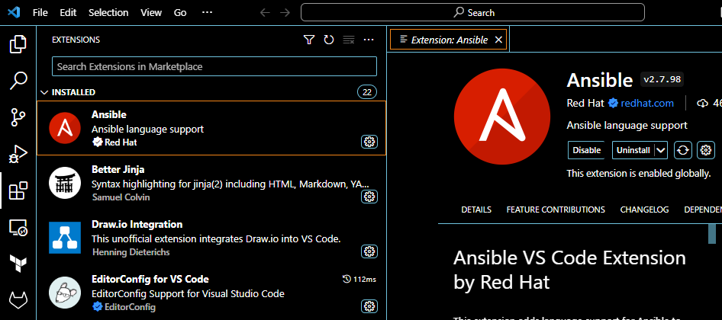
Step 1: install VS Code extension
Ansible LightSpeed
2
Search Ansible on the marketplace.
Install the official extension by Red Hat.
1
Notes:
Ansible LightSpeed is installed with the official Ansible Vscode extension.
To install the Ansible extension, simply search for Ansible on the vscode marketplace.

Slide 13
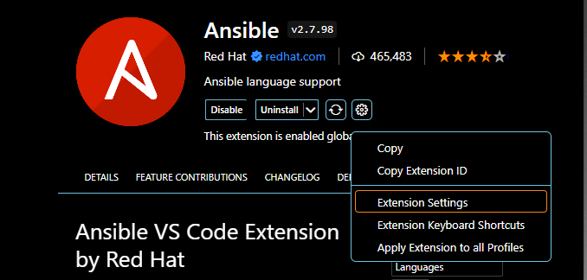
Step 2: enable LightSpeed
Ansible LightSpeed
1
Go to Ansible extension settings
Notes:
Then go to the Ansible extension settings.

Slide 14
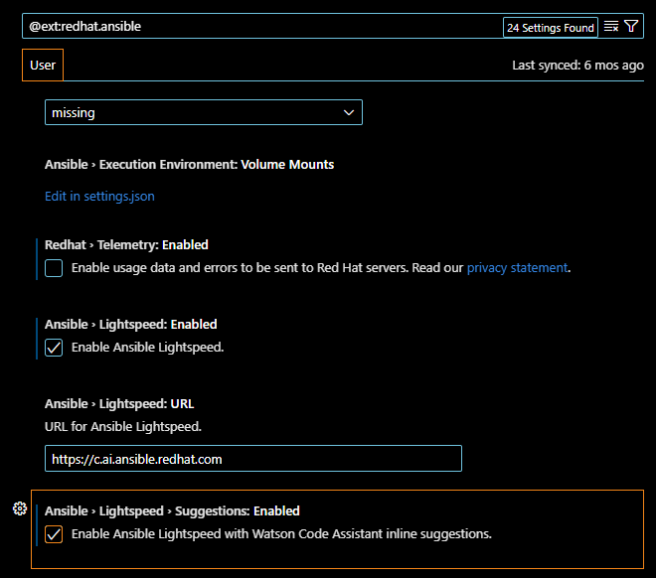
Step 2: enable LightSpeed
Ansible LightSpeed
Go to Ansible extension settings
Enable LightSpeed
2
2
Notes:
By default, Lightspeed is disabled.
You will need to enable it by checking these checkboxes.

Slide 15
Step 3: Connect VS Code with Lightspeed.
Ansible LightSpeed
Navigate to the Ansible icon on the left-hand side
Then click Connect.
2
1
Notes:
To use LightSpeed, you will need to connect to your GitHub account.
Click Connect.

Slide 16
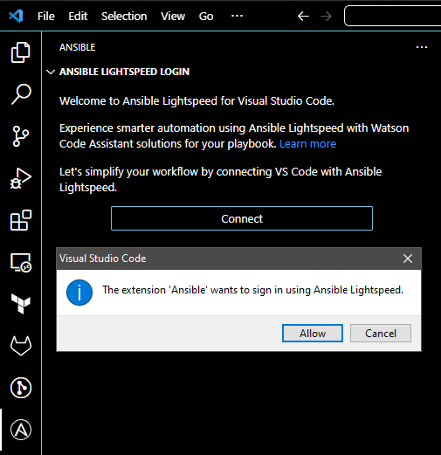
Step 3: Connect VS Code with Lightspeed.
Ansible LightSpeed
Navigate to the Ansible icon on the left-hand side
Then click Connect.
Click Allow
3
Notes:
Allow the extension to sign in.

Slide 17
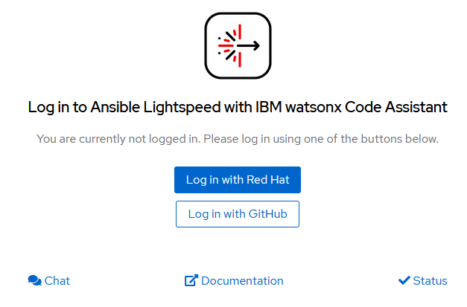
Step 3: Connect VS Code with Lightspeed.
Ansible LightSpeed
Navigate to the Ansible icon on the left-hand side
Then click Connect.
Click Allow
Log in using your GitHub account
Notes:
Next, log into your GitHub account.

Slide 18
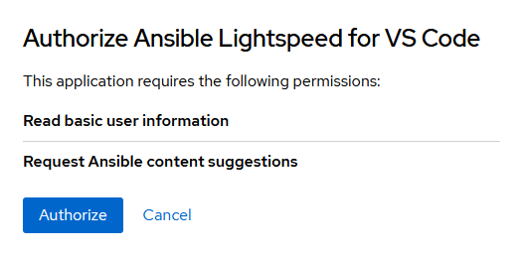
Step 3: Connect VS Code with Lightspeed.
Ansible LightSpeed
Navigate to the Ansible icon on the left-hand side
Then click Connect.
Click Allow
Log in using your GitHub account
Authorize to give it permission.
Notes:
Authorize Ansible Lightspeed for VSCode .
And voilà, your VSCode is now configured to use lightspeed.

Slide 19
Let’s generate!
Ansible LightSpeed
Create a YAML file.
Define the task only by describing it in the name section.
Put your cursor at the end of the task description, then press Enter.
Wait for Lightspeed to generate and a preview of the suggestion will appear.
Press TAB if you’re fine with the generated task and turn it into active text.
Notes:
Here's a small example of how Lightspeed can be used.
As you can see, once configured, it's very easy to generate ansible code.
You type a task description in English and Lightspeed suggests a code for your task.
All you have to do is accept it by pressing tab.

Slide 20
Ansible LightSpeed
Conclusions
Other AI tools that are not specifically designed to generate Ansible code struggle to generate code that respects Ansible best practices.
As users continue to use Ansible Lightspeed, model recommendations will continually improve based on the additional data available for artificial intelligence models.
The tool is promising and offers a significant productivity boost. He saves time by automating repetitive tasks.
Ansible Lightspeed is still available free of charge to all Ansible users.
Notes:
Like many AI-based tools today, Ansible Lightspeed is a game-changer in IT automation.
Unlike other AI tools, it excels at generating Ansible code that respects best practices, saving valuable time by automating repetitive tasks.
As more users use it, its recommendations improve, guaranteeing clever, context-sensitive automation.
And the best part? Unlike other tools such as Copilot, it's free for all Ansible users.

Slide 21
ChatGPT-for-HPC
Jeff Geerling’s
Ansible Content
Ansible Lightspeed with IBM
watsonx Code Assistant

