Slide 1

VSC Users day
Academic use case – chemistry
Notes:
Good day everyone, my name is Mats Denayer. I am a 3rd year PhD student of the ALGC research group at the VUB under the supervision of Frank De Proft. ALGC stands for “algemene chemie”, meaning general chemistry in Dutch. This name mainly refers to the group’s educational activities for the broad first year students in sciences, although its research activities are mainly focussed around physical and quantum chemistry. Within the context of an academic use case I will present here today an overview of my research activities and the use of VSC infrastructure that came hand in hand with it.

Slide 2




Education & VSC use history
2013
2016
2019
2021
Start education in Chemistry at Vrije Universiteit Brussel
Bachelor’s thesis at the ALGC research group
Use of Tier-2 supercomputer ‘Hydra’
Master’s thesis + start PhD thesis at the ALGC research group
Use of Tier-2 supercomputer ‘Hydra’ and Tier-1 supercomputer ‘Breniac’
Use of Tier-1 supercomputer ‘Hortense’
Notes:
I will start this presentation by giving a brief overview of my learning path up to this day, and the use of HPC infrastructures that came hand in hand with it. In 2013, I started the academic Bachelor of science in chemistry program at the VUB. As part of one of the requirements to obtain this degree, I conducted my Bachelor’s thesis at the ALGC research group, under the supervision of Freija Devleeschouwer, three years later. During this study, I analysed and characterized chalcogen bonds, a type of non-covalent interaction which can be considered as an oxygen group alternative to its better known cousin, the hydogen bond. For this work, i employed the local Tier-2 cluster called “Hydra” to carry out the heavy calculations required for said characterization. Although this was my first experience in using a HPC infrastructure, let alone using Linux, the computational research came to a good end as I learned to find my way across the supercomputer world under the guidance of my supervisor, as well as he HPC and Linux training sessions organized by the Hydra support team! In 2019, I obtained my Master’s degree in chemistry after writing a Master’s thesis on inverse design of redox active radicals that can be used in so-called organic radical batteries. The inverse design strategy employed in this study inherently required a lot of calculations which were ran on the tier-2 system Hydra and the Tier-1 computer Breniac, simultaneously. Finally, in oktober later that year, I started as a PhD candidate at the ALGC research group under the supervision of Frank De Proft. As part of my PhD research, we took part in the newest supercomputer Hortense’s pilot phase from November last years until March, right before its official launch. More details on my PhD thesis, and the use Hortense will follow in the coming slides.

Slide 3

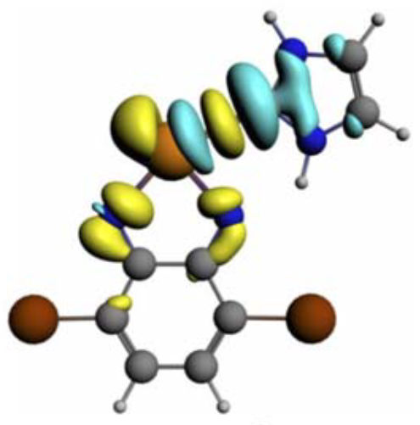
Education & VSC use history
Study chalcogen bond characteristics
2013
2016
2019
2021
Start education in Chemistry at Vrije Universiteit Brussel
Bachelor’s thesis at the ALGC research group
Use of Tier-2 supercomputer ‘Hydra’
Master’s thesis + start PhD thesis at the ALGC research group
Use of Tier-2 supercomputer ‘Hydra’ and Tier-1 supercomputer ‘Breniac’
Use of Tier-1 supercomputer ‘Hortense’
Notes:
I will start this presentation by giving a brief overview of my learning path up to this day. In 2013, I started the academic Bachelor of science in chemistry program at the VUB. As part of one of the requirements to obtain this degree, I conducted my Bachelor’s thesis at the ALGC research group, under the supervision of Freija Devleeschouwer, three years later. During this study, I analysed and characterized chalcogen bonds, a type of non-covalent interaction which can be considered as an oxygen group alternative to its better known cousin, the hydogen bond. For this work, i employed the local Tier-2 cluster called “Hydra” to carry out the heavy calculations required for said characterization. Although this was my first experience in using a HPC infrastructure, let alone using Linux, the computational research came to a good end as I learned to find my way across the supercomputer world under the guidance of my supervisor, as well as he HPC and Linux training sessions organized by the Hydra support team! In 2019, I obtained my Master’s degree in chemistry after writing a Master’s thesis on inverse design of redox active radicals that can be used in so-called organic radical batteries. The inverse design strategy employed in this study inherently required a lot of calculations which were ran on the tier-2 system Hydra and the Tier-1 computer Breniac, simultaneously. Finally, in oktober later that year, I started as a PhD candidate at the ALGC research group under the supervision of Frank De Proft. As part of my PhD research, we took part in the newest supercomputer Hortense’s pilot phase from November last years until March, right before its official launch. More details on my PhD thesis, and the use Hortense will follow in the coming slides.

Slide 4

Education & VSC use history
Study redox active radicals
2013
2016
2019
2021
Start education in Chemistry at Vrije Universiteit Brussel
Bachelor’s thesis at the ALGC research group
Use of Tier-2 supercomputer ‘Hydra’
Master’s thesis + start PhD thesis at the ALGC research group
Use of Tier-2 supercomputer ‘Hydra’ and Tier-1 supercomputer ‘Breniac’
Use of Tier-1 supercomputer ‘Hortense’
Notes:
I will start this presentation by giving a brief overview of my learning path up to this day. In 2013, I started the academic Bachelor of science in chemistry program at the VUB. As part of one of the requirements to obtain this degree, I conducted my Bachelor’s thesis at the ALGC research group, under the supervision of Freija Devleeschouwer, three years later. During this study, I analysed and characterized chalcogen bonds, a type of non-covalent interaction which can be considered as an oxygen group alternative to its better known cousin, the hydogen bond. For this work, i employed the local Tier-2 cluster called “Hydra” to carry out the heavy calculations required for said characterization. Although this was my first experience in using a HPC infrastructure, let alone using Linux, the computational research came to a good end as I learned to find my way across the supercomputer world under the guidance of my supervisor, as well as he HPC and Linux training sessions organized by the Hydra support team! In 2019, I obtained my Master’s degree in chemistry after writing a Master’s thesis on inverse design of redox active radicals that can be used in so-called organic radical batteries. The inverse design strategy employed in this study inherently required a lot of calculations which were ran on the tier-2 system Hydra and the Tier-1 computer Breniac, simultaneously. Finally, in oktober later that year, I started as a PhD candidate at the ALGC research group under the supervision of Frank De Proft. As part of my PhD research, we took part in the newest supercomputer Hortense’s pilot phase from November last years until March, right before its official launch. More details on my PhD thesis, and the use Hortense will follow in the coming slides.

Slide 5


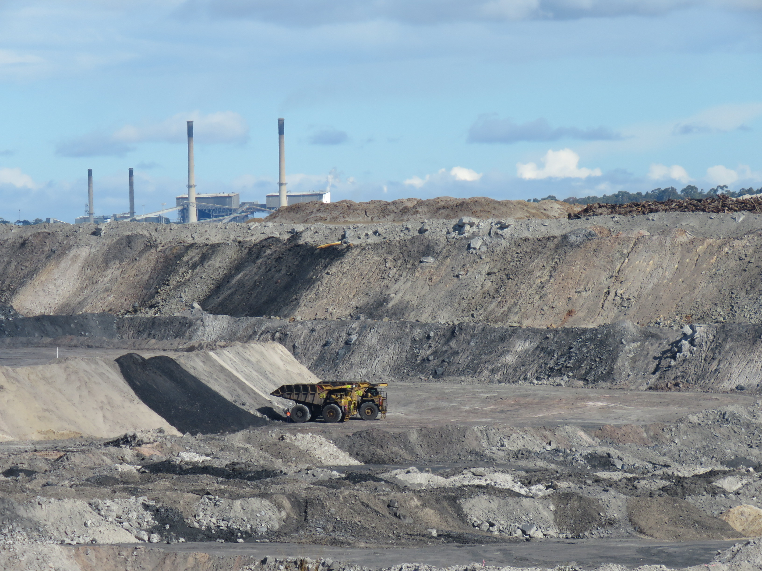
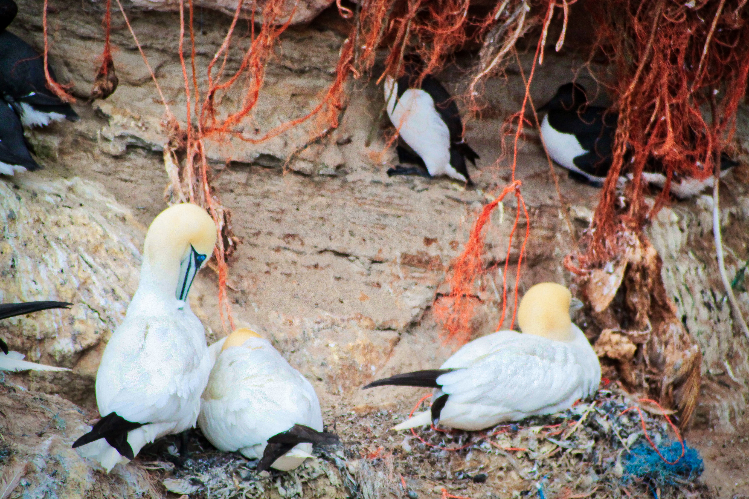




PhD thesis - context
Environmental concern on plastic waste
Single use plastics
Circular economy
Limit plastic waste accumulation
Reduce exploitation of fossil resources
Development of adequate recycling processes
Down-cycling
Hazardous solvents
Notes:
Driven by the environmental concern on polymer (mis)use, the European Union desires a transition towards a circular economy, limiting the accumulation of plastic waste on one hand, and reducing the exploitation of fossil resources on the other. Currently, many polymer materials are designed prioritizing functionality without bearing in mind the end-of-life of the product. Hereto, recycling processes must be developed in which the original polymer can easily be recovered without the occurrence of down-cycling, while precluding the use of hazardous (anti)solvents. My PhD research aims to aid in this transition by finding adequate solvents.

Slide 6

PhD thesis - workplan
Computational protocol for predicting suitable (anti)solvents for polymers with fundamental understanding of governing solvation interactions
Explore unknown polymer/solvent combinations
Define novel, insightful solubility descriptors
Assess validity of NCI quantification on benchmark system
Multiple chain simulations
Notes:
As an alternative to classical approaches such as Hansen solubility parameters, this PhD research aims to develop a computational protocol for fast and accurate prediction of the solubility behaviour of polymers in any given solvent using molecular dynamics (MD) simulations, while providing a fundamental understanding of the governing polymer-solvent and, if applicable, additive-solvent interactions via a Non-Covalent Interaction analysis, or NCI for short. In order to keep the protocol as simple and straightforward as possible, a single polymer chain is simulated modelling the corresponding polymer. We took the so-called integrated NCI density as the fundamental quantity to describe the solubility behaviour of the macromolecule. This quantity correlates with the non-covalent interaction strength and allows the identification of different interaction types such as vdw interactions and hydrogen bonding. The validity of calculating the integrated NCI density on a single solvated polymer chain as solubility assessment for the derived polymer was tested against experimental benchmark systems of polyethylene in anisole and methanol. In a next step, novel and insightful NCI density based solubility descriptors were defined for which the easy interpretation and computation opens up the possibility of fast, reliable and insightful high-throughput screening of different (anti)solvent and solute combinations. Finally, these descriptors are employed on a high-throuhput scale for unexplored polymer/solvent combinations up till now. In parallel, an alternative route to assess polymer solubility is explored in which a small bundle of entangled polymer chains, representing a fraction of an amorphous polymer phase, is immersed in solvent and the degree of spontaneous dissociation is evaluated.

Slide 7

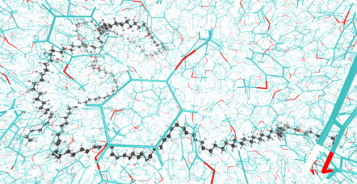
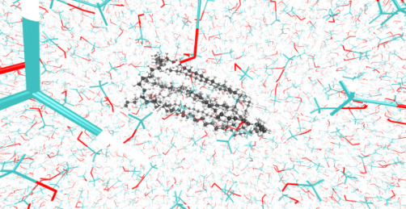
NCI quantification assessment
Qualitative agreement between I_{NCI} and known solubility descriptors such as solvation free energy (E_{solv}) and solvent accessible surface area (SASA)*
“integrated NCI density” (I_{NCI}) as a quantitave measure for non-covalent interaction strength
with I_{NCI} = I_{NCI,attr} + I_{NCI,vdw} + I_{NCI,rep}
Anisole
Methanol
Notes:
As a validation of our methodology, the integrated NCI density was calculated for PE in anisole, a known good solvent, and methanol, a known bad solvent. It was calculated for different chain lengths and compared to well established solubility descriptors such as the solvation free energy and the solvent accessible surface area. It can be seen on the charts that there is a strong qualitative agreement between the integrated NCI density and the solvation free energy both in solvent (anisole) and in antisolvent (methanol). Moreover, Assessing the conformation of the solvated macromolecule allows identifying an antisolvent for the derived polymer if the solute folds on itself, or a good solvent in case the polymer chain extends. The advantage of using the integrated NCI density as solubility descriptor over the SASA or solvation free energy is that it contains the combined information on the energetics as well as the conformation of the system. Moreover, it can distinguish strong non-covalent interactions with some covalent character, like hydrogen bonding, from weaker van der Waals type interactions, such as dispersion, and destabilizing (repulsive) interactions.

Slide 8

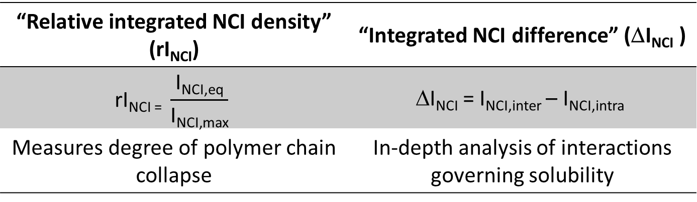
Defining novel solubility descriptors
“Relative integrated NCI density” (rI_{NCI}) | “Integrated NCI difference” (ΔI_{NCI} )
$$\text{rI}\text{NCI}\text{ =} \frac{\text{I}\text{NCI}\text{,}\text{eq}}{\text{I}\text{NCI}\text{,}\text{max}}$$ | ΔI_{NCI} = I_{NCI,inter} – I_{NCI,intra}
Measures degree of polymer chain collapse | In-depth analysis of interactions governing solubility
Anisole
Methanol
Notes:
Next, we defined two novel quantities as a measure for solubilty; one being the relative integrated NCI density indicating the degree of polymer chain collapse in a given solvent. This value indicates to which extent the polymer chain folds on itself which typically occurs in an antisolvent environment as the polymer tries to avoid interaction with the solvent molecules. The second quantity is the integrated NCI difference defined as the difference between the non-covalent interaction strength between the solute and the solvent and the non-covalent interaction strength between the solutes atoms themselves. The weaker is the interaction between the polymer and the solvent, and/or the stronger is the interaction between the polymer chain’s atoms themselves, the lower is ΔI_{NCI} – indicating a poor solvent for the given polymer. The integrated NCI difference thus provides an in-depth analysis of all relevant interactions governing the solubility. The table shows the results for rNCI, again for various PE chain lengths in anisole and methanol. It can be seen, indicated by the red box, that once the PE chain length surpasses a certain barrier (80 backbone atoms), solubility starts to decrease in methanol, whereas it remains soluble in anisole. The same conclusion can be drawn from the bar plot on the right, as the delta NCI value starts to decrease for large chain lengths in methanol, and even becomes negative for dictane in methanol. In anisole on the other hand, solubility keeps increasing with increasing chain length.

Slide 9

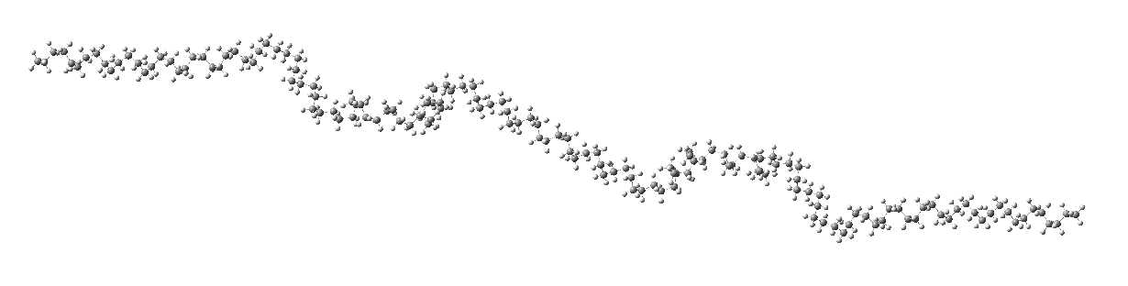
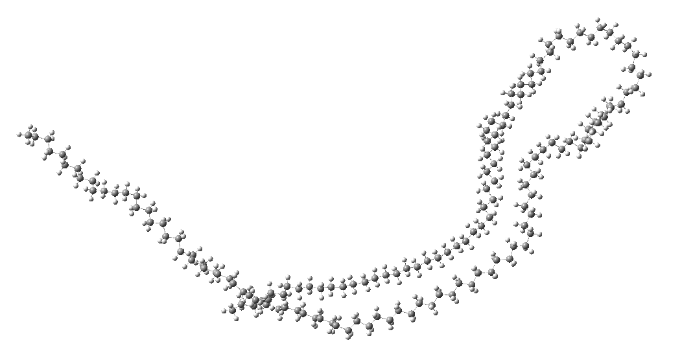
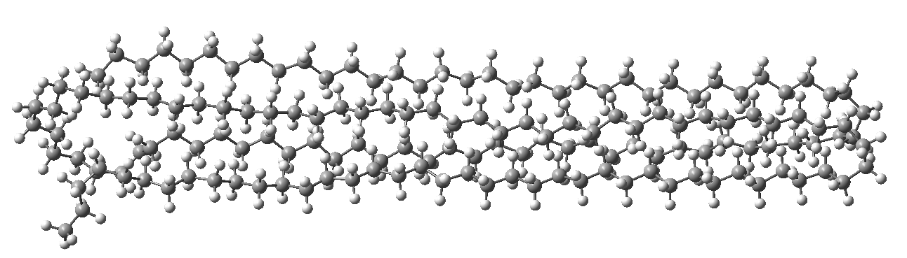

High-throughput simulations
INPUT: molecular dynamics simulations of 4 different polymers (PE, PP, PVC, and PS) in 12 different solvents
OUTPUT: (e.g. PE in anisole (left) and methanol (right))
ΔNCI = 28.74
ΔNCI = -3.67
Notes:
Currently running on the supercomputer hortense are high-throughput MD simulations of 5 different polymers divided over 12 different solvents. Each simulations results in a chart displaying the evolution of the integrated NCI density over the simulations time for the inter (solute-solvent) and intra (solute-solute) molecular interactions, together with the integrated NCI value. The slide shows an example of the simulations of polyethylene in anisole, a good solvent, and methanol, an antisolvent. It can be seen that in anisole, the inter and intramolecular interactions remain constant over the simulation trajectory as the polymer chain remains extended and in full contact with the solvent during the course of the MD simulation. In methanol, on the other hand, over time the intramolecular interactions overcome the intermolecular interactions as the PE chain folds on itself avoiding contact with the solvent molecules as much as possible. This behaviour is reflected in a negative Delta NCI value as defined on the previous slide. The results of these high-troughput simulations will be evaluated against experimental data provided by our project partners from KUL.

Slide 10
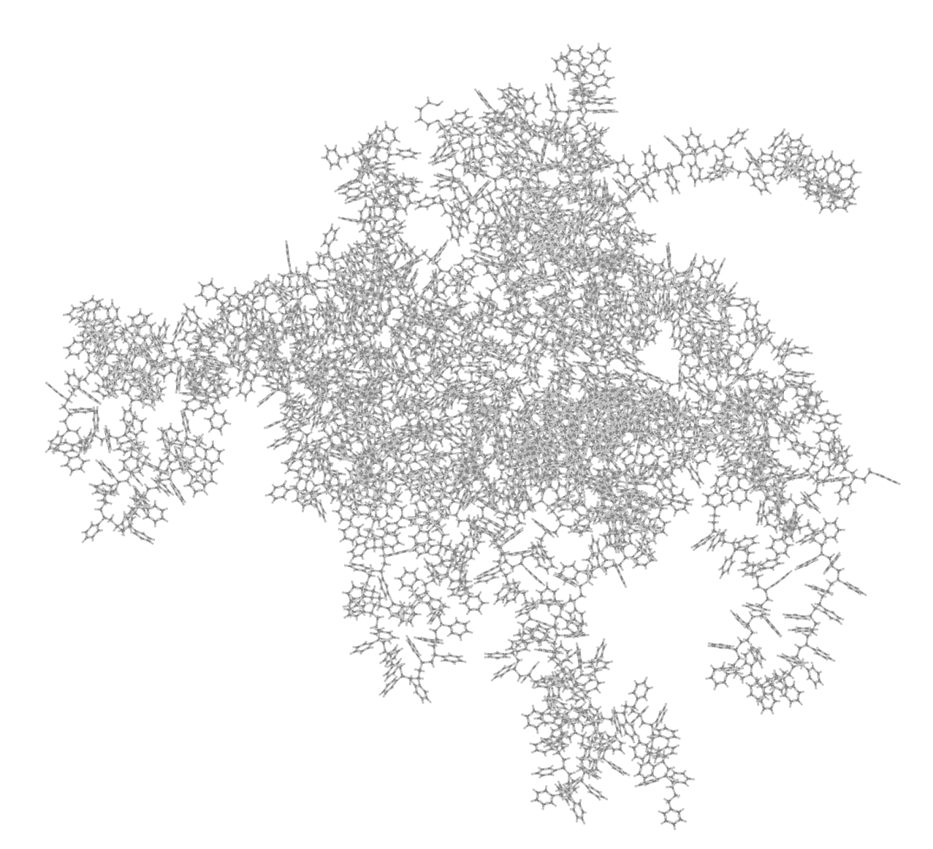
Alternative route: SASA assesment of amorphous polymer bundles
Dissociation propensity: SASA_{eq}/SASA_{max}
 | HDPE | PP | PS | PVC
acetone | 0.21 | 0.75 | 0.75 | 0.90
anisole | 0.30 | 0.85 | running | 0.87
cyclohexanol | 0.57 | 0.53 | running | running
cyclohexanone | running | 0.73 | running | 0.78
cyclopentanone | 0.27 | 0.83 | 0.76 | 0.98
dichloromethane | 0.63 | 0.92 | 1.00 | 0.98
diethylether | 0.27 | 0.86 | 0.68 | 0.59
methanol | 0.18 | 0.23 | 0.47 | 0.34
nitrobenzene | 0.49 | 0.84 | 0.80 | 0.89
pyridine | 0.33 | 0.88 | 0.87 | 0.98
tetrahydrofuran | 0.40 | 0.88 | 0.90 | running
toluene | 0.40 | 0.88 | 0.67 | 0.79
Notes:
As a further validation for our developed protocol based on a single polymer chain, an alternative route to assess polymer solubility is explored whereby a small bundle of entangled polymer chains, representing a fraction of an amorphous polymer phase, is immersed in solvent and the degree of spontaneous dissociation is evaluated. In this context, the dissociation propensity is defined as a measure for solubility, holding the solvent accessible surface area (SASA) at the end of the MD simulation (at equilibrium, averaged over a sufficiently long time-interval) against the theoretically maximal SASA, rendering a value between 0, indicative for an antisolvent (indicated in red), and 1, pointing towards a good solvent for the corresponding polymer (indicated in green). The table shows that we identified methanol as an antisolvent, and dichloromethane as a good solvent for all of the investigated polymers, in line with experimental data. The remaining values are still to be tested against experiment, for which we are currently in conctact with our experimental partners.

Slide 11

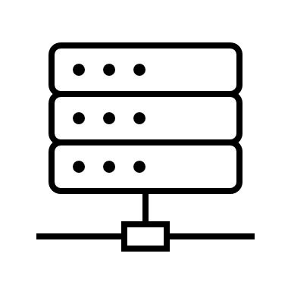
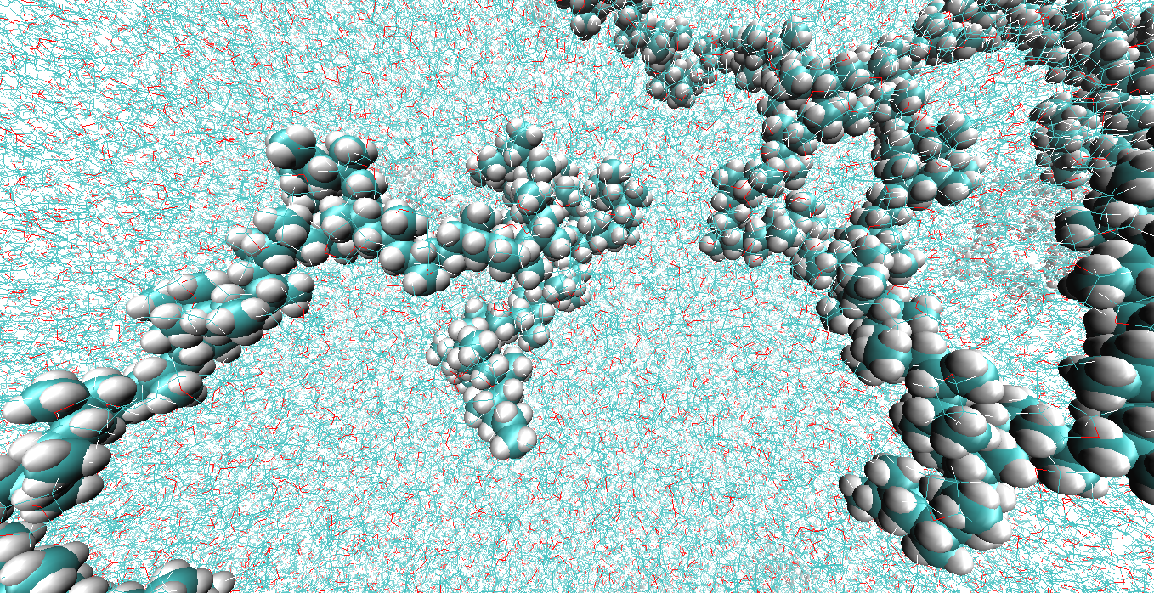
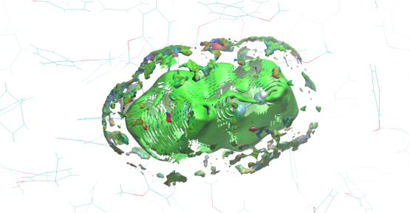
PhD thesis – VSC use
Tier 1 “Hortense”
Tier 2 “Hydra”
Molecular dynamics simulations
GROMACS/2021.3
Single node, 4GPUs
Post-processing
Non-covalent interaction analysis
Single node, 10 cores
Notes:
All molecular dynamics simulations are carried out on the Tier-1 cluster ‘Hortense’, whereas post-processing is conducted using the Tier-2 infrastructure ‘Hydra’. A typical simulation is ran on a single GPU node consisting of 4GPUs. A non-covalent interaction analysis carried out at the tier-2 computer typically uses 10 cores on a single CPU node.

Slide 12
Tier-1 performance
Benchmark system
PVC in methanol
1,280,000 atoms
100,000 steps
Optimal speedup/efficiency trade-off
Single node, 4 GPUs (1 simulation per node)
Speedup = 3.3
Efficiency = 83%
Hydra (tier-2) vs Hortense (tier-1)
Hydra: wall time = 4 weeks
Hortense: wall time = <1 week
Notes:
I will conclude this presentation by showing as to why the use of Hortense is of major importance for my research. Carrying out molecular dynamics simulations of this scale (meaning around several millions of atoms) requires resources that are not available on Tier-2 systems. Without Hortense, the total runtime for this study would be prohibitively large. Using the most optimal resources in terms of efficiency, a single 100ns simulations on the Tier-2 system Hydra would take around 28 days, whereas using Hortense a single simulation takes less than one week. The charts on the slide display the efficiency (black) and speedup (red) w.r.t. the baseline of either 1 core (top) or 1 GPU (bottom). It can be seen that in both case the speedup drastically increased with the number of resources. The efficiency however, is most optimal using GPUs.

Slide 13
Conclusions
Integrated NCI density as quantitative measure for non-covalent interaction strength → insight in strong attractive, van der waals, and strong repulsive interactions
Qualitative agreement between I_{NCI} and known solubility descriptors
Definition of two novel solubility quantities: relative intergrated NCI density and integrated NCI difference
Development of a computational protocol to assess polymer solubulity on a high-troughput scale
Use of Tier-1 infrasctructure essential
Notes:
We considered the integrated NCI density as a quantitative measure for non-covalent interaction strength. This quantity allows for an insightful analysis as it can be broken down into strong attractive, weak van der waals and strong repulsive interactions which can all be visualized and located on the system under investigation. We established a qualitative agreement between I_NCI and known solubility descriptors such as the solvation free energy and the solvent accesible surface area. The advantage of INCI over the latter is that it thus contains the combined information on the energetics as well as the conformation of the system.
We defined two quantities as a measure for solubilty; one being the relative integrated NCI density indicating the degree of polymer chain collapse in a given solvent. This value indicates to which extent the polymer chain folds on itself which typically occurs in an antisolvent environment as the polymer tries to avoid interaction with the solvent molecules. The second quantity is the integrated NCI difference defined as the difference between the non-covalent interaction strength between the solute and the solvent and the non-covalent interaction strength between the solutes atoms themselves. The weaker is the interaction between the polymer and the solvent, and/or the stronger is the interaction between the polymer chain’s atoms themselves, the lower is ΔI_{NCI} – indicating a poor solvent for the given polymer. The integrated NCI difference thus provides an in-depth analysis of all relevant interactions governing the solubility.

Slide 14




Acknowlegdements
Promotors: Frederik Tielens, Jelle Vekeman and Frank De Proft
Research Foundation Flanders (FWO)
Hortense and Hydra support team
Organization of VSC users day

