Slide 1
VSC Users Day
Introduction of VSC Tier-1 Compute Hortense features

Slide 2
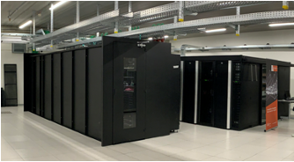



Tier-1 “Supercomputing as a Service”
Tier-1 Compute
Compute Power
Hortense
BrENIAC
Tier-1 Cloud
Tier-1 Data
Flexibility
Storage capacity
Data management

Slide 3


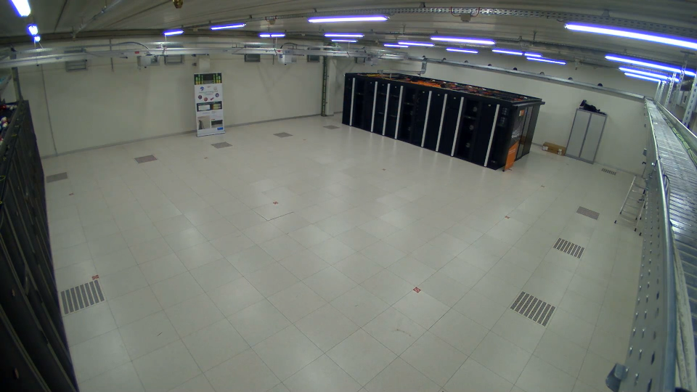
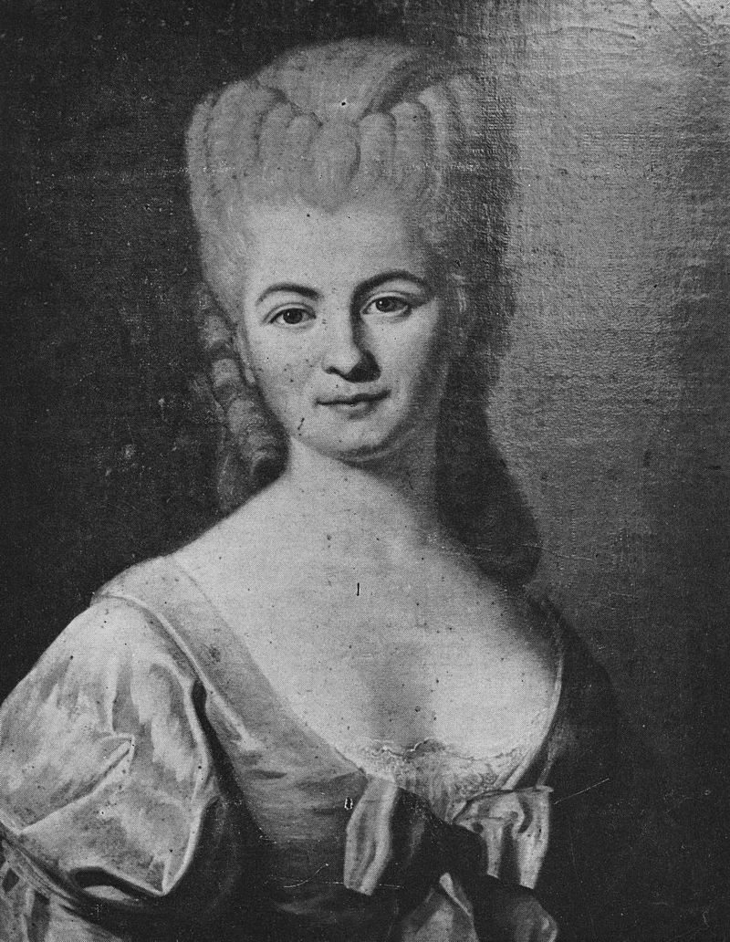
Tier-1 Compute Hortense
Pilot phase: 23 November 2021
Production: 15 March 2022
Nicole Reine Lepaute

Slide 4

Tier-1 Compute Hortense – Getting access
https://www.vscentrum.be/compute
Project access
Starting Grant
Collaborative grant
Industry contract
Exploratory
Project access: 3 cut-off dates / year
3 Oct 2022
Feb 2023
June 2023
Hortense projects up to now:
8 large scale pilot
38 full projects
55 starting grants
27 applicant projects
2 industry contracts
13 exploratory industry
Compute time used on Hortense:
149.907 GPU hours
= +17 years of work on 1 accelerator
56.503.923 CPU hours
= +6.450 years of work on 1 core

Slide 5
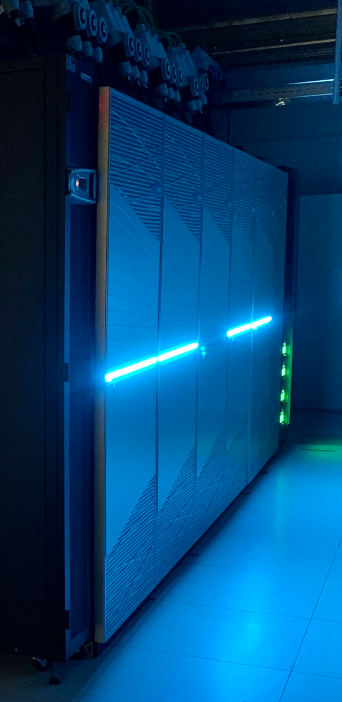



Tier-1 Compute Hortense – Specs
Total: 43.968 CPU cores, 80 GPUs
Partitions cpu_rome / cpu_rome_512
294 / 42 nodes
2x 64-core AMD Epyc 7H12 CPU @ 2.6 GHz
256 / 512 GiB RAM
Partition gpu_rome_a100
20 nodes
2x 24-core AMD Epyc 7402 CPU @ 2.8 GHz
256 GiB RAM
4x NVIDIA A100-SXM4 GPU (40 GB memory)
InfiniBand HDR-100 interconnect (~12.5GB/sec)
3 PB shared storage based on Lustre
Notes:
Calculation of 24hours on all CPUs of Hortense would take an average laptop 30 years

Slide 6
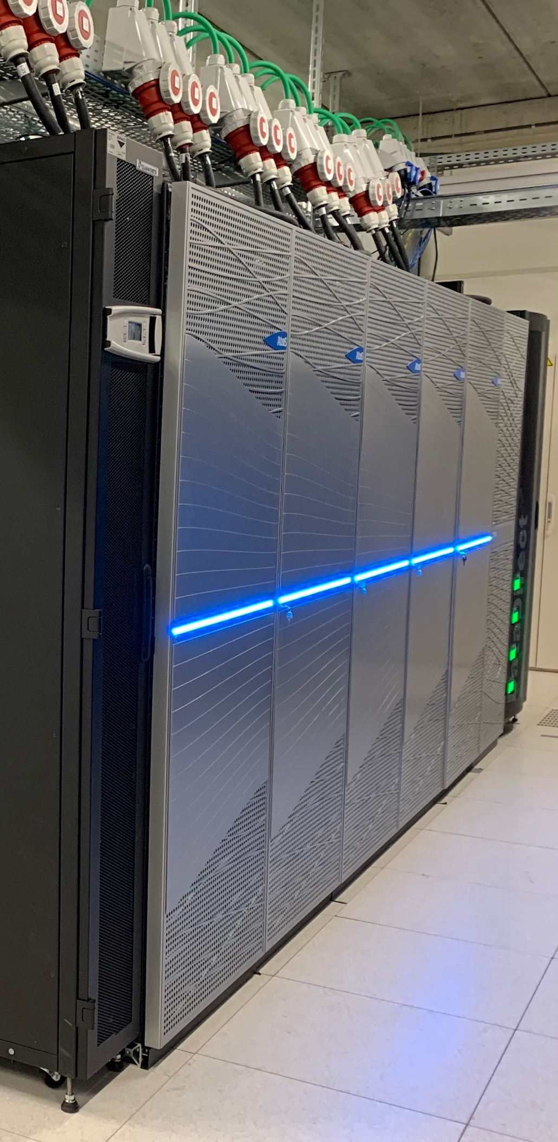




Tier-1 Compute Hortense – Specs
RedHat Enterprise Linux 8.4
Resource manager: Slurm (with Torque frontend)
Webportal based on OpenOnDemand
https://tier1.hpc.ugent.be
Scientific software stack installed and
leveraged by EasyBuild
303 CPU-only unique modules
+878 versions and toolchains
36 GPU-able unique modules, with 54 versions
ResourceApp portal to consult consumed/allocated credits
https://resapp.hpc.ugent.be

Slide 7
Hortense webportal
https://tier1.hpc.ugent.be
Entirely browser-based
  Easy access with account credentials / vsc-id
  Access without ssh-keys possible
File browser
  Drag and drop file transfer
  Small edits possible
  (Globus advisable for larger file transfer)
Terminal in a browser
Interactive GUI applications

Slide 8
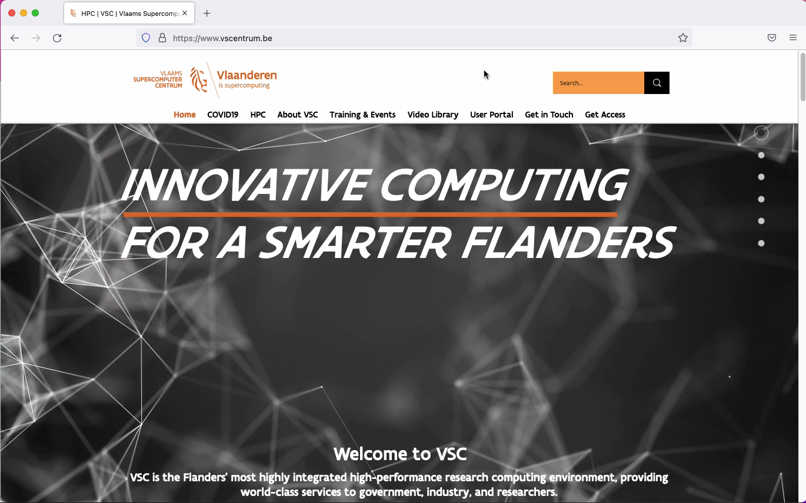
Hortense webportal
Easy browser-based access

Slide 9
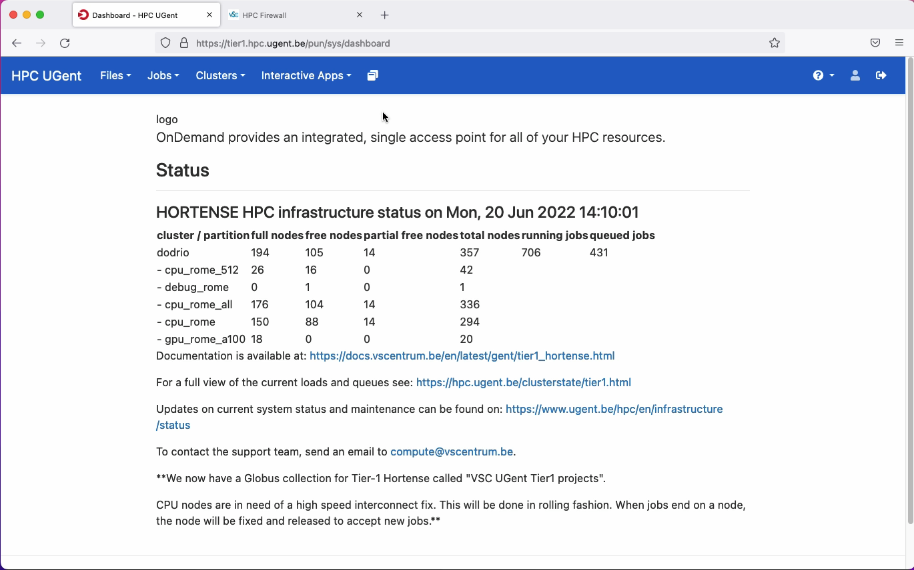
Hortense webportal
File browser

Slide 10
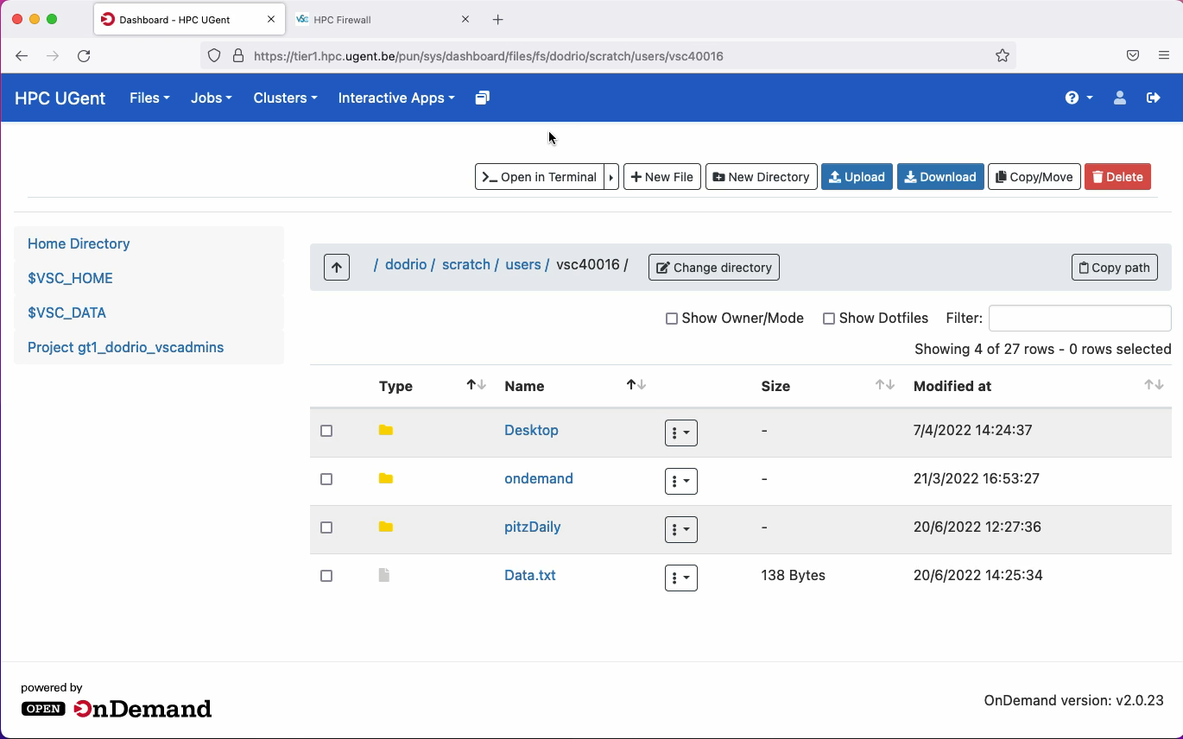
Hortense webportal
Terminal in a browser

Slide 11
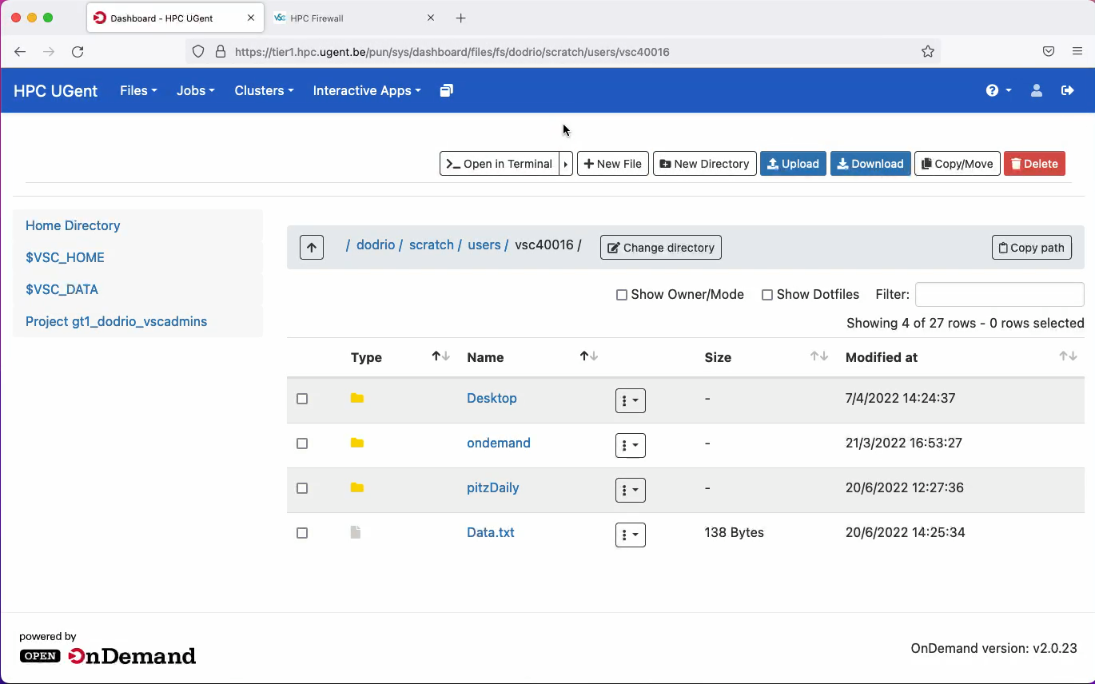
Hortense webportal
Interactive GUI applications

Slide 12
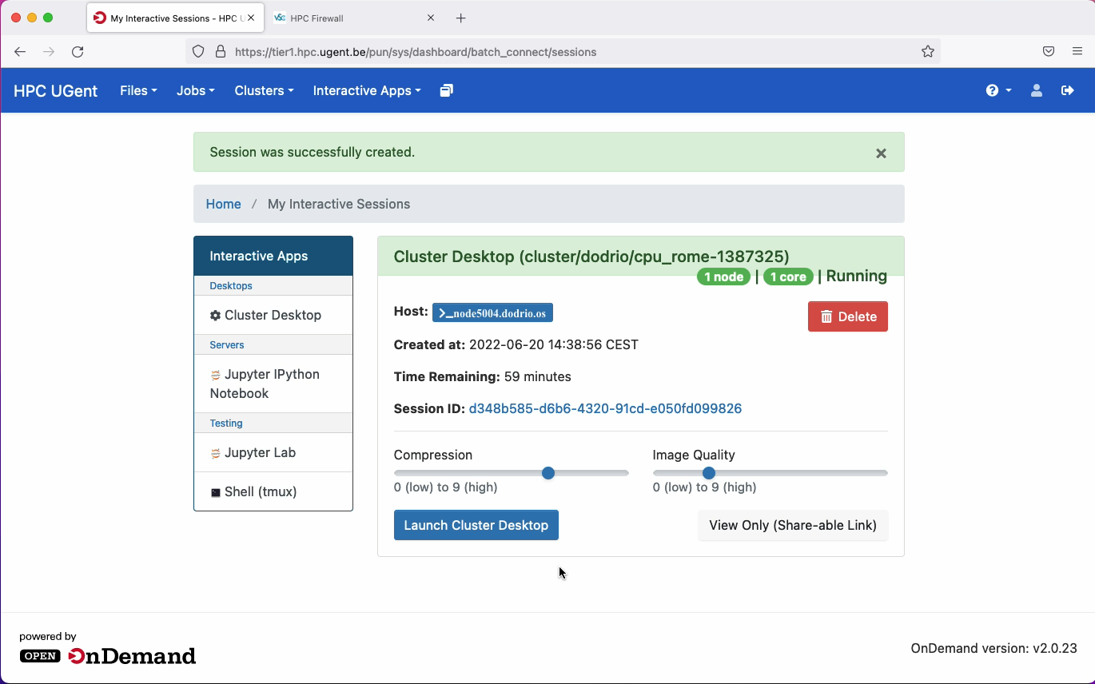
Hortense webportal
Interactive GUI applications

Slide 13
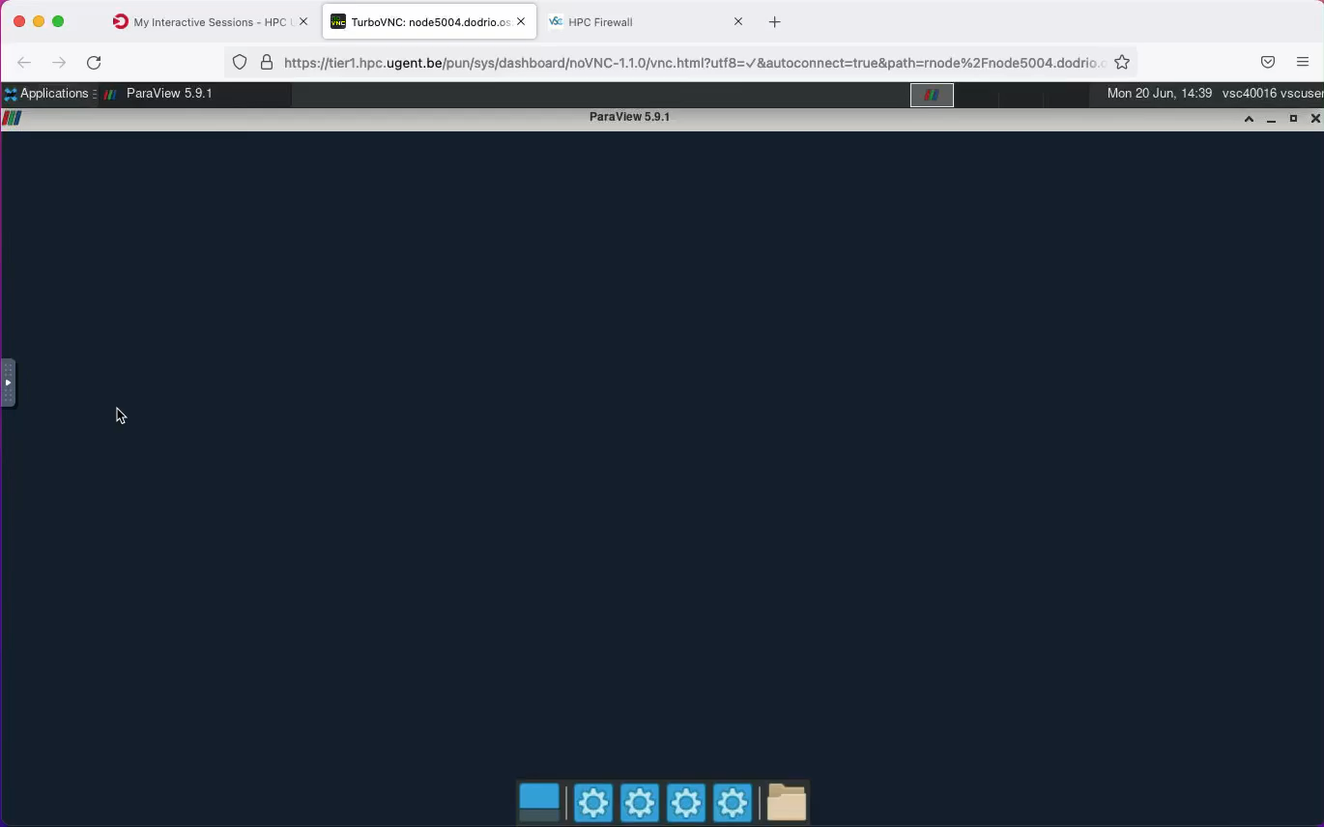
Hortense webportal
Interactive GUI applications

Slide 14
Hortense webportal
https://tier1.hpc.ugent.be
Entirely browser-based
  Easy access with account credentials / vsc-id
  Access without ssh-keys possible
File browser
  Drag and drop file transfer
  Small edits possible
  (Globus advisable for larger file transfer)
Terminal in a browser
Interactive GUI applications
Don’t hesitate to contact compute@vscentrum.be

Slide 15
VSC Users Day
Introduction of VSC Tier-1 Compute Hortense features

