Slide 1
Scientific Programming in The Age of AI Frederik De Ceuster

Slide 2
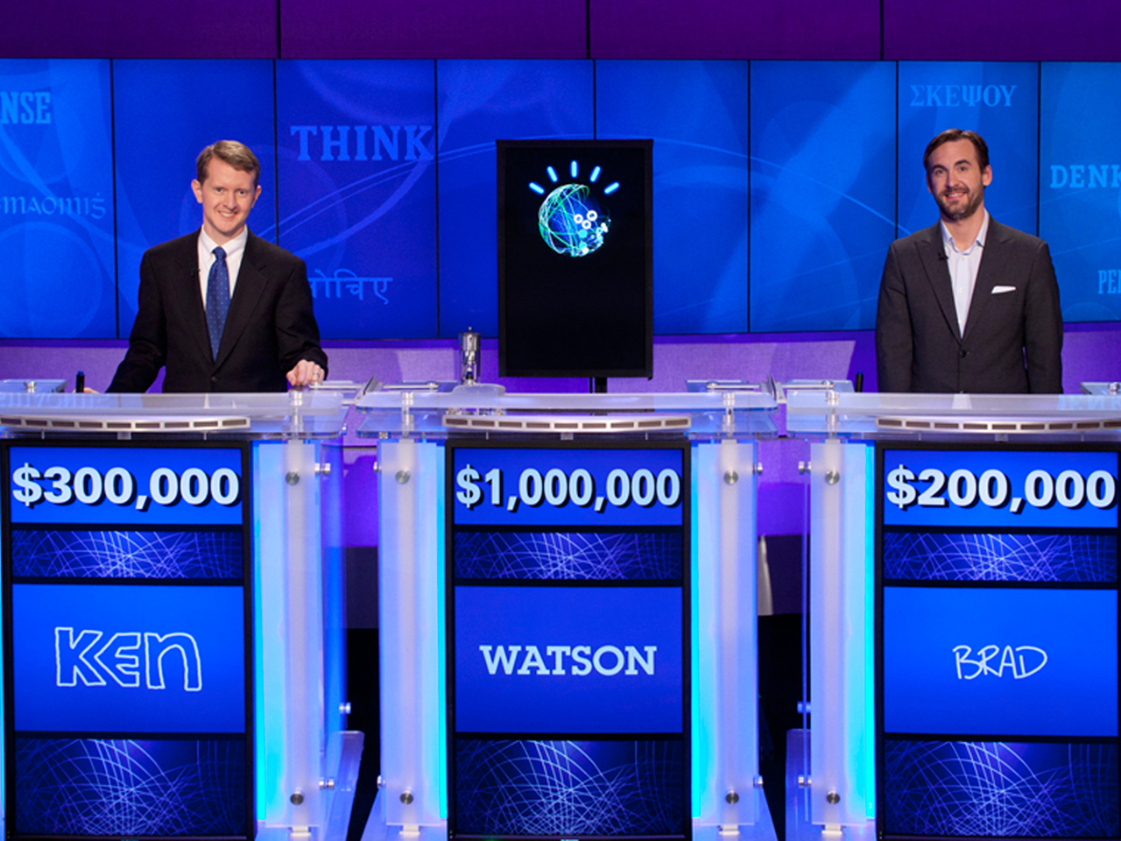
The Age of AI
2011
IBM’s Watson beats humans at Jeopardy!

Slide 3
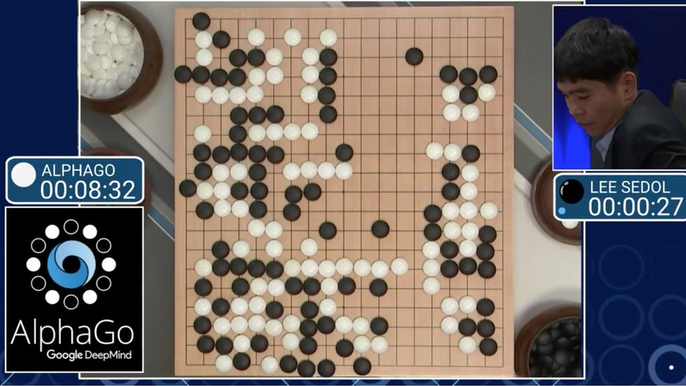
The Age of AI
2016
DeepMind’s AlphaGo beats humans at Go

Slide 4
The Age of AI
2023
OpenAI’s DALL-E2 beats humans at “photography”

Slide 5
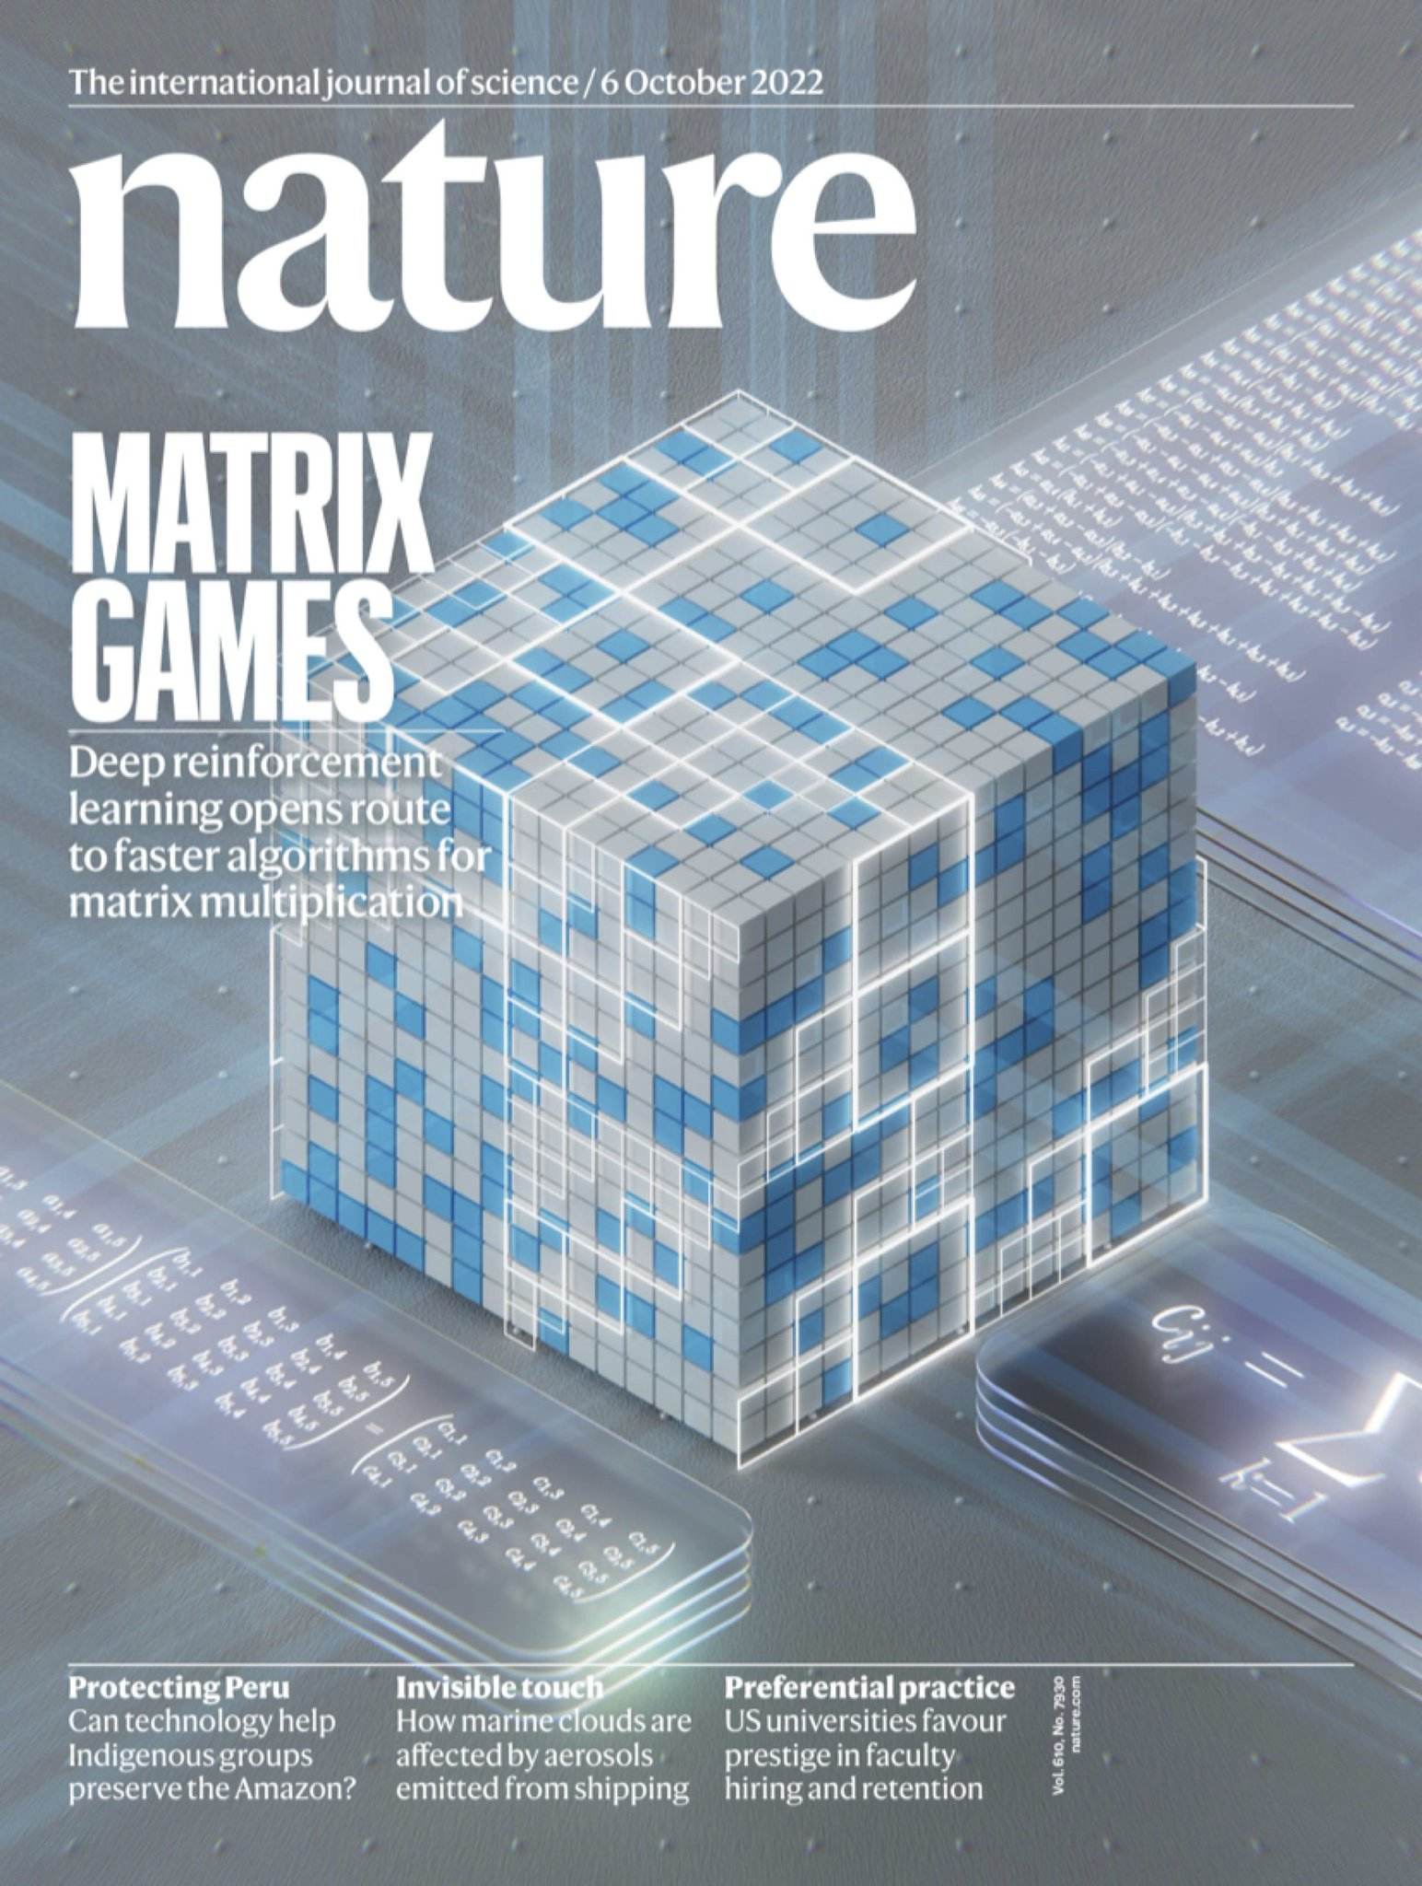
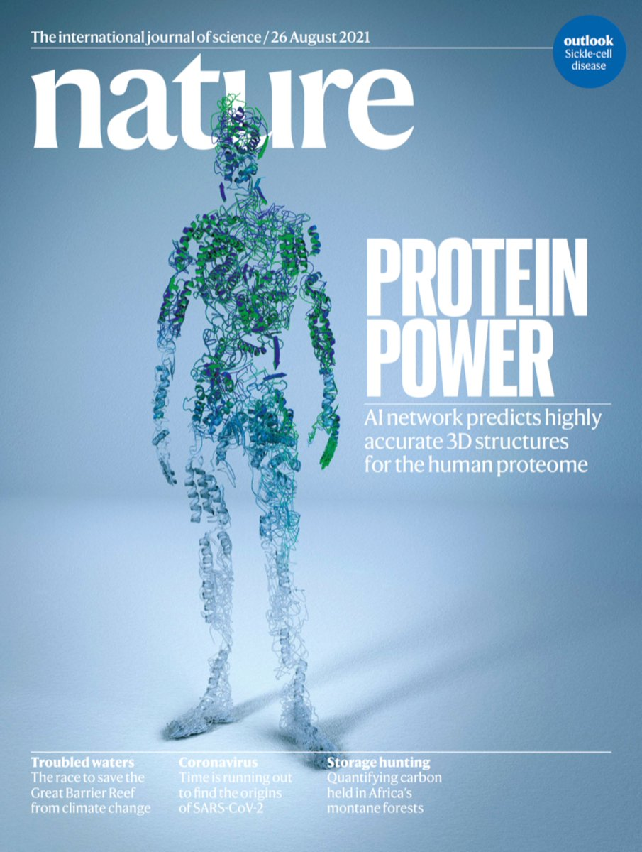
The Age of AI
Many scientific
contributions

Slide 6
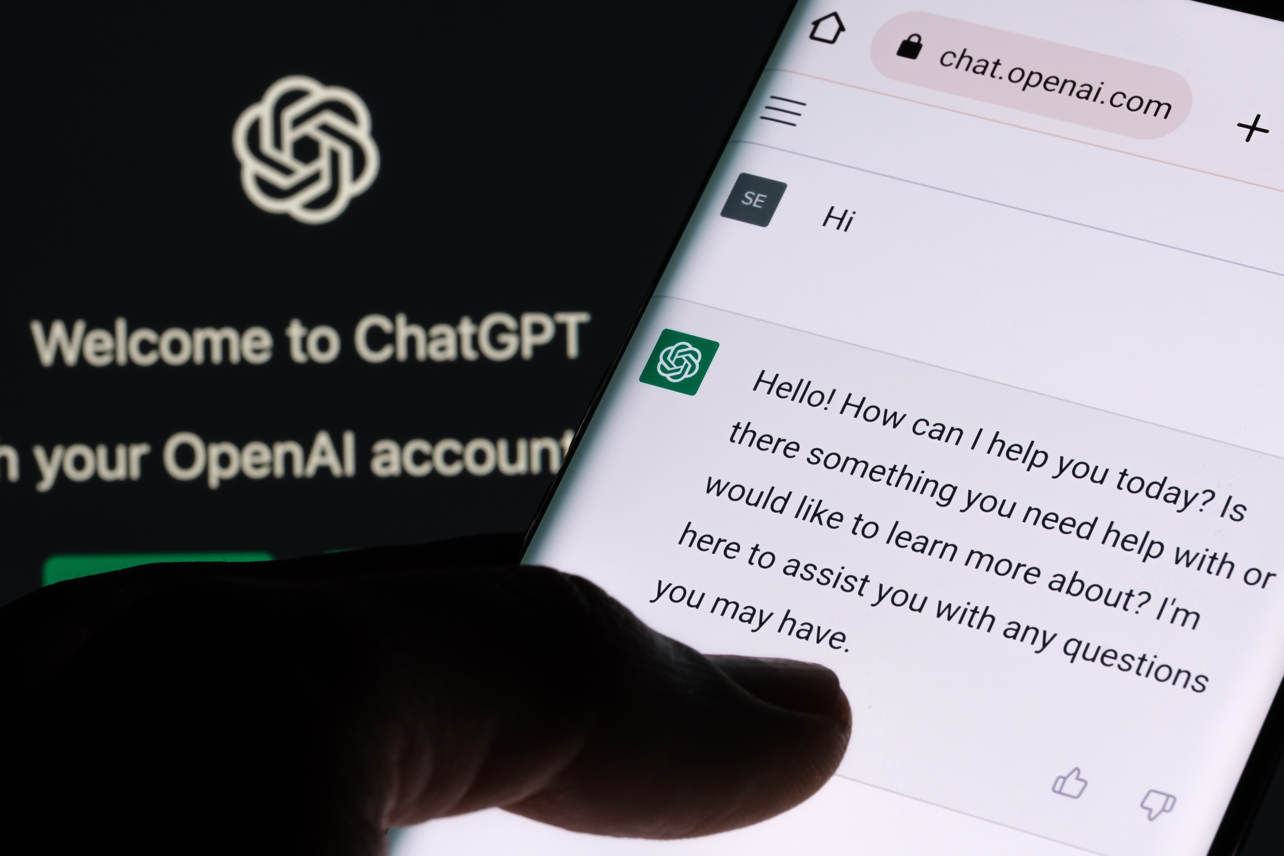
The Age of AI
November 30, 2022
OpenAI launches
ChatGPT
+100 mln users in two months!

Slide 7
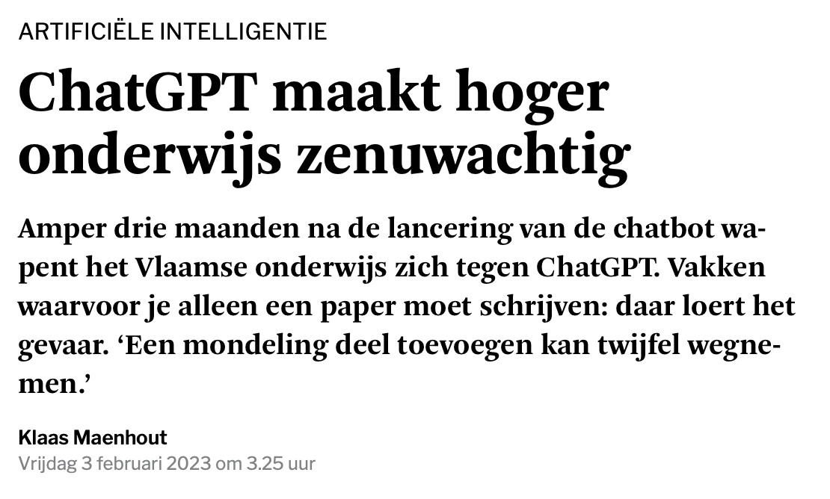
The Age of AI
November 30, 2022
OpenAI launches
ChatGPT
+100 mln users in two months!

Slide 8
Large Language Models (LLMs)
Deep artificial neural networks
trained to repeatedly predict
the next word in a
text sequence
10⁹ to 10¹² free parameters
Trained on “the internet”
Transformer Architecture
This is not a pipe (65%)
This is not a drill (35%)

Slide 9
Large Language Models (LLMs): training data
Opportunity: the internet contains plenty of open-source code!
e.g.
Issues:
Undesirable biasses
Intellectual propery rights
Do make your projects open-source,
but use a proper license!

Slide 10
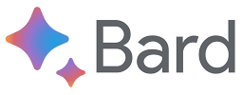
Large Language Models for code
IBM watsonx Code Assistant

Slide 11
The future of AI-assisted software development
Short term (or even today)
Improved developer productivity - AI writes boilerplate code, documentation, tests, …
Democratizing software development
- AI as instructor, providing feedback, explaining code, …
More technology agnostic with AI’s translation capabilities
- Translate legacy code (e.g. COBOL)
- Translate CPU to GPU code

Slide 12
The future of AI-assisted software development
Long term
Another language abstraction? A new type of compiler?
- From natural language specification to code?
From software developer to development manager?

